Slide 1
Triangles of The Neck
Ali Jassim Alhashli
UNIT IV – Problem IV- Anatomy

Slide 2
The Neck
Presents a somewhat quadrilateral
outline.
Boundaries:
Superiorly: lower border of the mandible.
- Inferiorly: by the upper border of the
clavicle.
Medially: midline of the neck.
Posteriorly: by the anterior border of the trapezius muscle.

Slide 3
The anterior and posterior triangles
of the neck

Slide 4
The Anterior Triangle
Boundaries:
Anterior border of SCM muscle.
Midline of the neck.
Inferior border of the mandible (lower jaw).
Apex: jugular notch in the manubrium of sternum.
Roof: skin – superficial fascia and platysma muscle – investing layer of deep cervical fascia.
Floor: Pharynx – larynx and thyroid gland.

Slide 5
The Anterior Triangle
Subdivisions of anterior triangle (four
smaller triangles):
Submental triangle (4)
Submandibular (or digastric) triangle (1)
Carotid Triangle (2)
Muscular triangle (3)

Slide 6
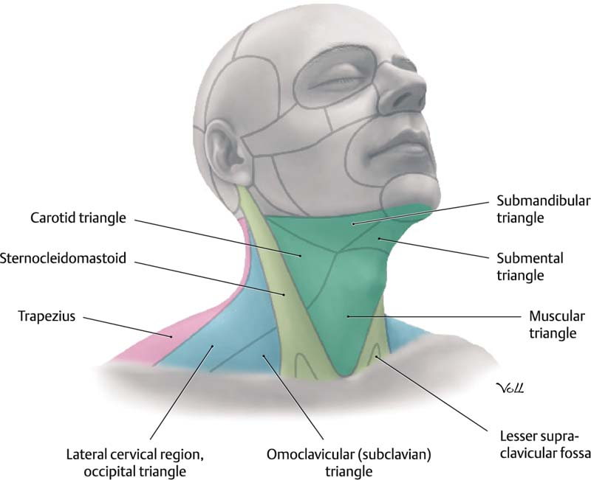
The Anterior Triangle (Green)

Slide 7
The Anterior Triangle
Submental Triangle
1. Boundaries: the apex is toward the jaw symphysis and the base of the triangle is formed by the hyoid. From both sides you find the anterior belly of digastric
Submandibular Triangle
1. Boundaries:
Inferior border of the mandible.
Anterior belly of digastric muscle.
Posterior belly of digastric muscle.
Floor: mylohyoid, hyoglossal & middle pharyngeal constrictor muscles.
2. Contents: submandibular gland (salivary) – submandibular lymph nodes
- fascial artery and vein & submental artery.
muscle. The floor mylohyoid muscles fibrous raphe.
is formed of two
which meet in a
2. Contents:
submental lymph nodes –
anterior jugular vein.

Slide 8
The Anterior Triangle
Carotid Triangle
1. Boundaries:
Superior belly of the
muscle.
Muscular Triangle
Boundaries:
Midline of the neck.
Superior belly of the omohyoid.
Anterior border of SCM.
omohyoid
Anterior border of SCM muscle.
Posterior muscle.
2. Contents:
belly of the digastric
carotid system (common
2. Contents: infrahyoid (omohyoid,
muscles sternohyoid,
sternothyroid, thyrohyoid: depressing hyoid bone and larynx) – Thyroid and parathyroid glands.
carotid, internal carotid & external carotid) – glossopharyngeal nerve – vagus nerve (X) - internal jugular vein.

Slide 9
The Posterior Triangle
Boundaries:
Posterior border of SCM muscle
Anterior muscle.
Middle inferiorly.
border of trapezius
third of clavicle
Apex: occipital bone.
Roof: skin – superficial fascia – platysma muscle – investing layer of the deep cervical fascia.
Floor: splenius captitis – levator
scapulae Posterior scalene
– middle
scalene
(from
scalene –
– Anterior
above
downwards).

Slide 10
The Posterior Triangle
Subdivisions of posterior triangle (two smaller triangles separated by the inferior belly of omohyoid muscle):
Supraclavicular triangle.
Occipital triangle.

Slide 11
The Posterior Triangle
Supraclavicular triangle
1. Boundaries:
Inferior belly of the omohyoid.
The clavicle.
Posterior border of SCM.
Occipital triangle
Boundaries:
Inferior belly of the omohyoid.
Anterior border of trapezius muscle.
Posterior border of SCM.
Contents: spinal accessory nerve (may be damaged while taking lymph node biopsy) – brachial plexus (innervation of upper limbs, might be used for local anesthesia)- occipital lymph nodes.
2. Contents: subclavian artery enter a catheter to the
and right
vein (to atrium
measuring the pressure or injecting fluid) – external jugular vein (in superficial location so may be vulnerable to injury).

