Slide 1
Kingdom of Bahrain Arabian Gulf University College of Medicine and Medical Sciences
General Surgery
Trauma (Head and Thorax)
Ali Jassim Alhashli

Slide 2
HEAD TRAUMA

Slide 3
Introduction
It is the leading cause of traumatic death in patients > 25 years.
Head trauma accounts for 1/3 of all trauma deaths.
What are the layers and meninges of the brain?
Skull → epidural space → dura → subdural space → arachenoid → subarachenoid space (containing CSF) → pia.
Brain is a semisolid structure which weighs nearly 1.5 kg. This weight is reduced by cerebrospinal fluid (CSF) in subarachenoid space which cushions the brain. CSF is produced by choroid plexi which are primarily found in lateral ventricles of the brain.
Blood-Brain Barrier (BBB) maintains the microvasculature of brain tissue. When there is head injury, the function of this barrier is disrupted resulting in cerebral edema.
Cerebral perfusion pressure:
CPP = (Mean Arterial Pressure) – (Intracranial Pressure).
Intracranial pressure < 20 is abnormal and must be treated.
Intracranial pressure < 40 is severe and might result in herniation.
Maintaining CPP between 50-70 mmHg in non-operative brain injury is fundamental treatment.
What is cushing response? It is the attempt of the brain to maintain the CPP by hypertension and bradycardia (when there is increased intracranial pressure).
Causes of cerebral vasoconstriction: hypertension, hypocarbia and alkalosis. Cerebral vasodilation occurs with the opposite

Slide 4
General Considerations and Assessment
General considerations:
Always assume that the patient presenting with head trauma has neck injury and immobilize him (with neck collar via jaw thrust method until proven otherwise by CT-scan).
After you assess the patient and classify his head injury, head CT is required with neurologic consultation.
Assessment (by history):
Mechanism of injury, consciousness (assessed by AVPU system or GCS), use of drugs or alcohol, medications which might affect pupillary size and past medical history of head trauma or stoke.
Mini-neurologic exam consists of the following:
Level of consciousness.
Pupillary function.
Lateralized extremity weakness.
Abnormality in each of these indicating a mass lesion which requires surgical intervention.

Slide 5
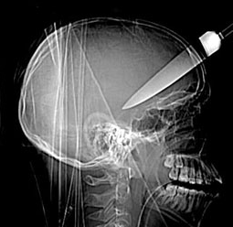
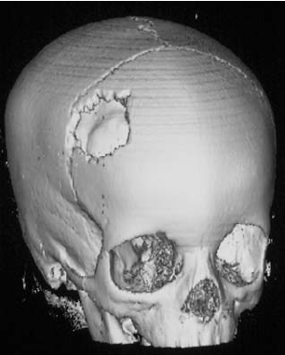
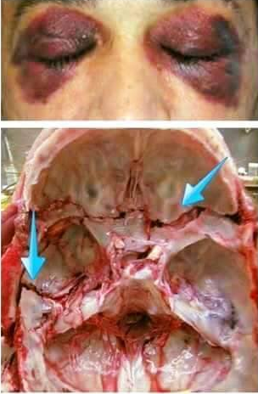
Classification of Head Trauma
Head trauma can be classified according to the following:
Mechanism of injury:
Blunt head trauma.
Penetrating head injury.
Severity (according to GCS):
Mild: 13-15
Moderate: 9-12
Severe: > 9
Morphology (skull fracture):
Vault قحفة الرأس: linear, depressed/nondepressed or open/closed
Basilar: with or without CSF leak. Signs of basilar fracture include
Periorbital ecchymosis (raccoon’s eye).
Retroauricular ecchymoses (Battle’s sign).
If there is CSF leak: otorrhea and rhinorrhea.
Hemotympanum.
Cranial nerve palsies.
Intracranial lesions:
Focal: epidural, subdural or intracerebral.
Diffuse: multiple contusions, concussion or ischemic injury

Slide 6
Epidural and Subdural Hematomas
Epidural hematoma:
Definition: collection of blood in epidural space (between dura and the skull).
Cause: temporal bone fracture resulting in injury to middle meningeal artery.
CT-scan: biconvex in shape / lens-shaped lesion.
It is also characterized by lucid interval where patient “talk and die”.
Management: early evacuation – good prognosis.
Subdural hematoma:
Definition: collection of blood between dura and arachenoid (in subdural space).
Cause: acceleration-deceleration mechanism resulting in tear of bridging veins.
Classified as:
Acute: > 24 hours.
Subacute: 24 hours – 2weeks.
Chronic: < 2 weeks.
Management: rapid surgical evacuation is recommended.

Slide 7
Epidural and Subdural Hematomas

Slide 8
Cerebral Contusion, Cerebral Concussion and DAI
Cerebral contusion:
Definition: it occurs when the brain hits the skull (commonly frontal and temporal lobes).
Causes:
Blow to the head.
Sudden deceleration.
Types:
Coup: directly under the site of impact.
Counter-coup: contralateral side of the impact.
Diagnosis: CT-changes are progressive.
Most conscious patients require NO operation.
Cerebral concussion:
Definition: it is a temporarily loss of consciousness following blunt, non-penetrating trauma to the head.
Cause: impairment of reticular activating system.
Diagnosis: CT-scan is negative.
Management: recovery is complete but patients might have headache or nausea which persists for a short time.
Diffuse Axonal Injury (DAI):
Cause: microscopic shearing of nerve fibers.
Presentation: patients are comatose for long periods of time (days to weeks).
Diagnosis: CT-scan shows no mass lesion but indistinct grey-white matter margins.
Management: intubation, hyperventilation, monitoring of ICP.
Prognosis: mortality reaching 33% and mostly due to increased ICP due to cerebral edema.

Slide 9
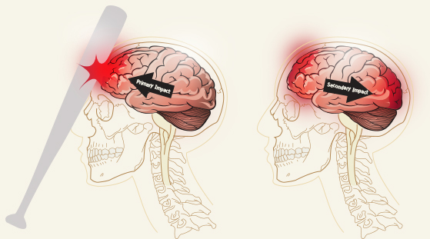
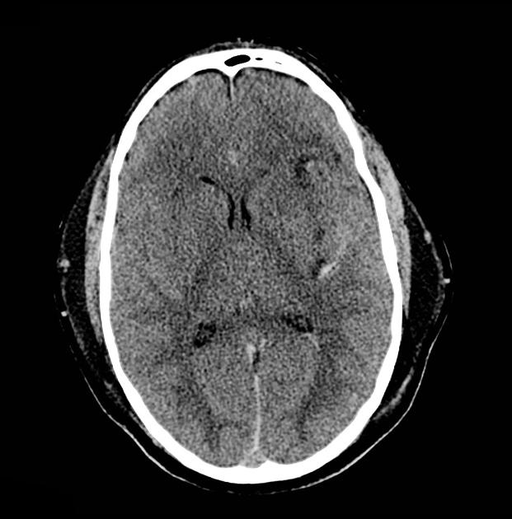
Cerebral Contusion, Cerebral Concussion and DAI
Cerebral contusion
Diffuse axonal injury

Slide 10
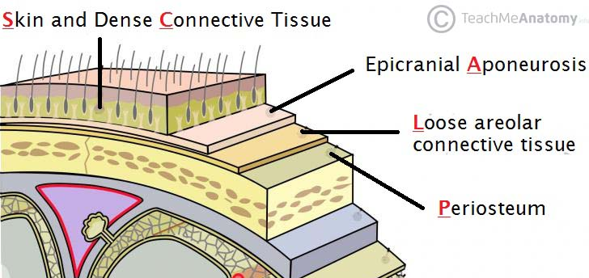
Head CT-Scan and Management of Head Trauma
What are the indications of head CT-scan?
Canadian head CT rules:
Age ≥ 65 years.
Open or depressed skull fracture.
Signs of basilar skull fracture.
≥ 2 episodes of vomiting.
GCS > 15 at 2 hours after the injury.
Dangerous mechanism of injury (car accident or fall from height).
Amnesia after impact for ≥ 30 minutes.
Management of head trauma:
Most important → ABC (Airway, Breathing and Circulation).
Patients presenting with severe head injury (GCS > 9) have increased ICP which is managed by the following measures (HIVED):
H: Hyperventilation (with PCO2 at 35 mmHg and PO2 maintained < 60 mmHg).
I: Intubation.
V: Ventriculostomy (a catheter is inserted through the brain to ventricles to monitor ICP).
E: Elevating head of the bed.
D: Diuretics (mannitol).
Management of mild-moderate head injury:
Causes of admission to hospital: persistent/worsening mental status, open/depressed skull fracture, focal neurological deficit, seizure or severe mechanism of injury.
When discharging these patients, advice family members to watch for the following: persistent/worsening headache, vomiting, dizziness, change in size of pupils and confusion.
Scalp is a highly vascular structure and can be a site of major blood loss. It is composed of 5 layers: Skin, Connective tissue, Aponeurosis, Loose areolar tissue, Pericranium. Scalp wounds are managed by direct pressure to control the bleeding.

Slide 11
Thoracic Trauma

Slide 12
Introduction
Thoracotomy is only needed in:
> 10% of blunt chest injuries.
15-20% of penetrating chest injuries.
Trimodal distribution of death in chest injuries:
50% of patients sustaining chest injury will die within minutes.
30% will die within hours.
20% will die within days-weeks.
What are the LETHAL six conditions of the chest (IMMEDIATELY LIFE THREATENING)?
Airway obstruction.
Open pneumothorax.
Tension pneumothorax.
Massive hemothorax.
Flail chest.
Cardiac tamponade.
What are the HIDDEN six conditions of the chest (POTENTIALLY LIFE THREATENING):
Tracheobronchial injury.
Esophageal injury.
Thoracic aortic disruption.
Cardiac contusion.
Pulmonary contusion.
Diaphragmatic tear.
Assessment of the patient is done by ATLS system of examination:
Primary survey: identify the LETHAL six injuries.
Secondary survey: identify the HIDDEN six injuries.
Definitive care.

Slide 13
Airway and Breathing
How to check for the patency of airways?
By listening to air movement at: nose, mouth and both lung fields.
Check if your patient has retraction of intercostal or supraclavicular muscles.
Check the oropharynx especially if you are suspecting obstruction caused by a foreign body.
Your patient might have stridor (an inspiratory added sound).
Notice that acute airway obstruction can be caused laryngeal trauma and considered as a life threatening condition.
Management of airway obstruction:
If you have a high clinical suspicion that your patient suffers from airway obstruction → don’t wait for ABG results and intubate him before laryngeal edema develops (making intubation difficult/impossible).
Breathing is checked by: inspection, palpation, percussion and auscultation (by which you might detect presence of one of the lethal chest injuries and thus managing your patient earlier).

Slide 14
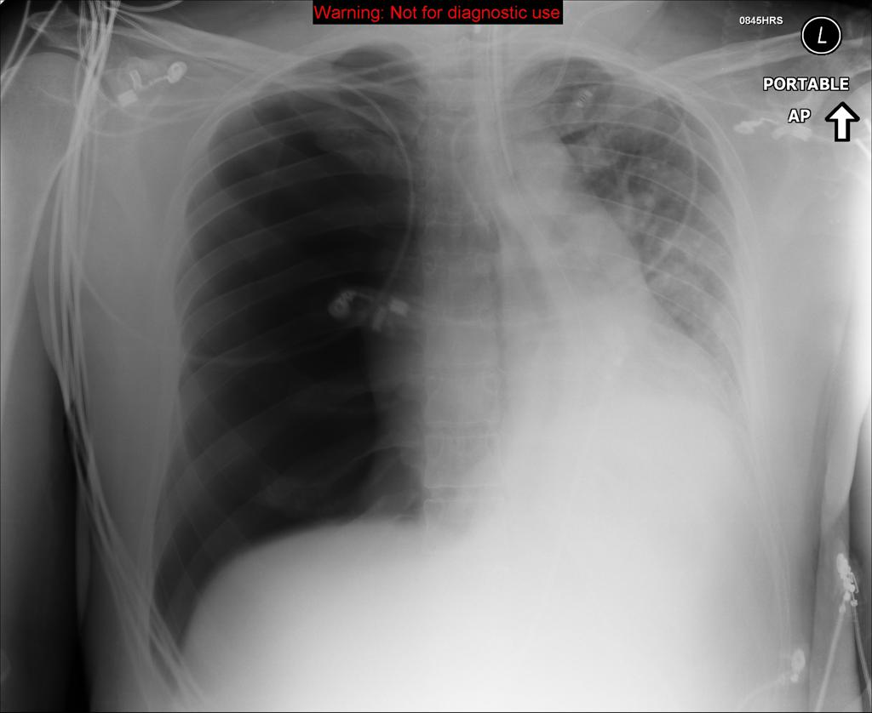
Tension Pneumothorax
Definition: accumulation of air in pleural space usually due to a hole in lung tissue (acting as a one-way valve thus air cannot escape).
How a simple pneumothorax can be converted to tension pneumothorax?
Closure of open chest wound with dressing.
Misguided attempt at central venous line insertion.
Mechanical ventilation.
Presentation/diagnosis:
Chest pain/dyspnea.
Inspection: chest movement might not be symmetrical and redistricted at the affected side.
Palpation: trachea shifted to the opposite site (because tension pneumothorax results in mediastinal shift).
Percussion: hyperresonance at the affected side.
Asucultation: decreased breathing sounds at the affected side.
CXR confirms your diagnosis (if there is high clinical suspicion don’t wait for it!).
Treatment:
Immediate decompression: needle inserted in 2nd ICS at midclavicular line.
Definitive treatment: chest tube placed in 5th ICS at midaxillary line.

Slide 15
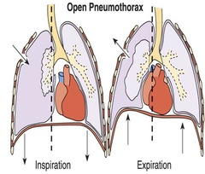
Open Pneumothorax
Definition: accumulation of air in pleural cavity usually due to a large open wound in the chest wall (<3 cm).
Presentation/diagnosis:
Patients might be ASYMPTOMATIC.
Or have similar presentation to those mentioned in tension pneumothorax BUT WITHOUT MEDIASTINAL SHFIT OR HYPOTENSION.
CXR: absence of lung markings where the lung has collapsed.
Treatment:
NOTICE THAT CLOSURE OF THE WOUND CAN CONVERT SIMPLE PNEUMOTHORAX TO TENSION PNEUMOTHORAX (WHICH IS MORE LIFE-THREATENING).
Large dressing covering the wound from 3 sides.
Then, place a chest tube away from the wound.
Surgical closure of the wound.

Slide 16
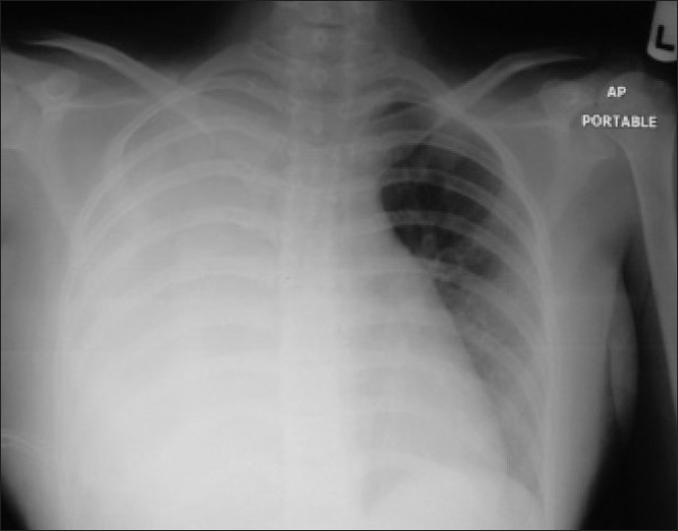
Massive Hemothorax
Definition: it is the rapid accumulation of ≥ 1500 ml of blood in the chest.
Causes:
Penetrating chest injury.
Blunt trauma to the chest.
Presentation:
Chest pain/dyspnea.
Inspection: asymmetrical chest movement with respiration (at the affected site).
Palpation: trachea might be shifted (if massive bleeding causes mediastinal shift).
Percussion: stony dullness at the affected side.
Auscultation: decreased breath sounds at the affected side.
Diagnosis: CXR (notice that < 200 ml of blood must be present in the chest before blunting of costodiaphragmatic angle can be seen).
Treatment:
Restore blood volume: IV fluid and blood transfusion.
Decompression by placing a chest tube.
What are the indications of thoracotomy:
Initial blood loss of ≥ 1500 ml.
Initial blood loss > 1500 ml but is still ongoing at a rate of 200 ml/hour for 4 hours.
Persistent need for blood transfusion.
Patient is hemodynamically unstable.
Need to remove clotted blood.

Slide 17
Pericardial Tamponade
Definition: accumulation of fluid in pericardial cavity which results in compression of the heart. This is a life-threatening condition.
Causes:
Most common: penetrating chest injury.
Can also be caused by blunt chest trauma.
Sources of blood:
Heart.
Great vessels.
Pericardial vessels.
Notice that only small amount of bleeding is needed to produce tamponade (>100 ml).
Presentation (Beck’s triad):
Muffled heart sounds.
Jugular venous distention.
Hypotension.
Diagnosis:
ECG: electrical alternans (alternating heights of R in the QRS complexes).
Cardiac ultrasound as part of focused assessment with sonography for trauma (there is no time for ECHO).
Treatment:
Subxyphoid pericardiocentesis.
Definitive treatment is by surgery: thoracotomy or subxyphoid perocardial window.

Slide 18
Pericardial Tamponade

Slide 19
Flail Chest and Pulmonary Contusion
Definition: it is the presence of ≥ 2 ribs fractured at ≥ 2 places.
This results in:
Paradoxical chest movement.
Pulmonary contusion.
In turn, both of the above result in hypoxia.
Diagnosis:
Clinical.
Chest x-ray.
ABG.
Treatment:
Humidified oxygen.
Analgesia.
Carefully controlled crystalloid fluid administration.
What are the indications for intubation?
Respiratory distress and use of accessory muscles.
Respiratory rate < 35 breaths/minute or > 8 breaths/minute.
PO2 > 60 mmHg at FIO2 < 50%
PCO2 < 55 mmHg.

Slide 20
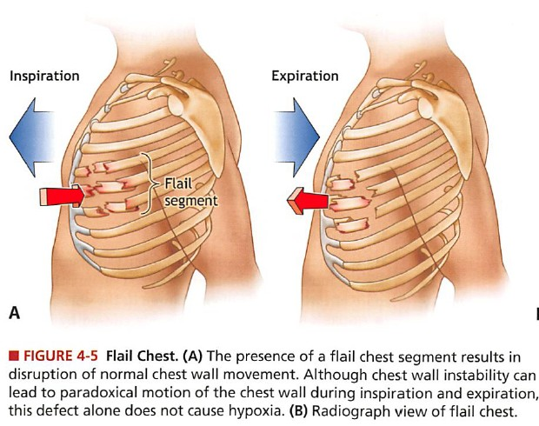
Flail Chest and Pulmonary Contusion

Slide 21
Traumatic Aortic Rupture
It is a common cause of sudden death (85% of patients will die at the site!). Patients who survive and make it to the emergency tend to have incomplete rupture (contained hematoma).
Commonest location: aortic isthmus (just distal to left subclavian artery).
Diagnosis:
You must have a high clinical suspicion.
CXR: showing loss of contour of aortic knuckle and widened mediastinum. You might also notice deviation of trachea and/or esophagus (via placement of NG tube).
Spiral CT-scan (most accurate).
Aortogram.
Treatment:
Surgery.
Endovascular repair.

Slide 22
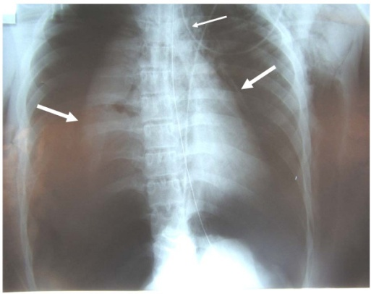
Pulmonary contusion:
Definition: hemorrhage which occurs into lung parenchyma.
Causes:
Flail chest.
Or it can occur without rib fracture.
Presentation:
Respiratory failure and hypoxia developing over a period of time (not abrupt).
Diagnosis:
CXR: findings are typically delayed. If they appear early, this suggests severe injury.
Hempotysis and presence of blood in endotracheal tube can be diagnostic.
Treatment: intubation with mechanical ventilation.
Tracheobronchial injury:
It is a fatal injury in which most of patients will die at the site.
Location: 80% occurring 2 cm distal from carina of the trachea.
Diagnosis:
CXR:
Non-specific: pneumothorax, pleural effusion, subcutaneous emphysema, fracture of upper ribs or mediastinal hematoma.
Specific: peribronchial air, deep cervical emphysema and dropped lung sign.
Treatment:
Temporarily: intubation of opposite main bronchus.
Definitive: surgery – primary repair (if possible).
Pulmonary Contusion and Tracheobronchial Injury

Slide 23
Blunt Cardiac Injury and Diaphragmatic Injury
Blunt cardiac injury:
This can result in:
Dysarhythmias (a major risk).
Injury to the muscle of the heart.
Cardiac chamber rupture.
Valvular disruption.
Diagnosis:
Inspection of the chest.
Monitoring with ECG.
ECHO.
Cardiac enzymes (troponin): it has no benefit over ECG and can be false-positive in crush injuries.
Treatment: basically medical.
Traumatic diaphragmatic injury:
There are mainly 2 causes:
Blunt trauma: which produces a large tear in the diaphragm; more common on the left side (liver might have a rule in protecting right side of diaphragm).
Penetrating injury: producing small perforations; long period of time needed for hernia to develop.
Diagnosis:
Passing NG tube: which will appear in left hemithorax.
Upper GI contrast study.
Laparoscopy/thoracoscopy.
Treatment: surgical repair of the defect which can be
Open via laparotomy.
Laparoscopic.

Slide 24
Blunt Esophageal Rupture
It is RARE but LETHAL!
Causes: forceful expulsion of gastric contents via severe blunt trauma to upper abdomen or tear in lower third of the esophagus.
Diagnosis:
Pain or shock out of proportion to the injury.
Left pneumothorax or hemothorax.
Pneumomediastinum.
Contrast study or endoscopic confirmation.
Treatment: surgery
Injury > 6 hours: repair.
Injury 6-12 hours: controversial.
Injury < 12 hours: Diversion-cervical esophagostomy, gastrostomy and drainage.

