Slide 1
DEMO – I (Shoulder Region)
Ali Jassim Alhashli &
Abdulaziz Almansoor
Year IV – Unit VII – Musculoskeletal System

Slide 2
STATION-1 (Gross Anatomy of Shoulder Region)
Note: origins, insertions, innervation and actions of these muscles will be mentioned in station-2

Slide 3
STATION-1 (Gross Anatomy of Shoulder Region)
Note: origins, insertions, innervation and actions of these muscles will be mentioned in station-2

Slide 4
STATION-1 (Gross Anatomy of Shoulder Region)
Note: origins, insertions, innervation and actions of these muscles will be mentioned in station-2

Slide 5
STATION-1 (Gross Anatomy of Shoulder Region)

Slide 6
STATION-2 (Axioappendicular & Scapulohumeral Muscles)
Axioappendicular muscles are divided to:
Anterior muscles including: pectoralis major, pectoralis minor, subclavius & serratus anterior.
Posterior muscles which are further subdivided to:
Superficial posterior muscles including: trapezius & latissmus dorsi.
Deep posterior muscles including: levator scapulae, rhomboid minor & rhomboid major.
Anterior axioappendicular muscles (general characteristics):
Pectoralis major: fan-shaped, in the superior part of the thorax, with clavicular and sternocostal heads. The pectoralis major & adjacent deltoid form the narrow deltopectoral groove in which the cephalic vein runs.
Pectoralis minor: triangular, lies in the anterior wall of the axilla, almost completely covered by the pectoralis major muscle. With the coracoid process of the scapula, the pectoralis minor forms a bridge under which vessels and nerves pass to the arm.
Subclavius: lies almost horizontally, inferior to the clavicle, affording protection to the subclavian vessels & superior trunk of brachial plexus if the clavicle fractures.
Serratus anterior: in the lateral part of the thorax, forms the medial wall of the axilla, broad sheet of thick muscle.

Slide 7
STATION-2 (Axioappendicular & Scapulohumeral Muscles)

Slide 8
STATION-2 (Axioappendicular & Scapulohumeral Muscles)
Posterior axioappendicular muscles (general characteristics):
Superficial posterior axioappendicular muscles:
Trapezius: large triangular muscle, covers the posterior aspect of the neck and the superior half of the trunk. The fibers of the trapezius are divided into 3 parts that have different actions at the scapulothoracic joint between the scapula and the thoracic wall:
Descending (superior) part: elevates the scapula.
Middle part: retracts the scapula (pulls it posteriorly).
Ascending (inferior) part: depresses the scapula and lower the shoulder.
Latissimus dorsi: large, fan-shaped muscle, covers a wide area of the back and passes from the trunk to the humerus.
Deep posterior axioappendicular muscles:
Levator scapulae: superior third lies deep to the SCM, inferior third is deep to the trapezius. It elevates the scapula.
Rhomboids (minor & major): lie deep to the trapezius, form parallel bands that pass inferolaterally from the vertebrae to the medial border of the scapula. The rhomboids retract the scapula.

Slide 9
STATION-2 (Axioappendicular & Scapulohumeral Muscles)

Slide 10
STATION-2 (Axioappendicular & Scapulohumeral Muscles)

Slide 11
STATION-2 (Axioappendicular & Scapulohumeral Muscles)
Scapulohumeral muscles (general characteristics):
Deltoid: thick, powerful muscle, forming the rounded contour of the shoulder. It is divided into clavicular (anterior), acromial (middle) and spinal (posterior) parts. When all 4 parts contract simultaneously, the arm is abducted. The deltoid acts as a shunt muscle resisting inferior displacement of the head of humerus from the glenoid cavity. Abduction must be initiated y the supraspinatus or by leaning to the side (deltoid becomes fully effective as an abductor after the initial 15 degrees of abduction.
Teres major: thick, rounded muscle, lies on the inferolateral third of the scapula. It adducts and medially rotates the arm.
Rotator cuff muscles (SITS: Supraspinatus, Infraspinatus, Teres minor, Subscapularis): they form a musculotendinous rotator cuff around the glenohumeral joint. All except the supraspinatus are rotators of the humerus. Tonic contraction of these muscles holds the relatively large head of the humerus firmly against the small and shallow glenoid cavity during arm movements.
Notes:
Supraspinatus muscle is responsible for the initial 15 degrees of abduction/
Acromial fibers of deltoid muscle are responsible for abduction from 15-90 degrees.
Trapezius and serratus anterior are responsible for abduction from 90-180 degrees .
The clavicular fibers of deltoid muscle are for flexion, acromial fibers for abduction and spinal fibers for extension.
Deltoid muscle is innervated by axillary nerve (C5). Damage occurs to this nerve when there is a fracture in the surgical neck of the humerus (below the greater and lesser tubercles). With nerve damage, deltoid muscle will lose its contour and sensation will also be lost in that area.
Supraspinatus syndrome (also known as: swimmer’s shoulder or thrower’s shoulder): occurs when the tendons of rotator cuff muscles become irritated and inflamed as they pass through the subacromial space. This can result in pain, weakness and loss of movement at the shoulder.

Slide 12
STATION-2 (Axioappendicular & Scapulohumeral Muscles)

Slide 13
STATION-3 (Surface Anatomy + Joints & Ligaments)

Slide 14
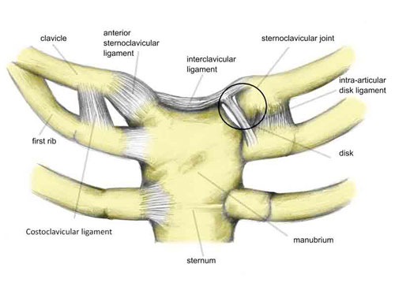
STATION-3 (Surface Anatomy + Joints & Ligaments)
Joints and their ligaments:
Sternoclavicular joint:
Synovial articulation between the sternal end of the clavicle and the manubrium of the sternum.
It is a saddle type joint but functions as a ball-and-socket.
This joint is divided into 2 compartments by an articular disc which is firmly attached to: anterior and posterior sternoclavicular ligaments as well as the interclavicular ligament (extending from the sternal end of one clavicle to the sternal end of the other clavicle and attaching also to the superior border of manubrium).
A joint capsule surround the joint. This capsule has a fibrous layer which is lined internally by a synovial membrane (with synovial fluid: reducing friction).
The costoclavicular ligament anchors the inferior surface of the sternal end of the clavicle to the first rib and its costal cartilage, limiting elevation of the pectoral gridle.

Slide 15
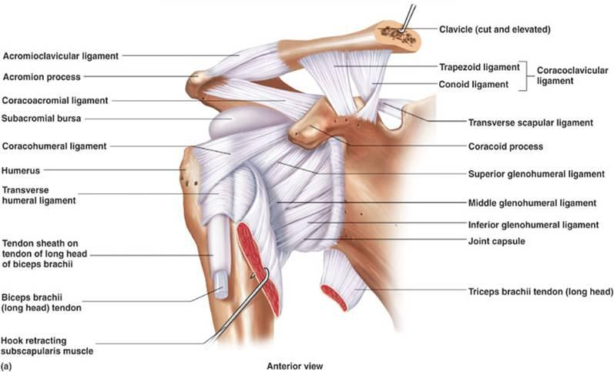
STATION-3 (Surface Anatomy + Joints & Ligaments)
Joints and their ligaments:
Acromioclavicular joint:
Synovial articulation between the acromial end of the clavicle and the acromion of the scapula.
It is separated by incomplete wedge-shaped articular disc.
There is a fibrous layer of the joint capsule which is attached to the margins of the articular surfaces. This fibrous layer is lined internally by a synovial membrane.
Acromioclavicular ligament is a fibrous band extending from the acromion to the clavicle, strengthens the acromioclavicular joint superiorly.
Coracoclavicular ligament is subdivided into: conoid and trapezoid ligaments.

Slide 16
STATION-3 (Surface Anatomy + Joints & Ligaments)
Joints and their ligaments:
Glenohumeral joint:
It is a synovial joint, ball-and-socket type, permitting a wide range of movement (mobility makes the joint relatively unstable).
The large spherical humeral head articulates with the relatively small and shallow glenoid cavity of the scapula. Both articular surfaces are covered with hyaline cartilage.
The inferior part of the joint capsule, the only part not reinforced by the rotator cuff muscles, is its weakest area.
Coracohumeral ligament is a strong band passing from the base of coracoid process to the anterior aspect of the greater tubercle.
Transverse humeral ligament runs from the greater to the lesser tubercle, bridging over the intertubercular sulcus converting the groove into a canal for the tendon of the long head of biceps brachii.
Coracoacromial ligament is between the coracoid process of the scapula and the acromion.
Movement of glenohumeral joint: flexion-extension, abduction-adduction, rotation and circumduction.
Subacromial bursa (subdeltoid bursa): is located between the acromion, coracoacromial ligament and deltoid superiorly; and supraspinatus tendon and joint capsule of glenohumeral joint inferiorly.

Slide 17
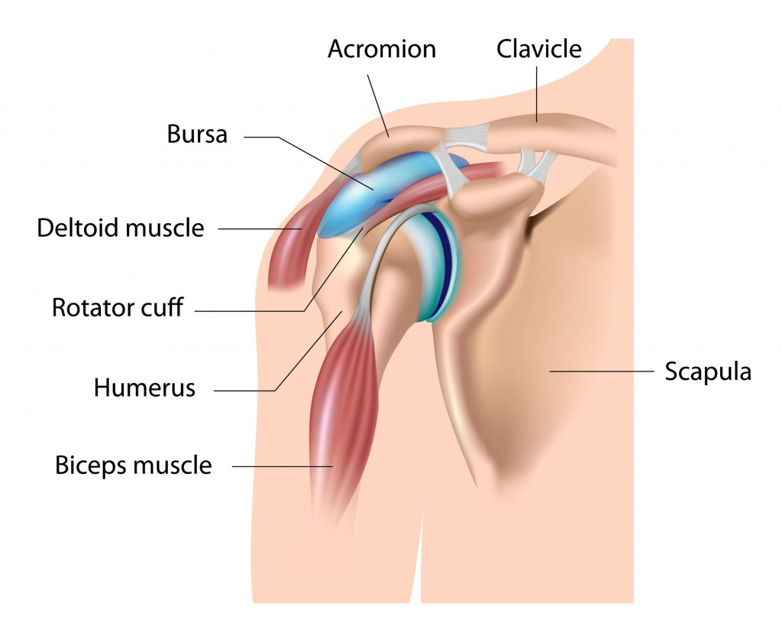
STATION-3 (Surface Anatomy + Joints & Ligaments)

Slide 18
STATION-3 (Surface Anatomy + Joints & Ligaments) Movements of Glenohumeral Joint

Slide 19
STATION-3 (Surface Anatomy + Joints & Ligaments)

Slide 20
STATION-3 (Surface Anatomy + Joints & Ligaments) Clinical Correlations
Fracture of the clavicle:
Cause:
Indirect force: transmitted from an outstretched hand through the bones of the forearm and arm to the shoulder during a fall.
Direct force: a fall directly on the shoulder.
Where does it occur?
The weakest part of the clavicle at the junction of its middle and lateral thirds.
What will happen after the fracture?
SCM muscle will elevate the medial fragment of the clavicle.
The shoulder drops.
Lateral fragment of the clavicle may be pulled medially by pectoralis major.
Fractures of humerus:
Nerves may be injured when the associated part of the humerus is fractured:
Surgical neck → axillary nerve
Transverse fracture of the shaft of humerus → radial nerve
Medial epicondyle → ulnar nerve

Slide 21
STATION-4 (Bones + Radiology)
Clavicle:
Connects the upper limb to the trunk.
Sternal end articulated with manubrium of sternum at the sternoclavicular joint.
Acromial end articulated with acromion at the acromioclavicular joint.
Medial two thirds are convex while the lateral third is flattened and concave.
Although designated as a long bone, the clavicle has no medullary (marrow) cavity. It consists of spongy (trabecular) bone with a shell of compact bone.

Slide 22
STATION-4 (Bones + Radiology)
Scapula:
Triangular flat bone which lies on the posterolateral aspect of the thorax and extending from 2nd-7th ribs.
Convex posterior surface divided by spine of the scapula into a small supraspinatous fossa & a larger infraspinatous fossa.
Concave costal surface which has a large subscapular fossa.
3 borders: medial, lateral and superior borders.
2 angles: superior and inferior.
Spine of scapula continues laterally as the flat expanded acromion.
Glenoid cavity articulates with the head of the humerus at the glenohumeral joint. The glenoid cavity is a shallow, concave, oval fossa, considerably smaller than the head of the humerus.
The beak-like coracoid process is superior to the glenoid cavity and projects anterolaterally.

Slide 23
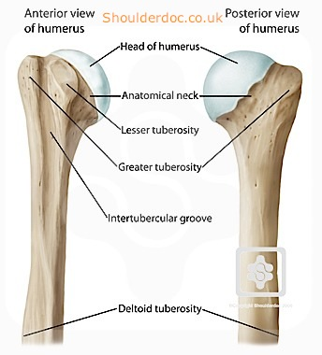
STATION-4 (Bones + Radiology)
Head of the humerus:
The largest bone in the upper limb.
Articulated with the scapula at the glenohumeral joint and with the radius & ulna at the elbow joint.
The ball-shaped head of the humerus articulates with the glenoid cavity of the scapula.
The intertubercular sulcus separates lesser tubercle from greater tubercle.
Distal to the humeral head, the anatomical neck of the humerus separates the head from the tubercles.
Distal to the tubercles is the narrow surgical neck of the humerus.

Slide 24
STATION-4 (Bones + Radiology)

Slide 25
GOOD LUCK!

