Slide 1
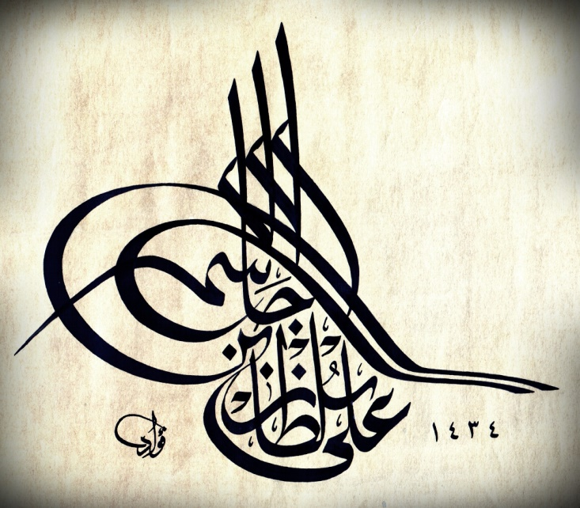
DEMO – VII (Back and Skin)
Ali Jassim Alhashli
Year IV – Unit VII – Musculoskeletal System

Slide 2
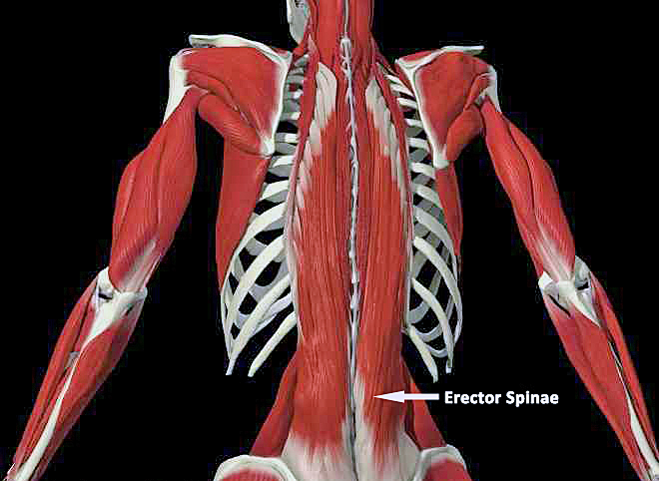
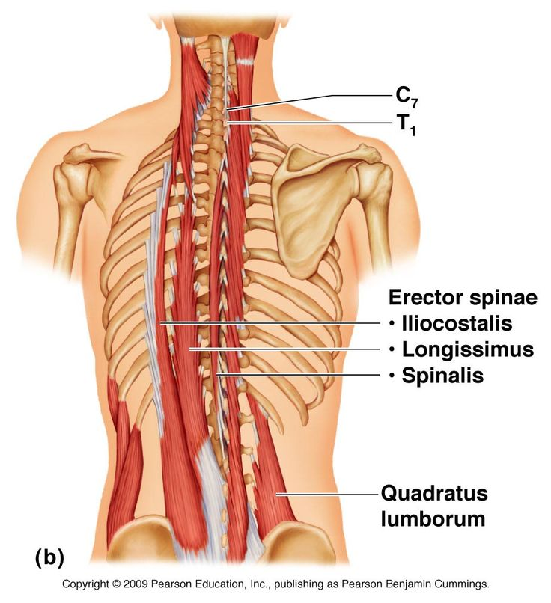
STATION-1 (Gross Anatomy)
The lumbar region has a groove/depression in which the spinous processes of the lumbar vertebrae can be felt.
There are 2 bulges felt on both sides of the groove → these are known as erector spinae muscles.

Slide 3
STATION-1 (Gross Anatomy)
There are 4 curvatures of vertebral column:
Cervical
Thoracic
Lumbar
Sacral
Function: provide a flexible support (shock-absorbing resilience) for the body.
Thoracic and sacral curvatures: primary curvatures which are concave anteriorly (kyphosis).
Cervical and lumbar curvatures: secondary curvatures which are convex anteriorly (lordosis).
Cervical curvature becomes prominent: when an infant begins to hold his/her head erect.
Lumbar curvature becomes apparent: when an infant begins to walk and assumes the upright posture.
The sacral curvature of females is reduced so that the coccyx protrudes less into the pelvic outlet (birth canal).

Slide 4
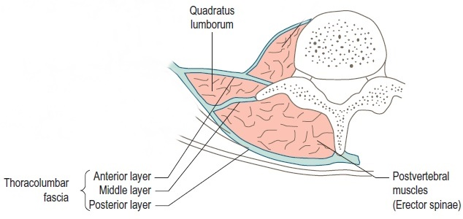
STATION-1 (Gross Anatomy)
Thoracolumbar fascia and arrangement of muscles
Lumbar vertebra
Spinal nerve roots in the vertebral canal

Slide 5
STATION-1 (Gross Anatomy)
Abnormal Curvatures of Vertebral Column
They result from:
Developmental anomalies.
Pathological processes (such as osteoporosis: vertebral body osteoporosis is more common in thoracic vertebrae).
Excessive thoracic kyphosis: abnormal increase in the thoracic curvature. There will be overall loss of height. Note that kyphosis occurs in geriatric people of both sexes (normally).
Excessive lumbar lordosis: abnormal increase in the lumbar curvature. Note that women develop a temporary lordosis during late pregnancy.
Scoliosis (curved back): abnormal lateral curvature (S-shaped). Most common deformity of the vertebral column in pubertal girls (aged 12-15 years).

Slide 6
STATION-1 (Gross Anatomy) Protrusion of Nucleus Pulposus
Herniation or protrusion of the gleatinous nucleus pulposus into or through the anulus fibrosus is a well-recognized cause of low-back and lower limb pain.
If degeneration of the posterior longitudinal ligament and wearing of the anulus fibrosus has occurred, the nucleus pulposus may herniate into the vertebral canal and compress the spinal cord or nerve roots of spinal nerves in the cauda equina.
Herniations usually occur posterolaterally, where the anulus is relatively thin and does not receive support from the posterior or anterior longitudinal ligaments.
Posterolateral herniation is most common in the lumbar region at the L4-L5 or L5-S1 levels.
Compression will result in tingling and numbness but not pain!! Pain is produced by stretching the nerve which in turn will stretch the dura covering the spinal cord leading to inflammation of the dura → and this will eventually lead to pain.

Slide 7
STATION-2 (Lumbar Puncture)
There are certain spinous processes which can be felt and considered as surface landmarks.
The spinous process is formed by the union of the 2 laminae posteriorly.
The superior and inferior articular facets will form synovial joints. A synovial joint has 4 characteristics:
Fibrous capsule.
Synovial membrane.
Synovial fluid.
Hyaline cartilage.
The spinous process of C7 vertebra is very prominent and can be felt easily. Inferior to it is the spinous process of T1 vertebra.
In the lumbar region: there is a transverse line joining the iliac crests know as (supracrestal line) and it is passing at the level of IV disc between L4-L5.
The spinous processes of thoracic vertebrae are very long and end at the level of the vertebra below (directed postero-inferiorly).
The spinous processes of lumbar vertebrae are short and end at the level of the same vertebral body they originate from.
How to differentiate between T12 and L1 where the spinous processes are nearly similar to each other?
In T12 vertebral body, you will find facets for articulation with the rib.

Slide 8
STATION-2 (Lumbar Puncture)
A cervical vertebra can be differentiated by the presence of foramen trasversarium in the transverse process. Structures which are passing in this foramen are:
Vertebral arteries which will unite to form basalar arteries.
Vertebral veins.
The spinal cord ends:
Adults: at the level of L1-L2
Children: at the level of L3-L4
Lumbar puncture is done at the level of L3-L4 or L4-L5 (must be done at this level for children).
The structures which will be passed by the needle during lumbar puncture are:
Skin and subcutaneous tissue.
Supraspinous ligament.
Interspinous ligament.
Ligamentum flavum.
Posterior epidural space.
Dura.
Subarachnoid space.
Production of cerebrospinal fluid: ependymal cells of the choroid plexus produce more than two-thirds of CSF. The remainder of the CSF is produced by the surfaces of the ventricles and by the lining surrounding the subarachenoid space.
Reabsorption of CSF: via arachnoid granulations.

Slide 9
STATION-3 (General Review + Radiology)
Joints of vertebral bodies:
Symphyses (secondary cartilaginous joints) designed for weight-bearing and strength.
The articulating surfaces of adjacent vertebrae are connected by IV discs and ligaments.
The IV discs provide strong attachments between the vertebral bodies permitting movment between adjacent vertebrae.
Each IV disc consists of:
Annulus fibrosus (outer fibrous part): ring, concentric lamellae of fibrocartilage which insert into the smooth rounded epiphyseal rim of vertebral bodies.
Nucleus pulposus (gelatinous central mass):
Central core, becomes broader when compressed and thinner when stretched.
With age, the nuclei pulposi dehydrate and lose elastic and proteoglycans while gaining collagen, eventually becoming dry, granular and more resistant to deformation.
Because the lamellae are thinner and less numerous posteriorly than they are anteriorly or laterally, the nucleus pulposus is not centered in the disc but is more posteriorly placed.
Note that the nucleus pulposus is avascular.
There is no IV disc between C1 (atlas) and C2 (axis) vertebrae.
The most inferior functional disc is between L5 and S1 vertebrae.
Thicker in cervical and lumbar regions and thinner in the superior thoracic region.

Slide 10
STATION-3 (General Review + Radiology)

Slide 11
STATION-3 (General Review + Radiology)
Joints of vertebral arches:
Zygapophyseal joints (facet joints):
Synovial.
Plane type.
Between the superior and the inferior articular processes of adjacent vertebrae.
Covered with joint (articular) capsule.
Permit gliding movements between the articular processes.
Regional differences of vertebrae:
Cervical vertebrae:
Small bodies.
Bifid spinous processes (the spinous process of C7 is very long).
Presense of foramina transversaria
Thoracic vertebrae:
Large bodies.
Long spinous processes directed postero-inferiorly.
Presence of facets on vertebral bodies for articulation with head of ribs.
Lumbar vertebra:
Massive bodies.
Short spinous processes.
The intervertebral foramen is formed by: superior and inferior vertebral notches (it is the place where nerve roots are going to pass).

Slide 12
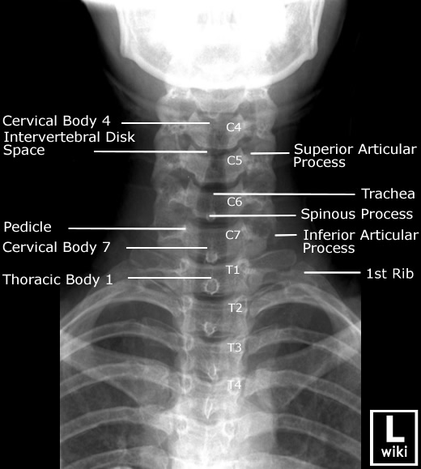
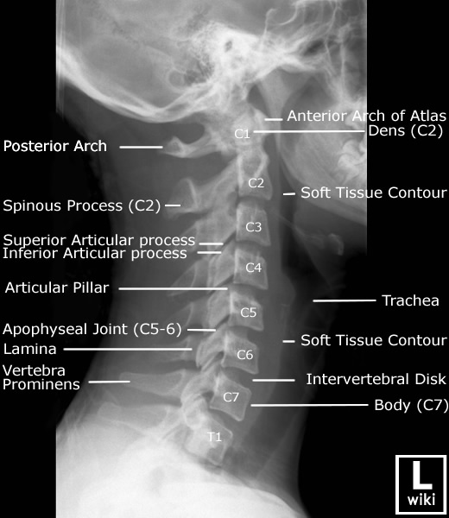
STATION-3 (General Review + Radiology)
Atypical vertebrae:
C1:
It has no body (but instead it has anterior and posterior arches).
Its superior articular facets articulate with occipital condyles to form atlanto-occipital joint (synovial joint of condyloid type allowing mainly flexion-extension).
C2:
It has a projection called dense which will form atlanto-axial joint (synovial joint of pivot type allowing rotation movement).

Slide 13
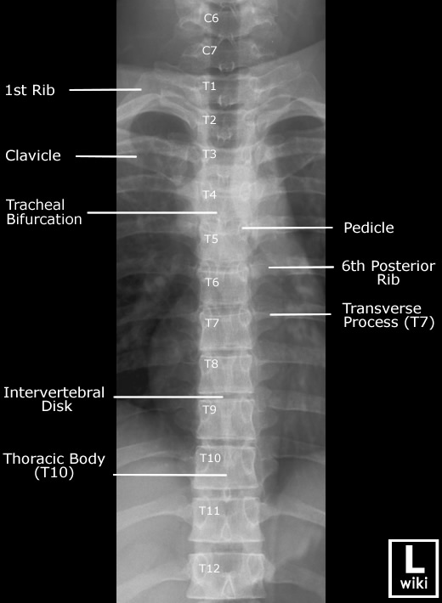
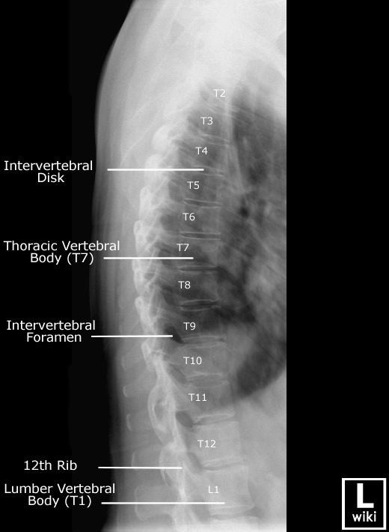
STATION-3 (General Review + Radiology)

Slide 14
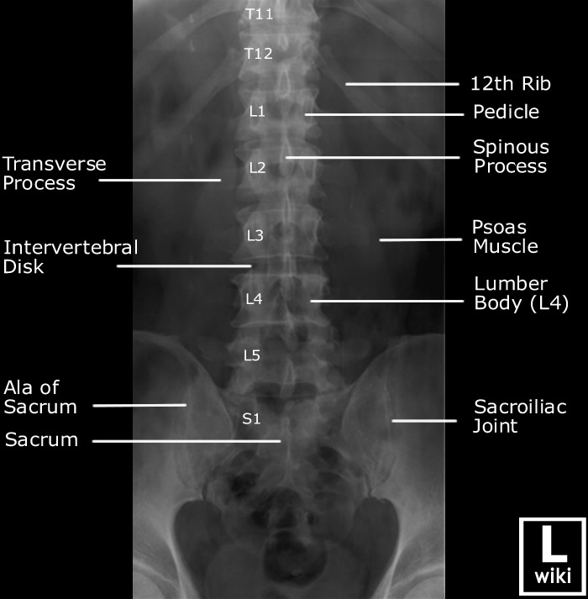
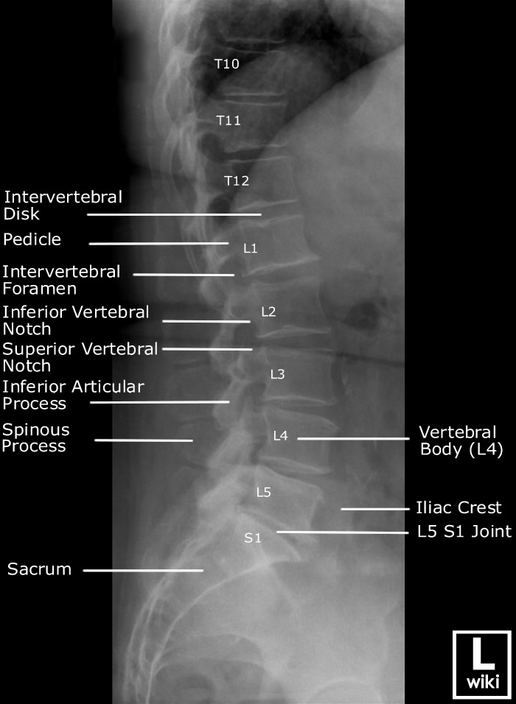
STATION-3 (General Review + Radiology)

Slide 15
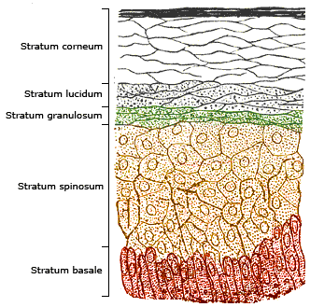
STATION-4 (Histology of Skin and Appendages)
There are 2 types of skin:
Thick skin: found in palm and sole.
Thin skin: found everywhere else in the body. It has hair follicles and sebaceous glands in the dermis.
Note: these 2 types of skin are classified based on the thickness of the epidermis.
Epidermis: stratified squamous keratinized epithelium. In think skin it has 4 layers while in thick skin it has 5 layers. These layers are:
Stratum basale: 1st layer (deepest) – containing mitotic stem cells.
Stratum spinosum: containing desmosomes between keratinocytes.
Stratum granulosum: cells contain granules (keratohyaline granules).
Stratum lucidum (only found in thick skin): clear cells – provides faster and better healing process of thick skin.
Stratum corneum: composed mainly of keratin.

Slide 16
STATION-4 (Histology of Skin and Appendages)
Types of cells in the epidermis of the skin:
Keratinocytes:
They form all the thickness of the epidermis.
Melanocytes:
They are found is stratum basale.
They are derived from neural crest.
They produce melanin (by converting tyrosine to DOPA by the action of the enzyme tyrosinase. DOPA is further converted to melanin).
If the enzyme tyrosinase is not present this will lead to a condition known as albinism.
Melanin is transferred from melanocytes to keratinocytes by paracrine secretion.
The number of melanocytes is fixed in people → difference in color is due to different amount/content.
Langerhans cells:
They are star-shaped cells found in stratum spinosum.
They are derived from monocyte-phagocytic system.
They function as antigen-presenting cells of the immunity system of the skin.
Merkel cells:
They are found in stratum basale.
They are derived from neural crest.
They are mechanoreceptors.

Slide 17
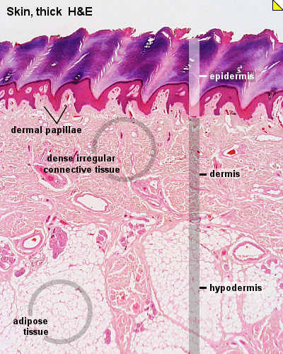
STATION-4 (Histology of Skin and Appendages)
Dermis:
It is the 2nd layer of the skin.
It contains type-1 collagen and it is the part where skin appendages are found.
It is of 2 types:
Papillary: composed of loose connective tissue.
Reticular: composed of dense irregular connective tissue.
Hypodermis:
It is the 3rd layer of the skin.
Mainly composed of adipose tissue (which is different in distribution between males and females).

Slide 18
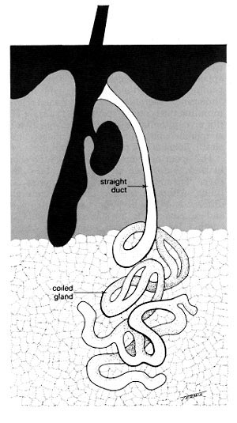
STATION-4 (Histology of Skin and Appendages)
Skin glands:
Sebaceous glands:
They are acinar glands (with several acini opening into a short duct which usually ends at the upper portion of a hair follicle).
They open at the epidermis directly in: glans penis, lips and clitoris.
Sebum: it is the secretion of sebaceous glands
Sebaceous glands are holocrine glands (in which the product of secretion is released with remnants of dead cells).
Sweat glands:
Distributed over the entire body except the nipples and portions of the external genitalia.
There are 2 types of sweat glands:
Merocrine sweat glands: more numerous; prominent on palms, soles and forehead; simple, coiled, tubular glands; duct empties at a funnel-shaped pore at the skin surface; major function is thermoregulation; sweat contains salts (NaCl), vitamin C, antibodies and small amounts of nitrogenous wastes; pH of the sweat is 4-6 (creating acid mantle which is bacteriostatic).
Apocrine sweat glands: found in axillary, pubic and anal regions of the body; larger than merocrine sweat glands; become active at puberty; play no role in thermoregulation; ducts empty into hair follicles; sweat is thicker and contains more lipids and proteins (when degraded by epidermal bacteria →foul odor is produced).

Slide 19
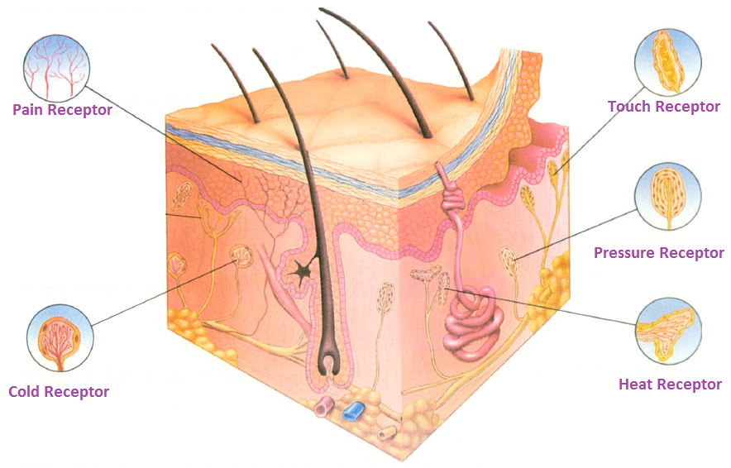
STATION-4 (Histology of Skin and Appendages)

Slide 20
GOOD LUCK! WISH YOU ALLTHE BEST ☺

