Slide 1
DEMO VI (Leg and Foot)
Ali Jassim Alhashli
Year IV – Unit VII – Musculoskeletal System

Slide 2
STATION – 1 (Gross Anatomy of Leg and Foot) Anterior Compartment of The Leg
Dorsiflexor.
Located anterior to the interosseous membrane between the lateral surface of the tibial shaft and the medial surface of the fibular shaft.
Superior extensor retinaculum: strong, broad, band of deep fascia, passing from the fibula to the tibia (proximal to the malleoli).
Inferior extensor retinaculum: Y-shaped, band of deep fascia, attaches laterally to the anterosuperior surface of the calcaneus and medially to the medial malleolus and medial cuneiform.
The 4 muscles in the anterior compartment are:
Tibialis anterior.
Extensor digitorum longus.
Extensor hallucis longus: lateral to its tendon you can palpate the dorsalis pedis artery.
Fibularis tertius.
These muscles are mainly dorsiflexors of the ankle joint and extensors of the toes.

Slide 3
STATION – 1 (Gross Anatomy of Leg and Foot) Anterior Compartment of The Leg
Deep fibular nerve:
Supplying the anterior compartment of the leg.
Arises between the fibularis longus muscle and the neck of the fibula.
Sensation: area of skin between the 1st and 2nd digits on the dorsum of the foot (first web space).
Anterior tibial artery:
Supplies structures in the anterior compartment.
Begins at the inferior border of the popliteus muscle.
Descends on the anterior surface of interosseus membrane between the tibialis anterior and the extensor digitorum longus.
Ends at the ankle joint, midway between the malleoli, where it becomes the dorsalis pedis artery (dorsal artery of foot).

Slide 4
STATION – 1 (Gross Anatomy of Leg and Foot) Anterior Compartment of The Leg

Slide 5
STATION – 1 (Gross Anatomy of Leg and Foot) Lateral Compartment of The Leg
Evertor.
Bounded by:
Lateral surface of the fibula.
Anterior and posterior intermuscular septa.
Deep fascia of the leg.
Contains 2 muscles:
Fibularis longus: passing in the groove of cuboid bone and inserting in the base of 1st metatarsal and medial cuneiform bone.
Fibularis brevis: inserting in the tuberosity of the base of the 5th metatarsal.
Their tendons pass posterior to the lateral malleolus.
Superficial fibular nerve: supplying the two muscles, continues as a cutaneous nerve, supplying the skin on the distal part of the anterior surface of the leg and nearly all the dorsum of the foot (except the lateral aspect which is supplied by the sural nerve + the area which is supplied by the deep fibular nerve).
Arterial supply of the muscles:
Proximally: perforating branches of the anterior tibial artery.
Distally: perforating branches of the fibular artery.

Slide 6
STATION – 1 (Gross Anatomy of Leg and Foot) Lateral Compartment of The Leg

Slide 7
STATION – 1 (Gross Anatomy of Leg and Foot) Posterior Compartment of The Leg
Superficial muscle group:
Including: gastrocnemius, soleus and plantaris.
The two headed gastrocnemius and soleus share a common tendon, the calcaneal tendon which attaches to the calcaneus (elevating the heel and thus depressing the forefoot, generating as much as 93% of the plantarflexion force).
“You stroll with the soleus but win the long jump with the gastrocnemius”.
Subcutaneous calcaneal bursa: located between the skin and the calcaneal tendon, allows the skin to move over the taut tendon.
Retrocalcaneal bursa: located between the tendon and the calacaneus, allows the tendon to glide over the bone.
Gastrocnemius: most superficial, fusiform, two-headed. Maximally activated when knee extension is combined with dorsiflexion.
Soleus: deep to the gastrocnemius, larger, flatter. The soleus can be palpated on each side of the gastrocnemius when the individual is standing on tiptoes. It cannot act on the knee joint.
Plantaris: small muscles, short-belly, long tendon. It is a vestigial muscle absent in 5%-10% of people (removed for grafting).

Slide 8
STATION – 1 (Gross Anatomy of Leg and Foot) Posterior Compartment of The Leg
Deep muscle group:
4 muscles: popliteus, flexor digitorum longus, flexor hallucis longus and tibialis posterior.
Popliteus: thin, triangular muscle, in the floor of the popliteal fossa, acts on the knee joint.
Flexor hallucis longus: the powerful flexor of all the joints of the great toe.
Flexor digitorum longus: smaller than flexor hallucis longus even though it moves four digits. The tendon passes diagonally into the sole of the foot, superficial to the tendon of the flexor hallucis longus.
Tibialis posterior: deepest muscle in the group, between the flexor digitorum longus and the flexor hallucis longus. It acts synergistically with the tibialis anterior to invert the foot. In addition it maintains (fix) the medial longitudinal arch of the foot.

Slide 9
STATION – 1 (Gross Anatomy of Leg and Foot) Posterior Compartment of The Leg

Slide 10
STATION – 1 (Gross Anatomy of Leg and Foot) Posterior Compartment of The Leg
Tibial nerve (L4, L5, and S1-S3):
Runs through the popliteal fossa.
Passing between the heads of the gastrocnemius.
Pass deep to soleus.
Supplies all muscles in the posterior compartment of the leg.
At the ankle, the nerve lies between the flexor hallucis longus and the flexor digitorum longus.
Posteroinferior to the medial malleolus, the tibial nerve divides into the medial and lateral plantar nerves.
Posterior tibial artery:
Larger terminal branch of the popliteal artery.
Provides blood supply to the posterior compartment of the leg and to the foot.
Begins at the distal border of the popliteus and passes deep to the soleus.
Giving off the fibular artery (gives muscular branches to the muscles in the lateral compartment of the leg).
Accompanied by the tibial nerve (both run posterior to the medial malleolus).
Divides into the medial and lateral plantar arteries.

Slide 11
STATION – 2 (Ligaments of the Foot)
Medial longitudinal arch of the foot (more prominent):
Formed by 9 bones: calcaneus, talus, navicular, 3 cuneiforms and 3 metatarsals.
Note that these bones are kept in their proper position by certain ligaments.
Lateral longitudinal arch of the foot:
Formed by 4 bones: calcaneus, cuboid and the lateral 2 metatarsals.
Plantar aponeurosis (resembling palmar aponeurosis in the hand):
Extending from the calcaneus to the bases of 2nd-4th metatarsals.
It is a thickening of the deep fascia and supports the longitudinal arches of the foot.
Inflammation of the plantar aponeurosis in know as (plantaritis): it occurs when the aponeurosis is over-stretched especially after vigorous exercise such as running.
Short plantar ligament: extending from calcaneus to cuboid (C to C).
Long plantar ligament: extending from calcaneus to metatarsals.

Slide 12
STATION – 2 (Ligaments of the Foot)
Sustentaculum tali provides an attachment for 3 structures (STD):
S: spring ligament.
T: tibialis posterior.
D: deltoid ligament.
Note that below, it has a groove for the passage of the tendon of flexor hallucis longus muscle.
Spring ligament (talocalcaneonavicular ligament):
Supporting the medial longitudinal arch of the foot.
Supporting the head of talus.
In pes planus, the head of the talus bone is displaced medially and distal from the navicular. As a result, the spring ligament and the tendon of the tibialis posterior muscle are stretched so much so that the individual with pes planus loses the function of the medial longitudinal arch (MLA). If the MLA is absent or nonfunctional in both the seated and standing positions, the individual has “rigid” flatfoot.
Muscles supporting the longitudinal arches of the foot:
Tibialis posterior and tibialis anterior muscles: supporting the medial longitudinal arch of the foot.
Fibularis longus and fibularis brevis: supporting the lateral longitudinal arch of the foot.
Note that fibularis longus also supports the transverse arch of the foot.

Slide 13
STATION – 3 (Surface Anatomy by Dr. A.Haleem)
Bones of the foot:
7 tarsal bones:
Calcaneus (heel bone): largest, strongest, articulates with talus superiorly and cuboid anteriorly. It transmits most of body weight from the talus to the ground.
Talus (ankle bone): has a head, neck and a body. It rests on the anterior 2/3 of calcaneus. The trochlea of talus bears the weight of the body transmitted from the tibia and articulated with the two malleoli. The head of the talus articulates anteriorly with the navicular.
Navicular: flattened, boat-shaped, between the talar head and the cuneiforms. The medial surface of the navicular projects inferiorly as the tuberosity of navicular.
3 cuneiforms: medial, intermediate and lateral. They articulate with the navicular posteriorly and the base of the appropriate metatarsal anteriorly. In addition, the lateral cuneiform articulates with the cuboid.
Cuboid: most lateral bone in the distal row of the tarsus. It has a groove for the tendon of the fibularis longus muscle.
5 metatarsals:
1st metatarsal: shorter, stouter.
2nd metatarsal: longest.
Each metatarsal has a base, shaft and a head.
Bases of metatarsals articulate with the cuneiform and cuboid bones.
Tuberosity of the 5th metatarsal projects over the lateral margin of the cuboid bone.
14 phalanges:
The great two has 2 phalanges: proximal and distal.
Other 4 digits have 3 each: proximal, middle and distal.

Slide 14
STATION – 3 (Surface Anatomy by Dr. A.Haleem)
Medial longitudinal arch of the foot: is supported by the spring ligament.
Transverse longitudinal arch of the foot: is supported by the tendon of fibularis longus muscle.
The tendon of fibularis longus muscle is passing through the plantar surface of the foot to insert in the base of 1st metatarsal while the tendon of fibularis brevis muscle is inserting in the tuberosity of the base of 5th metatarsal.
Tendon of calcaneus: representing the insertion of triceps surae muscle (composed of the two-headed gastrocnemius and the soleus muscles).
Movements of the foot:
At the ankle joint: flexion-extension.
At the subtalar joint: inversion and eversion.
Pulse of posterior tibial artery: can be felt in the midpoint between the calcaneus and medial malleolus.
Dorsalis pedis pulse: can be felt lateral to the tendon of extensor hallucis longus muscle.

Slide 15
STATION – 3 (Surface Anatomy by Dr. A.Haleem)
Eversion of the foot: caused by muscles of the lateral compartment of the leg (fibularis longus + fibularis brevis).
Inversion of the foot: caused by tibialis anterior and tibialis posterior muscles.
If there is injury to the common fibular nerve: inversion of the foot is possible by the action of tibialis posterior muscle which is innervated by tibial nerve.
Ligaments of the ankle joint:
Lateral: anterior and posterior talofibular + calcaneofibular.
Deltoid: tibionavicular, tibiocalcaneal, anterior and posterior tibiotalar.
Pott’s fracture: a fracture to the lateral or medial malleoli or bony parts on the outside and inside of the ankle respectively is known as Pott's fracture. It is often caused in the same way as an ankle sprain so can be difficult to tell apart initially. Lateral ankle sprains are more common and so fractures to the lateral malleoli also tend to occur more frequently.

Slide 16
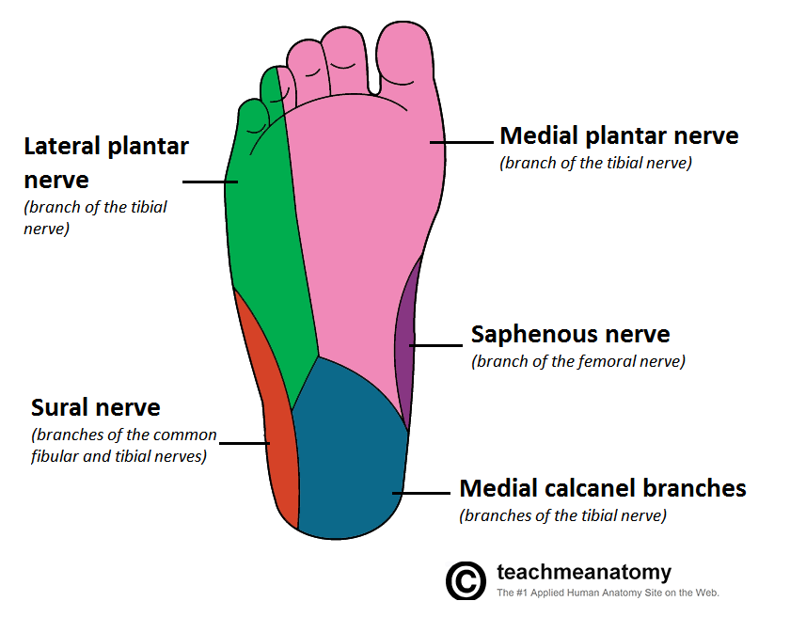
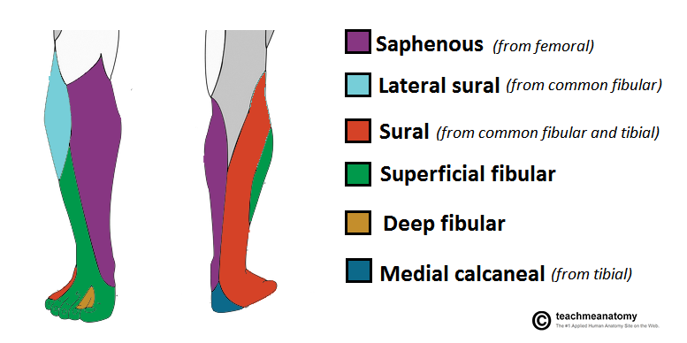
STATION – 3 (Surface Anatomy by Dr. A.Haleem) Cutaneous Innervation of The Leg and Foot

Slide 17
STATION-4 (Revision + Radiology)
Tibiotalar joint (ankle joint): synovial (classification) hinge (type) joint.
The head of the talus forms a joint with the navicular bone. This joint is called talonavicular joint.
The calcanceus forms a joint anteriorly with the cuboid bone. This joint is called calcaneocuboid joint.
Flexor hallucis longus muscle remains muscular even beneath the ankle joint because it is responsible for the toe-off action during walking.
Subtalar joint is a complex of:
Talus and calcaneus.
Talus and navicular.
Calcaneus and cuboid.
Calcaneal fracture: it occurs in people who fall on their heels (ex. From a ladder). The bone breaks into several fragments (comminuted fracture) that disrupt the subtalar joint.

Slide 18
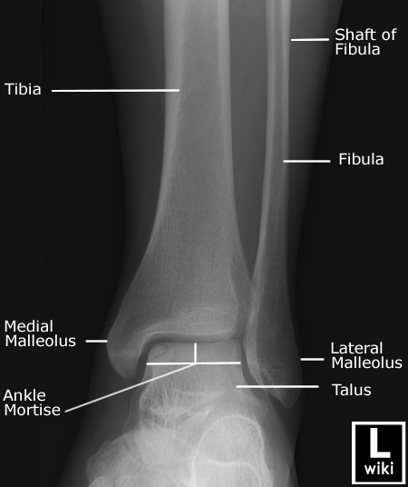
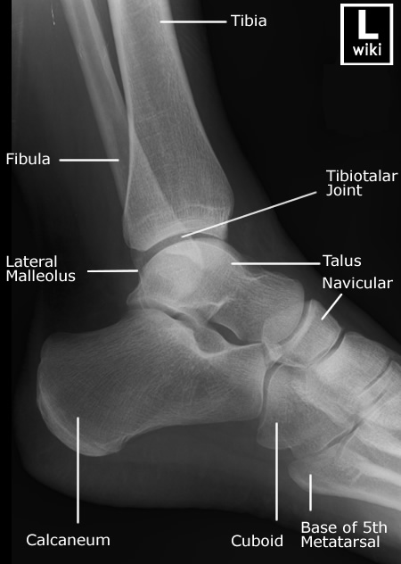
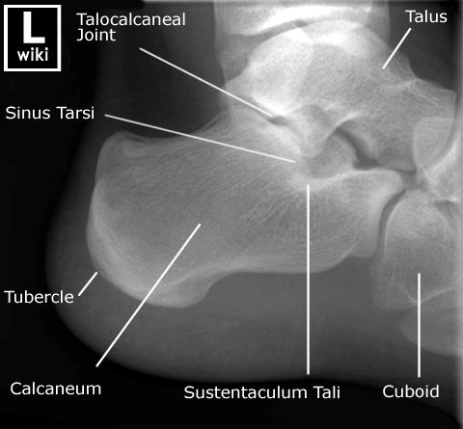
STATION-4 (Revision + Radiology)

Slide 19
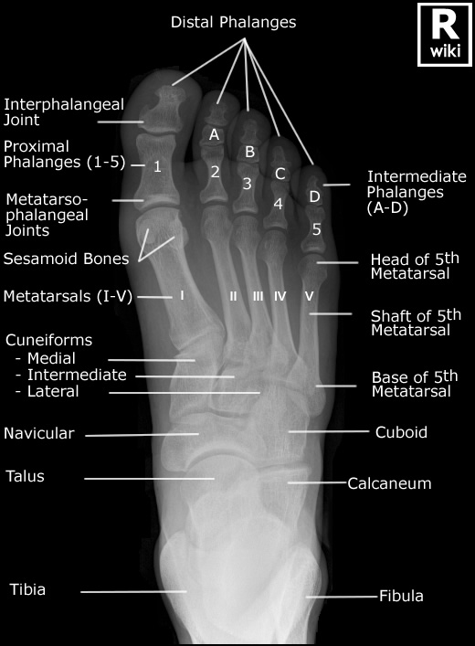
STATION-4 (Revision + Radiology)

Slide 20
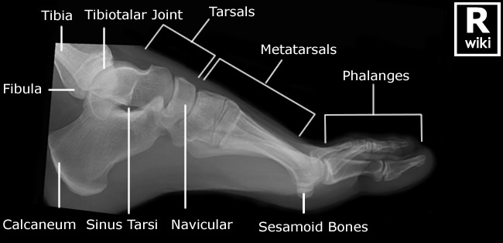
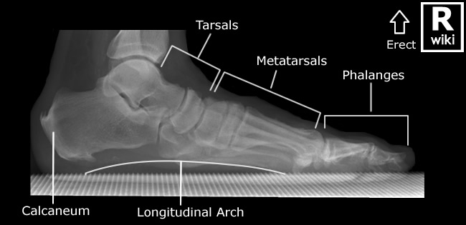
STATION-4 (Revision + Radiology)

Slide 21
Good Luck! Wish You All The Best ☺

