Slide 1
DEMO – V (Knee Joint and Popliteal Fossa)
Ali Jassim Alhashli
Year IV – Unit VII – Musculoskeletal System

Slide 2
STATION – 1 (Gross Anatomy of Popliteal Fossa)
Popliteal fossa: fat-filled, diamond-shaped, posterior to the knee.
The popliteal fossa is bounded by:
Superolaterally: biceps femoris.
Supermedially: semitendinosus and semimembranosus.
Inferolaterally and inferomedially: lateral and medial heads of gastrocnemius resepectively.
Roof: skin and popliteal fascia.
Floor: popliteal surface of the femur, posterior capsule of the knee joint, and the popliteus fascia covering the popliteus muscle.
The contents of the popliteal fossa include the:
Termination of the small saphenous vein.
Popliteal artery and vein.
Tibial and common fibular nerves.
Popliteal lymph nodes and lymphatic vessels.
Fascia of popliteal fossa:
Subcutaneous tissue contains: fat, small saphenous vein, and 3 cutaneous nerves: posterior cutaneous nerve of the thigh, media and lateral sural cutaneous nerves.
Popliteal fascia: strong sheet of deep fascia that forms a protective covering for neurovascular structures.

Slide 3
STATION – 1 (Gross Anatomy of Popliteal Fossa)
Vessels in popliteal fossa:
Popliteal artery:
Continuation of the femoral artery.
Begins where the femoral artery passes through the adductor hiatus.
Ends at the inferior border of the popliteus by dividing into (anterior and posterior tibial arteries).
Popliteal artery is the deepest structure in popliteal fossa.
5 genicular branches of the popliteal artery supply the joint capsule and ligaments of the knee joint: superior lateral, superior medial, middle, inferior lateral and inferior medial.
The muscular branches of the popliteal artery supply the hamstring, gastrocnemius, soleus and plantaris muscles.
Popliteal vein:
Continuation of the posterior tibial vein.
Superiorly, the popliteal vein becomes the femoral vein as it traverses the adductor hiatus.
The small saphenous vein passes from the posterior aspect of the lateral malleolus to the popliteal fossa, where it pierces the deep popliteal fasica and enters the popliteal vein.

Slide 4
STATION – 1 (Gross Anatomy of Popliteal Fossa)
Nerves in popliteal fossa:
Sciatic nerve ends at the superior angle of the popliteal fossa by dividing into: tibial and common fibular nerves.
Tibial nerve: medial, larges, most superficial of the 3 main central components of the popliteal fossa (nerve, vein and artery). Medial sural nerve is derived from the tibial nerve.
Common fibular nerve: lateral, smaller, begins at the superior angle of the popliteal fossa and follows closely the medial border of biceps femoris. It leaves the fossa by passing superficial to the lateral head of the gastrocnemius and winding around the fibular neck.

Slide 5
STATION – 2 (Surface Anatomy and Clinical Correlations)
What is the difference between dislocation and subluxation?
Dislocation: separation of 2 bones at a joint with complete loss of contact between their articular cartilages.
Subluxation: partial separation (still there is contact between them).
When is it difficult to see the patella?
It cannot be seen in case of effusion of the knee joint, obesity or if it was removed (when it is fractured to more than 2 pieces).
There is a slight joint gap between the femoral condyles (medial and lateral) and the tibial condyles (medial and lateral).
Below the patella, you can feel the patellar ligament which is inserting in the tibial tuberosity.
Common fibular nerve injury will result in ---< foot drop.
In the posterior aspect of the knee, you can see the popliteal fossa which is bounded by:
Superolaterally: biceps femoris.
Supermedially: semitendinosus and semimembranosus.
Inferolaterally and inferomedially: lateral and medial heads of gastrocnemius resepectively.
How do you feel for the pulse of popliteal artery?
To palpate this artery, the person is placed in the supine position with the knee flexed to relax the popliteal fascia and hamstrings. The pulsations are best felt in the inferior part of the fossa.

Slide 6
STATION – 2 (Surface Anatomy and Clinical Correlations)
Important ligament of the knee (will be discussed in more details in station-3):
Intra-capsular: anterior and posterior cruciate ligaments.
Extra-capsular: patellar, tibial collateral and fibular collateral ligaments.
Rotation of the knee joint:
When the foot is on the ground ---< the tibia is fixed ---< and the femur is the bone which is going to rotate.
When the foot is off the ground ---< the femur is fixed ---< and the tibia is the bone which is going to rotate.
Increased abduction at the knee joint: injury to the tibial collateral ligament.
Increased adduction at the knee joint: injury to the fibular collateral ligament.
Slight gliding movement occurs when there is flexion at the knee joint to keep the femur in contact with tibia and prevent displacement.
Replacement of the entire knee joint is know as: complete arthroplasty.

Slide 7
STATION – 3 (Ligaments of The Knee Joint + Radiology)
Knee joint: modified hinge synovial joint, allowing flexion-extension (mainly) in addition to rotation when the knee is flexed.
Articular surfaces of the knee joint:
Two femorotibial articulations (lateral and medial): between the lateral and the medial femoral and tibial condyles.
One intermediate femoropatellar articulation: between the patella and the femur.
Notes:
Patella is a sesamoid bone, with no periosteum, no medullary cavity and is avascular.
The fibula is not involved in the knee joint.
The stability of the knee joint depends on:
Strength and actions of surrounding muscles and their tendons. The most important muscle in stabilizing the knee joint is the large quadriceps femoris, particularly the inferior fibers of the vastus medialis and lateralis.
Ligaments connecting the femur and tibia.

Slide 8
STATION – 3 (Ligaments of The Knee Joint + Radiology)
Extracapsular ligaments:
Patellar ligament:
It is the distal part of the quadriceps tendon.
Strong, thick, fibrous band, passing from apex of patella to the tibial tuberosity.
Receives the medial and lateral patellar retinacula, aponeurotic expansions of the vastus medialis and vastus lateralis.
Fibular collateral ligament (FCL):
Rounded, cord-like, strong.
Extends inferiorly from lateral epicondyle of the femur to the lateral surface of the head of the fibula.
Tendon of the popliteus muscle passes deep to the FCL, separating it from the lateral meniscus.
Tibial collateral ligament (TCL):
Strong, flat band, extending from medial epicondyle of the femur to the medial condyle and superior part of the medial surface of the tibia.
At its midpoint, it is attached to the medial meniscus.
Note: oblique and arcuate popliteal ligaments are supporting the posterior aspect of the fibrous capsule of the knee joint. Oblique popliteal ligament is pierced by the obturator nerve and it is an expansion of semimembranosus muscle.

Slide 9
STATION – 3 (Ligaments of The Knee Joint + Radiology)
Intracapsular ligaments:
Anterior cruciate ligament (ACL):
Weak.
Arises from the anterior intercondylar area of the tibia, just posterior to the attachment of the medial meniscus.
Extends superiorly, posteriorly and laterally to attach to the posterior part of the medial side of the lateral condyle of the femur.
Limits posterior rolling of the femoral condyles on the tibial plateau during flexion, prevents posterior displacement of the femur on the tibia and hyperextension of the knee joint.
Posterior cruciate ligament (PCL):
Strong.
Arises from posterior intercondylar area of the tibia.
Passes superiorly, anteriorly and medially to attach to the anterior part of the lateral surface of the medial condyle of the femur.
Limits anterior rolling of the femur on the tibial plateau during extension, prevents anterior displacement of the femur on the tibia and hyperflexion of the knee joint.

Slide 10
STATION – 3 (Ligaments of The Knee Joint + Radiology)
Unhappy triad:
Cause: direct blow to the lateral side of the knee joint or excessive lateral twisting of the knee while it is flexed.
Torn ligaments:
Anterior cruciate ligament.
Tibial collateral ligament.
Medial meniscus.
Prepatellar bursitis (housemaid’s knee): friction bursitis caused by friction between the skin and the patella. If the inflammation is chronic, the bursa becomes distended with fluid and forms a swelling anterior to the knee.

Slide 11
STATION – 3 (Ligaments of The Knee Joint + Radiology)

Slide 12
STATION – 4 (Histology of Cartilage)
Characteristic of cartilage:
Develops from mesenchyme and consists of cells (chondrocytes and chondroblasts), connective tissue fibers and ground substance.
Avascular, gets nutrients via diffusion through ground substance.
There are 3 types of cartilage: hyaline, elastic and fibrocartilage.
Hyaline cartilage:
Most common in the body and serves as a skeletal model for most bones.
In developing bones, cartilage present in epiphyseal plates for bone growth in length.
Replaced by bone during endochondral ossification.
Contains type II collagen fibrils, which are not seen in histologic sections due to reflective index that is similar to that of ground substance.
In adults, present on articular surfaces of bones, ends of ribs, nose, larynx, trachea and bronchi.

Slide 13
STATION – 4 (Histology of Cartilage)
Elastic cartilage:
Contains branching elastic fibers in matrix and is highly flexible.
Found in external ear, auditory tube, epiglottis and larynx.
Fibrocartilage:
Filled with dense bundles of type I collagen fibers that alternate with cartilage matrix.
Provides tensile strength, bears weight, and resists compression.
Found in intervertebral disks, symphysis pubis, and certain joints.

Slide 14
STATION – 4 (Histology of Cartilage)
Perichondrium:
Found on peripheries of hyaline and elastic cartilage.
Peripheral layer is dense vascular connective tissue with type I collagen.
Inner layer is chondrogenic and gives rise to chondroblasts that secrete cartilage matrix.
Articular hyaline cartilage of bones and fibrocartilage not lined by perichondrium.
Cartilage matrix:
Produced and maintained by chondrocytes and chondroblasts.
Contains large proteoglycan aggregates and is highly hydrated (high water content).
Allows diffusion and is semirigid shock absorber.
Adhesive glycoprotein chondronectin binds cells and fibrils to the surrounding matrix.
Elastic cartilage provides structural support and increased flexibility.
Cartilage cells:
Primitive mesenchymal cell differentiate into chondroblasts that synthesize the matrix.
Mesenchyme also differentiates into fibroblasts of the perichondrium.
Mature cartilage cells, chondrocytes, become enclosed in lacunae.
Main function of chondrocytes is to maintain the cartilage matrix.
Inner layer of surrounding connective tissue perichondrium is chondrogenic.
Cartilage grows by both interstitial and appositional growth.

Slide 15
STATION – 4 (Histology of Cartilage)

Slide 16
STATION – 4 (Histology of Cartilage)
Process of bone formation (ossification):
Endochondral ossification:
Most bones develop by this process, with a hyaline cartilage model preceding bone.
Hyaline cartilage model grows in length and width, then calcifies and chondrocytes die.
Mesenchymal cells in the periosteum differentiate into osteoprogenitor cells and form osteoblasts.
Osteoblasts synthesize the osteoid matrix, which calcifies and traps osteoblasts in lacunae as osteocytes.
Osteocytes establish cell-to-cell communication via canaliculi that open into blood channels.
Primary ossification center forms in the diaphysis and secondary center of ossification in the epiphysis.
Epiphyseal plate between the diaphysis and epiphysis allows for growth in bone length.
Eventually all cartilage is replaced by bone except the articular cartilage.

Slide 17
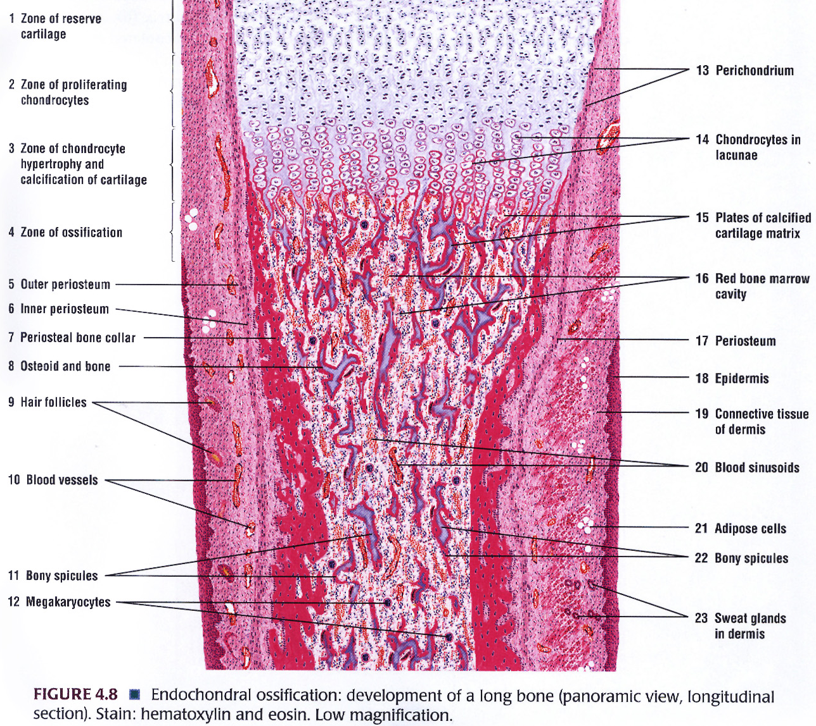
STATION – 4 (Histology of Cartilage)

Slide 18
STATION – 4 (Histology of Cartilage)
Process of bone formation (ossification):
Intramembranous ossification:
Mesenchymal cells differentiate directly into osteoblasts.
Osteoblasts produce the osteoid matrix that quickly calcifies.
Osteoblasts initially for spongy bone that consists of trabeculae and trap osteocytes.
Mandible, maxilla, clavicle and flat skull bones are formed by this process.
Fontanelles in newborn skulls represent intramembranous ossification in progress.

Slide 19
GOOD LUCK! Wish You All The Best ☺

