Slide 1
DEMO – III (Forearm and Hand)
Ali Jassim Alhashli
Year IV – Unit VII – Musculoskeletal System

Slide 2
STATION – 1 (Gross Anatomy of The Hand)
Fascia of palm:
It is continuous with antebrachial fascia and fascia of the dorsum of the hand.
Thin over the thinar and hypothenar eminences.
Thick centrally where it forms the fibrous palmar aponeurosis (strong, well-defined, overlies long flexor tendons) and in the fingers where it forms the digital sheaths.
Medial fibrous septum: extends deeply from the medial border of palmar aponeurosis to the 5th metacarpal. Medial to this septum is hypothenar compartment containing hypothenar muscles.
Lateral fibrous septum: extends deeply from the lateral border of palmar aponeurosis to the 3rd metacarpal. Lateral to this septum is thenar compartment containing thenar muscles.
Central compartment: is between thenar and hypothenar compartments and contains flexor tendons and their sheaths, lumbrical muscles, superficial palmar arch and digital vessels & nerves.
Adductor compartment: containing adductor pollicis.

Slide 3
STATION – 1 (Gross Anatomy of The Hand)

Slide 4
STATION – 1 (Gross Anatomy of The Hand)
Muscles of the hand:
They are located in 5 compartments:
Thenar muscles in thenar compartment: abductor pollicis brevis, flexor pollicis brevis and opponens pollicis.
Hypothenar muscles in hypothenar compartment: abductor digiti minimi, flexor digiti minimi brevis and opponens digiti minimi.
Adductor pollicis in adductor compartment.
Lumbricals in central compartment.
Palmar and dorsal interossei in separate interosseous compartments between the metacarpals.
Thenar muscles:
They form thenar eminence on the lateral surface of the palm
Chiefly responsible for opposition of the thumb.
Several mucles are required to control the freedom of movement of the thumb:
Abduction: APL and abductor pollicis brevis.
Adduction: adductor pollicis and first dorsal interosseous.
Extension: EPL, EPB and ABL.
Flexion: flexor pollicis longus and flexor pollicis brevis.
Opposition: opponens pollicis.

Slide 5
STATION – 1 (Gross Anatomy of The Hand)

Slide 6
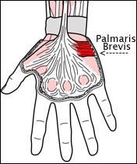
STATION – 1 (Gross Anatomy of The Hand)
Muscles of the hand:
Hypothenar muscles:
Produce hypothenar eminence on the medial side of the palm.
Palmaris brevis is a small muscle in the subcutaneous tissue of the hypothenar eminence. It is not in the hypothenar compartment. It wrinkles the skin of the hypothenar eminence, deepening the hollow of the palm, thereby aiding the palmar grip. It covers and protects the ulnar nerve and artery.
Short muscles of the hand:
4 slender lumbrical muscles with worm-like appearance. They flex the fingers at the metacarpophalangeal joints and extend the interphalangeal joints.
4 dorsal interossei muscles between the metacarpals causing abduction (DAB).
3 palmar interossei on the palmar surfaces of 2nd, 4th and 5th metacarpals causing adduction of the fingers (PAD).

Slide 7
STATION – 1 (Gross Anatomy of The Hand)
Flexor tendons of extrinsic muscles:
The tendons of flexor digitorum superficialis (FDS) and flexor digitorum profundus (FDP) enter the common flexor sheath deep to flexor retinaculum.
The tendons enter the central compartment of the hand and fan out to enter the respective digital synovial sheaths.
Near the base of the proximal phalanx, the tendon of FDS splits and surrounds the tendon of the FDP.
Fibrous digital sheaths: strong, ligamentous sheaths containing the flexor tendons and their synovial sheaths. They extend from heads of metacarpals to bases of distal phalanges and prevent the tendons from pulling away from the digits.
The tendon of FPL passes deep to the flexor retinaculum to the thumb within its own synovial sheath.

Slide 8
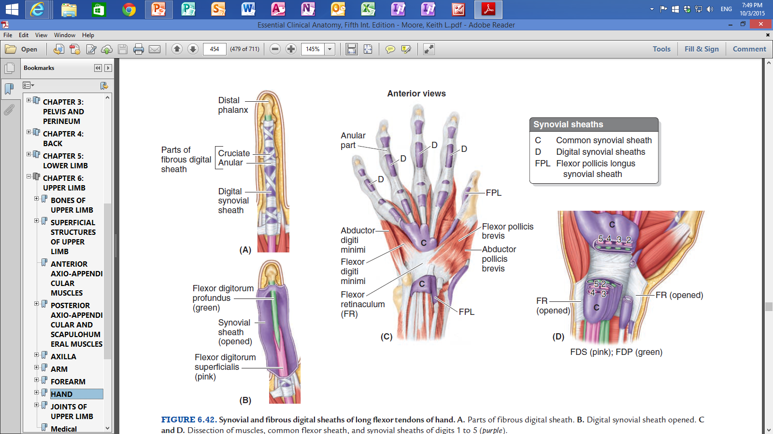
STATION – 1 (Gross Anatomy of The Hand)

Slide 9
STATION – 1 (Gross Anatomy of The Hand)
Arteries of the hand:
Ulnar and radial arteries and their branches provide all the blood supply of the hand.
Ulnar artery enters the hand anterior to flexor retinaculum between the pisiform and the hook of hamate via the ulnar canal (Guyon canal). It lies lateral to the ulnar nerve.
Ulnar artery is the main contributor to the superficial palmar arch which gives rise to 3 common palmar digital arteries that anastomose with palmar metacarpal arteries coming from the deep palmar arch.
Radial artery curves around the scaphoid and trapezium in the floor of the anatomical snuff box and enters the palm by passing between the heads of the 1st dorsal interosseous muscle.
The radial artery ends by anastomosing with the deep branch of the ulnar artery to form the deep palmar arch. The deep palmar arch gives rise to 3 palmar metacarpal arteries.
Radial indicis artery: passes along the lateral side of the index finger.
Clinical correlation: if there is severe injury to the vessels of the hand, a pneumatic tourniquet is applied to the brachial artery to stop hemorrhage or blood flow.

Slide 10
STATION – 1 (Gross Anatomy of The Hand)

Slide 11
STATION – 1 (Gross Anatomy of The Hand)
Nerves of the hand:
Median nerve:
Enters the hand through the carpal tunnel deep to the flexor retinaculum along with the tendons of FDS, FDP and FPL.
Carpal tunnel: passageway deep to the flexor retinaculum between the tubercles of the scaphoid and the trapezoid bones on the lateral side and the pisiform and the hook of hamate on the medial side.
Median nerve supplies two and a half thenar muscles and the 1st and 2nd lumbricals. It also sends sensory fibers to the skin on the lateral palmar surface, the sides of the first 3 digits, the lateral half of the 4th digit and the dorsum of the distal halves of these digits.
Palmar cutaneous branch of the median nerve does not pass through the carpal tunnel. In carpal tunnel syndrome, the median nerve is compressed and there will be atrophy of thenar muscles but the palmar sensation laterally will not be affected because palmar cutaneous branch of the median nerve does not pass through the tunnel.

Slide 12
STATION – 1 (Gross Anatomy of The Hand)
Nerves of the hand:
Ulnar nerve:
Passing through the ulnar canal anterior to flexor retinaculum. The ulnar artery is on its lateral side.
Just proximal to the wrist, the ulnar nerve gives off a palmar cutaneous branch that passes superficial to the flexor retinaculum and palmar aponeurosis. It supplies skin on the medial side of the palm.
The ulnar nerve also gives off a dorsal cutaneous branch, which supplies the medial half of the dorsum of the hand, the 5th finger and the medial half of the 4th finger.
The ulnar nerves divides to superficial branch which supplies cutaneous branches to the anterior surfaces of the medial one and a half fingers and deep branch which supplies hypothenar muscles, medial two lumbricals, adductor pollicis, deep head FPB and all interossei muscles.
Radial nerve:
Supplies no hand muscles.
Its terminal branches (superficial and deep) arise in the cubital fossa.
Superficial branch is entirely sensory supplying the skin and fascia over the lateral two thirds of the dorsum of the hand, the dorsum of the thumb and the proximal parts of the lateral one and a half digits.

Slide 13
STATION – 1 (Gross Anatomy of The Hand)

Slide 14
STATION – 1 (Gross Anatomy of The Hand)
Clinical correlations:
Tenosynovitis:
Inflammation of the tendon and synovial sheath.
Digit swells and movement becomes painful.
Infection is usually confined to the infected digit.
Because the synovial sheath of the little finger is usually continuous with the common flexor sheath, tenosynovitis in this finger may spread to the common sheath and thus through the palm and carpal tunnel to the anterior forearm (same concept happens if the infection occurs in the thumb).
Ulnar nerve injury:
An injury to the nerve in the distal part of the forearm denervates most intrinsic hand muscles. The power of wrist adduction is impaired. The hand is drawn to the lateral side.
The patient will not be able to flex the 4th and 5th digits at the distal interphalangeal joints when trying to make a fist.
The patient also cannot extend the interphalangeal joints when trying to straighten the 4th and 5th digits.
This presentation is know as clow hand.

Slide 15
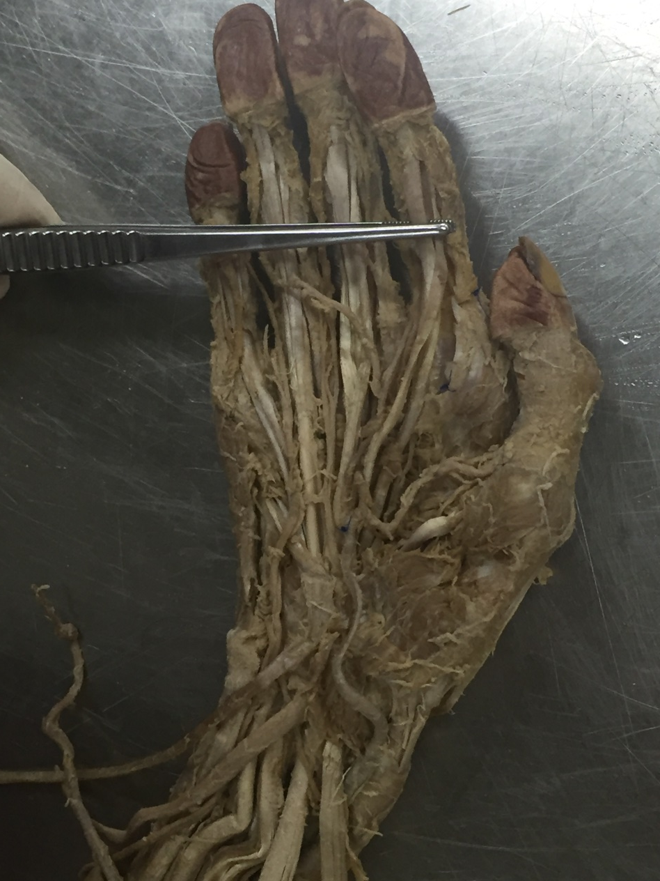
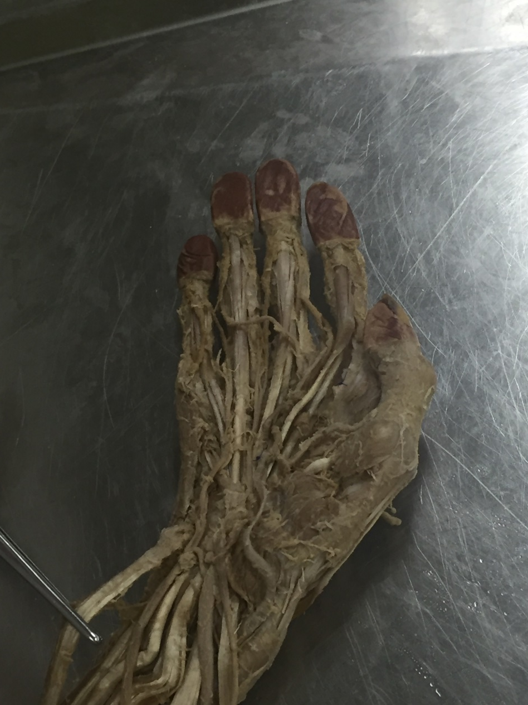
STATION – 1 (Gross Anatomy of The Hand)
Tendon of FDP passing through the tendon of FDS and inserts in the base of distal phalanx
Tendon of flexor carpi ulnaris (FCU) attaching to pisiform bone, hook of hamate and the base of 5th metacarpal

Slide 16
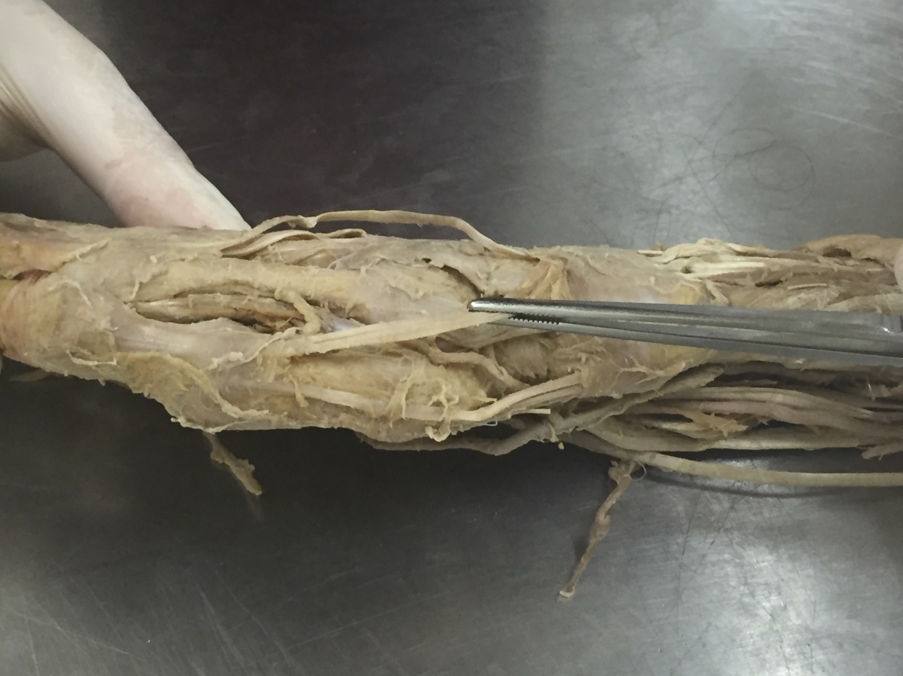
STATION – 1 (Gross Anatomy of The Hand)
Tendon of extensor pollicis brevis (EPB)
Radial artery
Tendon of abductor pollicis longus (APL)
Medial aspect of the hand showing the boundaries of anatomical snuff box. The forceps is holding the tendon of extensor pollicis longus muscle (EPL)

Slide 17
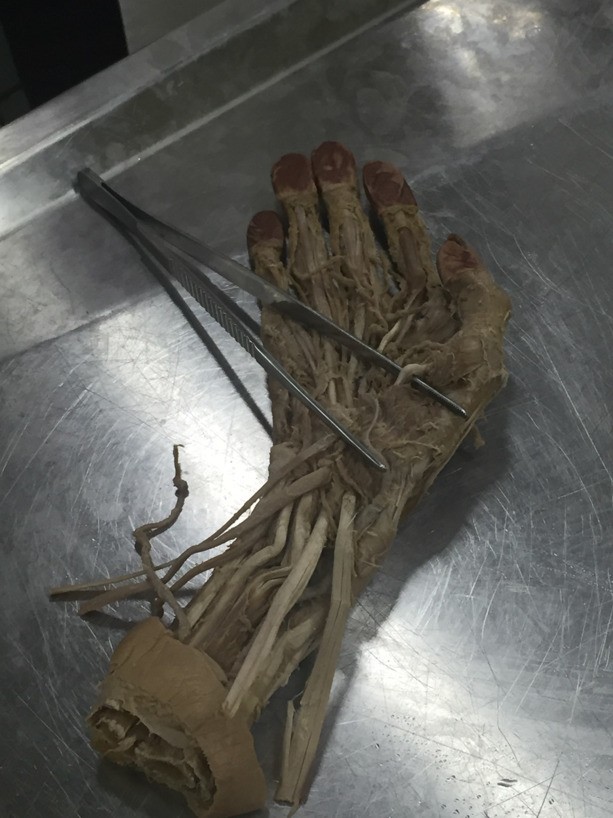
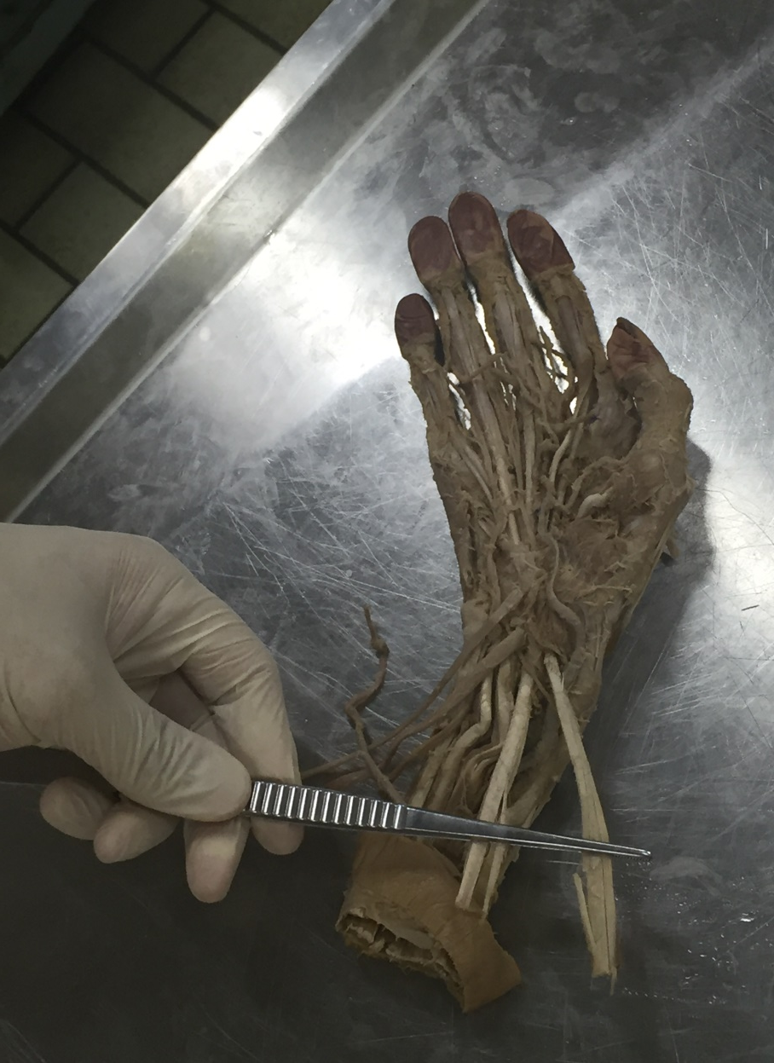
STATION – 1 (Gross Anatomy of The Hand)
Tendon of flexor pollicis longus muscle (causing flexion of the thumb)
Right: tendon of flexor carpi radialis attaching to the base of 2nd and 3rd metacarpals. Left: tendon of palmaris longus muscle

Slide 18
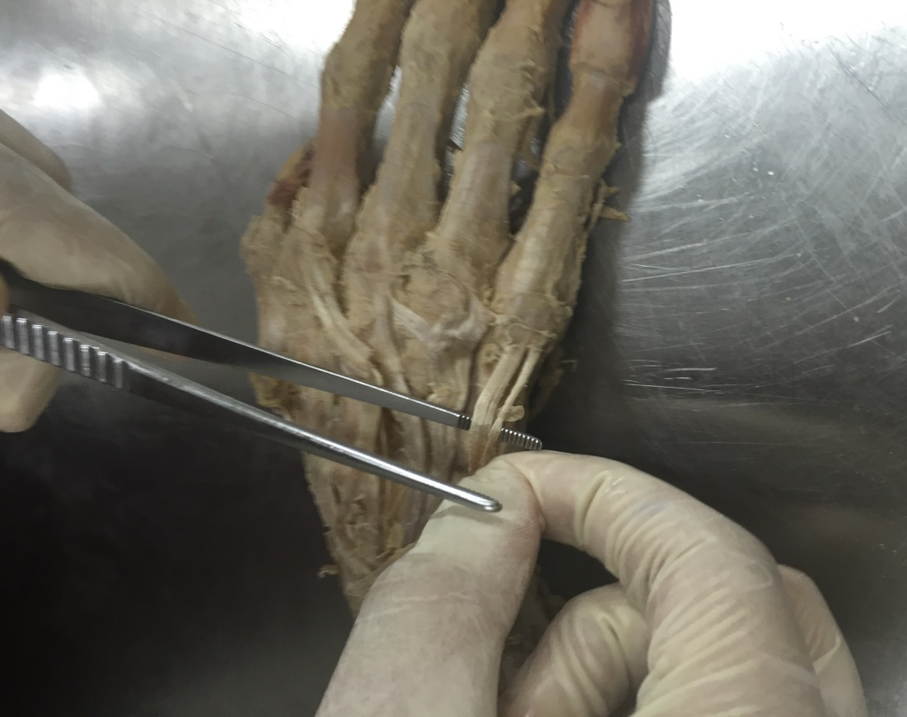
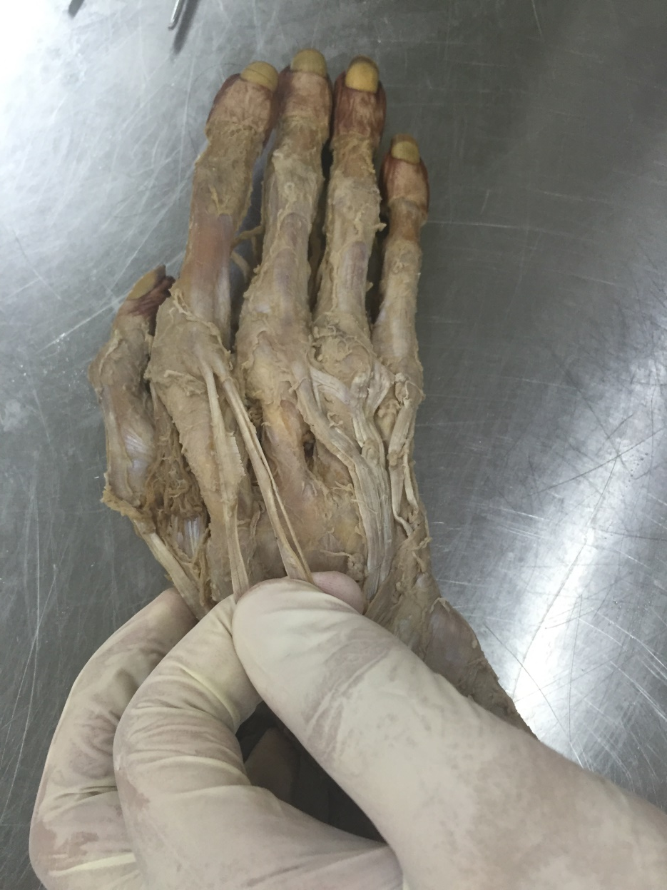
STATION – 1 (Gross Anatomy of The Hand)
Left: tendon to little finger coming from extensor digitorum. Right: extensor digiti minimi tendon
Left: extensor indicis tendon. Right: tendon to the index finger comming from extensor digitorum

Slide 19
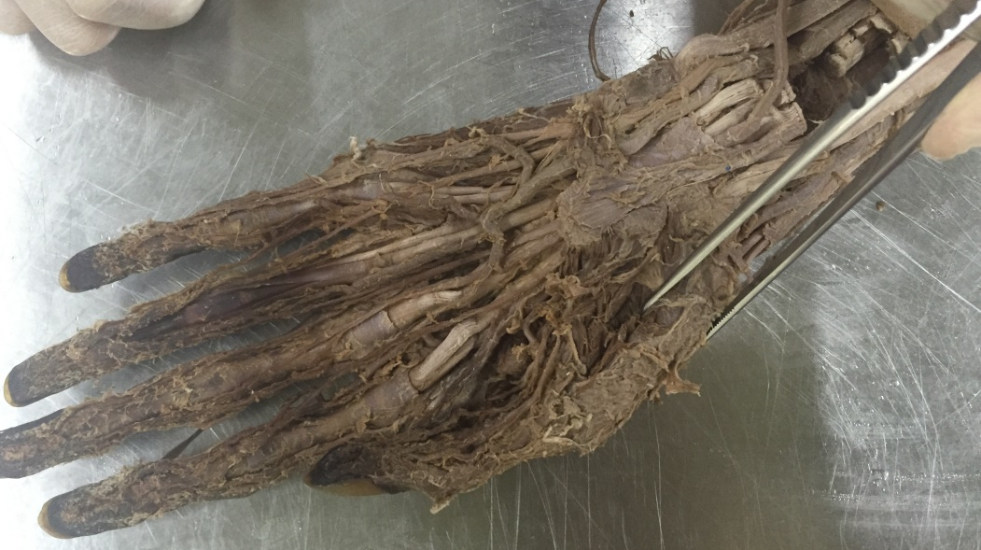
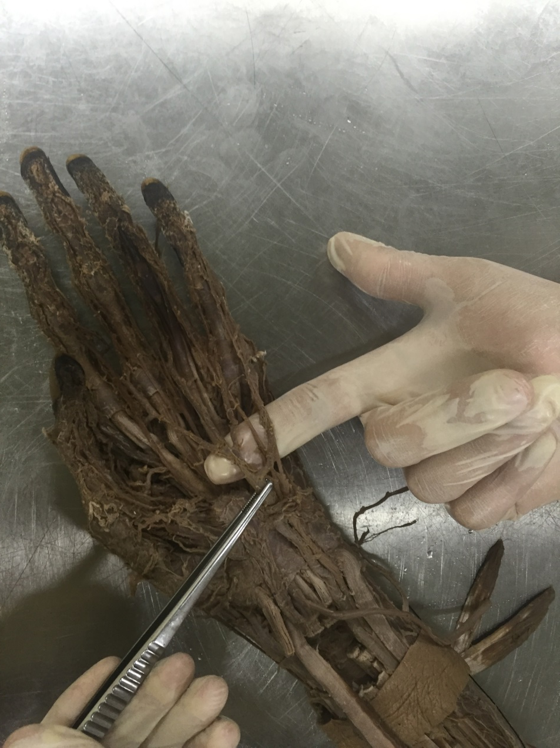
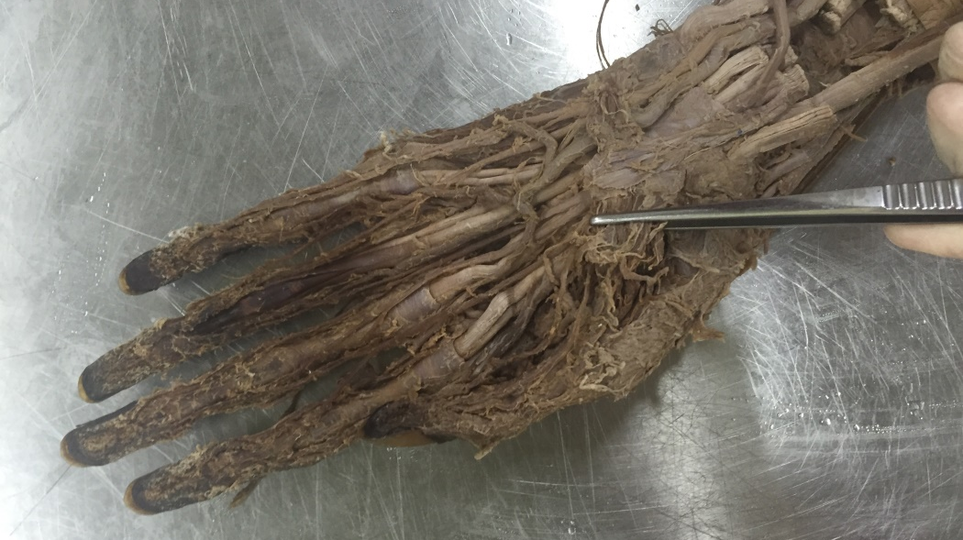
STATION – 1 (Gross Anatomy of The Hand)
Superficial palmar arch and its 3 common palmar digital arteries
Above: abductor pollicis brevis. Below: flexor pollicis brevis

Slide 20
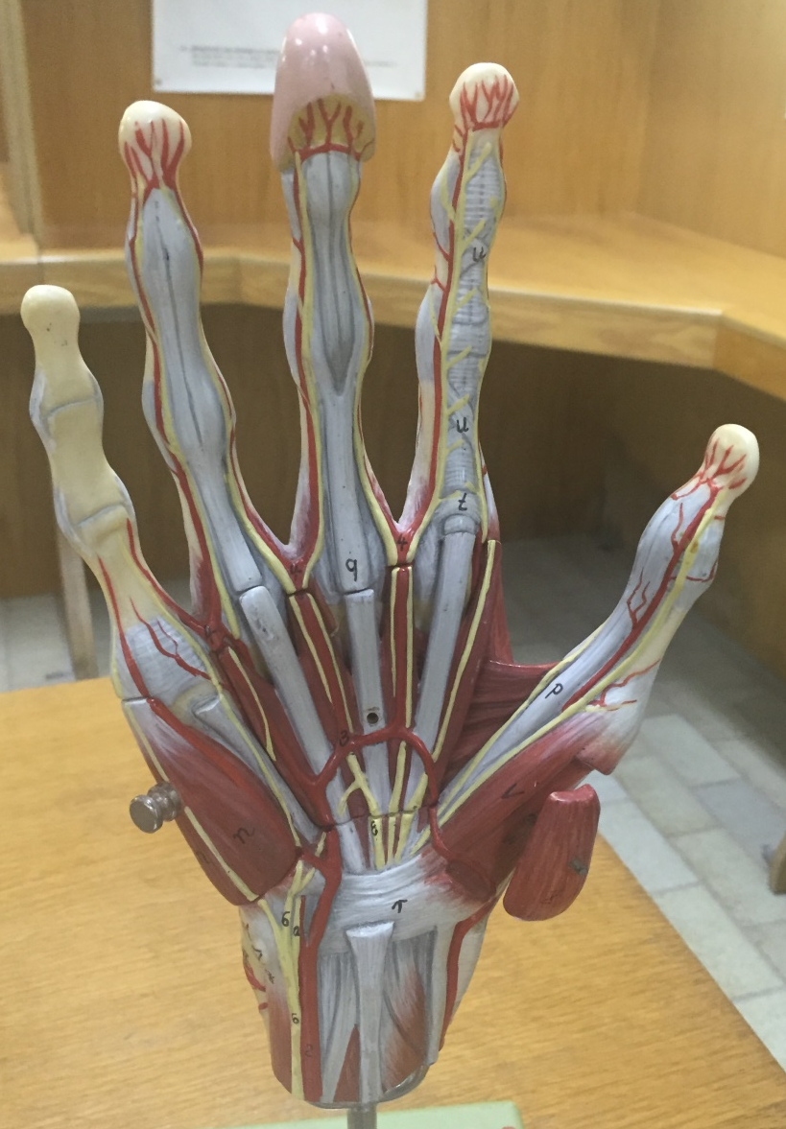
STATION – 1 (Gross Anatomy of The Hand)
1st lumbrical muscle
Adductor pollicis
Median nerve
Superficial palmar arch
Tendon of flexor pollicis longus (FPL)
Flexor digiti minimi
Flexor pollicis brevis
Abductor digiti minimi
Abductor pollicis brevis
Flexor retinaculum
Ulnar artery and ulnar nerve
Palmaris longus tendon
Radial artery
Opponens pollicis

Slide 21
STATION – 1 (Gross Anatomy of The Hand)
Intertendinous connection
Radial artery
Extensor retinaculum
Tendons of extensor digitorum

Slide 22
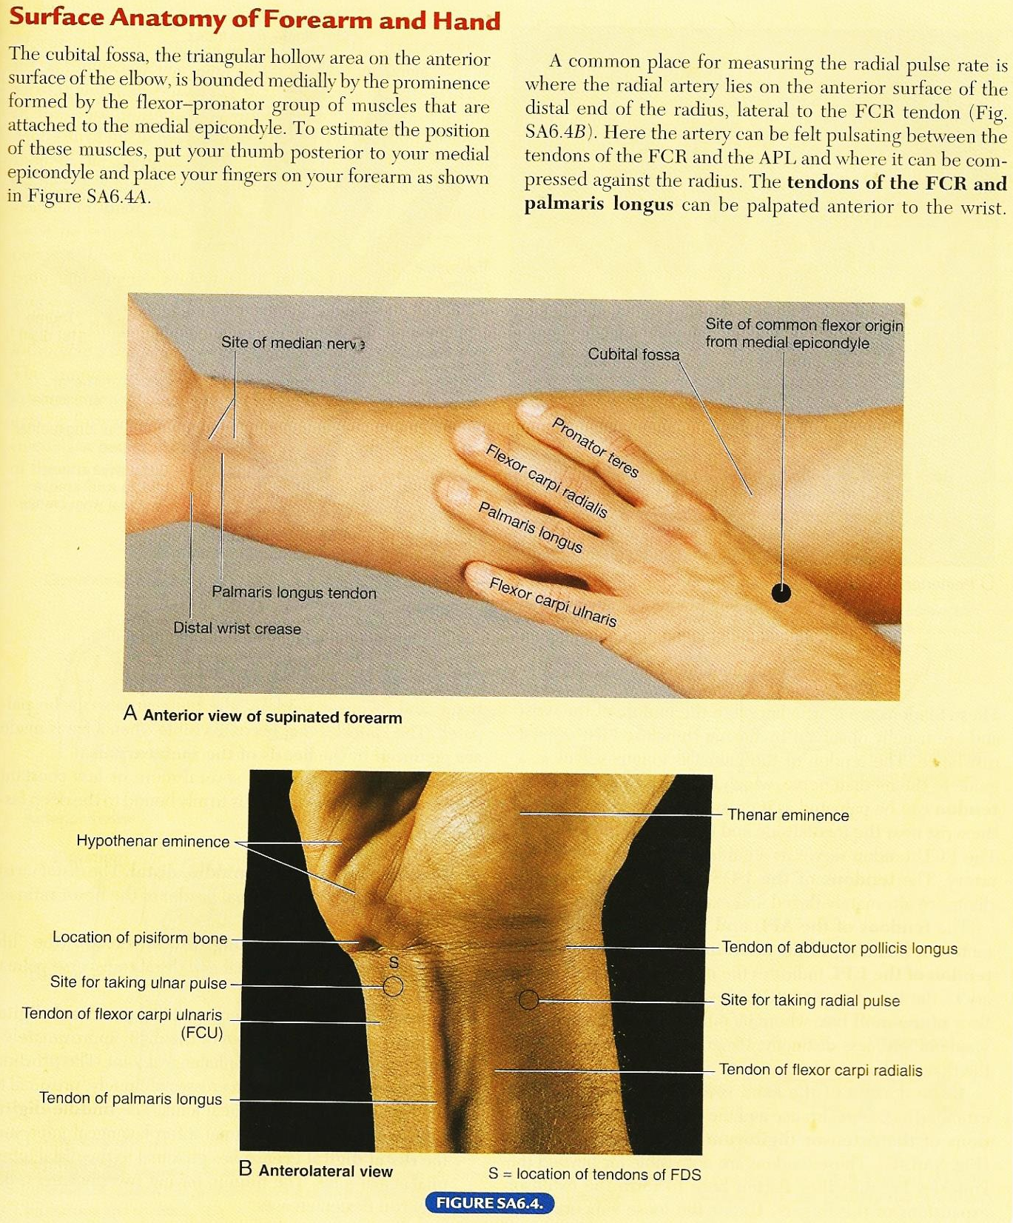
STATION – 2 (Surface Anatomy of Forearm and Hand)

Slide 23
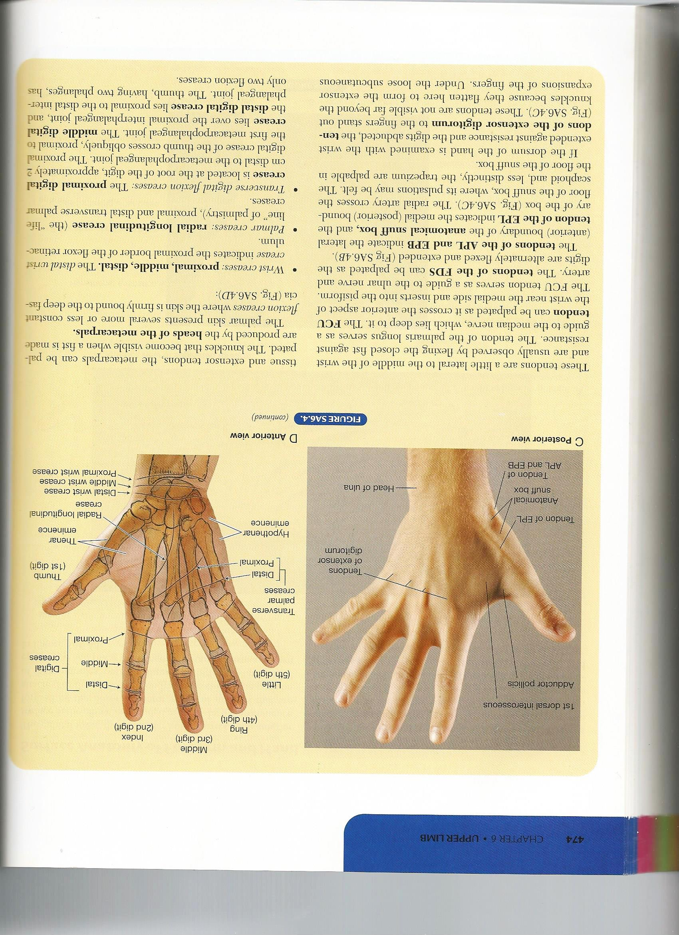
STATION – 2 (Surface Anatomy of Forearm and Hand)

Slide 24
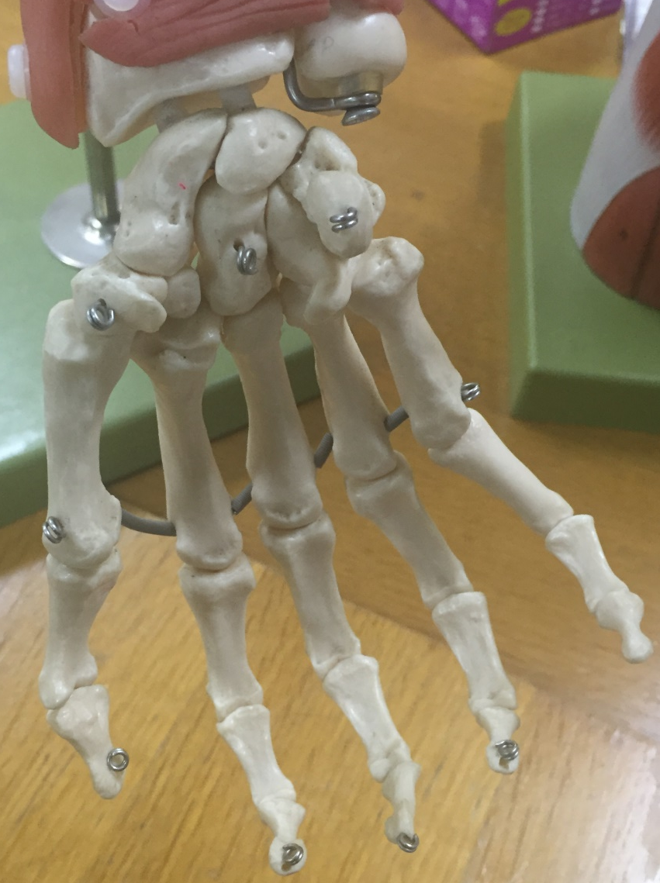
STATION – 2 (Bones of The Hand)
Scaphoid
Trapezoid
Lunate
Triquetrum
Trapezium
Pisiform
Carpal bones arranged in proximal and distal rows
Hamate
Metacarpals
Phalanges (proximal, middle, distal) except for the thumb (proximal, distal)
Capitate

Slide 25
STATION – 2 (Joints of The Hand)
Joint | Type | Movements
Wrist (radiocarpal) | Condyloid synovial joint | Flexion-extension, abduction-adduction, circumduction
Carpal (intercarpal) | Plane synovial joint | Small amount of gliding
Carpometacarpal | Plane synovial joints except for the thumb which is saddle type | Limited movement of digits except the thumb (flexion-extension, abduction-adduction, opposition)
Metacarpophalangeal | Condyloid synovial joints | Flexion-extension, abduction-adduction, circumduction of 2nd to 5th digits
Interphalangeal | Hinge synovial joints | Flexion-extension

Slide 26
STATION – 3 (Muscles of The Forearm)
Flexor-pronator muscles of forearm (anterior compartment of forearm):
Superficial layer of 4 muscles: pronator teres, flexor carpi radialis, palmaris longus and flexor carpi ulnaris. These muscles are all attached proximally to medial epicondyle of humerus.
Intermediate layer of 1 muscle: flexor digitorum superficialis.
Deep layer of 3 muscles: flexor digitorum profundus, flexor pollicis longus and pronator quadratus.
Notes:
The 5 superficial and intermediate muscles cross the elbow joint; the 3 deep muscles do not.
Brachioradialis is a flexor of the forearm, but it is located in the extensor (posterior) compartement and supplied by the radial nerve (instead of the median nerve for flexor compartment).
FDS flexes the middle phalanges while FDP flexes the distal phalanges.
Pronator quadratus is the prime mover for pronation assisted by the pronator teres.

Slide 27
STATION – 3 (Muscles of The Forearm)

Slide 28
STATION – 3 (Muscles of The Forearm)
Extensor-supinator muscles of forearm (posterior compartment of forearm):
All of these muscles are innervated by radial nerve.
The extensor tendons are held in place in the wrist region by the extensor retinaculum and they are covered with synovial sheath.
The extensor muscles are organized anatomically into:
4 superficial extensors: extensor carpi radialis brevis, extensor digitorum, extensor digiti minimi and extensor carpi ulnaris.
These muscles are attached proximally by a common extensor tendon to the lateral epicondyle.
The proximal attachment of the other 2 superficial extensors (brachioradialis & extensor carpi radialis longus) is to the lateral supra-epicondylar ridge of the humerus.
4 flat tendons of the extensor digitorum pass deep to the extensor retinaculum to the medial four fingers.
The extensor indicis tendon joins the tendons of extensor digitorum to pass deep to the extensor retinaculum through the tendinous sheath of extensor digitorum and extensor indicis (common extensor synovial sheath).
Adjacent tendon are linked proximal to the metacarpophalangeal joints by 3 oblique intertendinous connections that restrict independent extension of fingers.
5 deep extensors: supinator, abductor pollicis longus, extensor pollicis longus, extensor pollicis brevis and extensor indicis.
APL, EPB and EPL act on the thumb.
The tendons of the APL and EPB bound the triangular anatomical snuff box laterally and the tendon of the EPL bounds it medially. Radial artery lies on the floor of the snuff box. Scaphoid bone can also be felt.

Slide 29
STATION – 3 (Muscles of The Forearm)

Slide 30
STATION – 3 (Muscles of The Forearm)

Slide 31
STATION – 4 (Radiology)

Slide 32
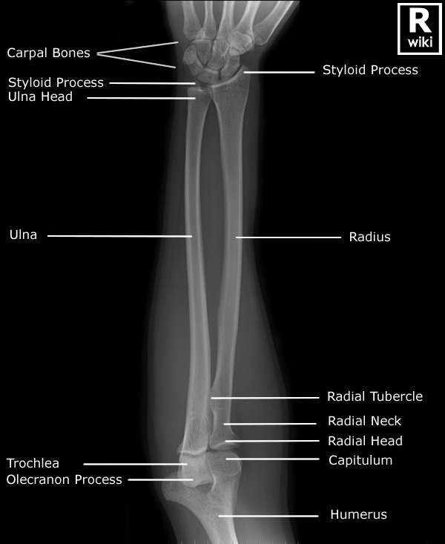
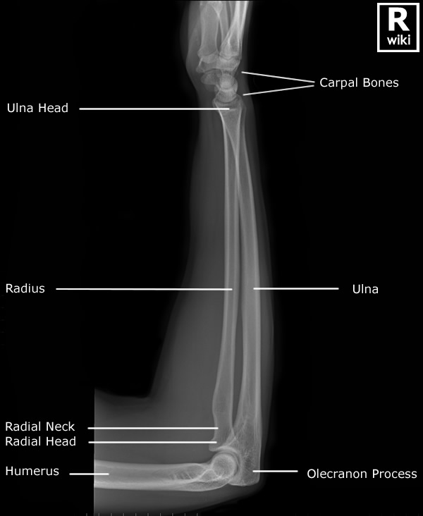
STATION – 4 (Radiology)

Slide 33
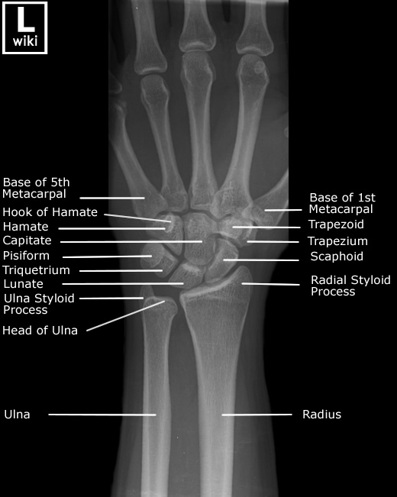
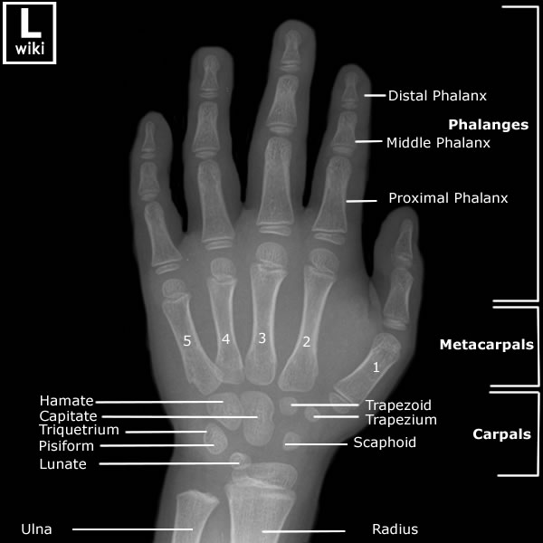
STATION – 4 (Radiology)
Adult Hand
Pediatric Hand

Slide 34
GOOD LUCK!

