Slide 1
DEMO – V (Meninges and CSF)
Ali Jassim Alhashli
Year IV – Unit VIII - CNS

Slide 2
STATION - 1
Dura matter is composed of two layers:
Periosteal layer.
Meningeal layer.
Notice that both of them are strongly attached to each other but they separate at the areas where dural venous sinuses are located.
Dural folds:
Falx cerebri: it is sickle-shaped and extending from crista galli to tentorium cerebelli (exactly terminating at the internal occipital protuberance).
Inferior border of falx cerebri is free.
Superior border is attached and contains the superior sagittal sinus which has arachenoid villi that drain cerebrospinal fluid (CSF).
Tentorium cerebelli: it is dividing the cavity of the skull into:
Supratentroial cavity.
Infratentorial cavity: which is containing pons, medulla and cerebellum (hindbrain).
Note: tentorium cerebelli extends to attach to posterior clenoid processes. In addition, this fold contains straight and transverse venous sinuses.

Slide 3
STATION - 1
Dural folds (continued):
Falx cerebelli: it is attached to the occipital crest and divides the two cerebellar hemispheres.
Sella diaphragmata: it is covering the pituitary gland and has a hole allowing the passage of pituitary stalk (infundibulum).
Venous sinuses:
Superior and inferior sagittal sinuses are located at the superior and inferior borders of falx cerebri respectively.
Straight sinus is found at the junction of falx cerebri with tentorium cerebelli.
Occipital sinus is located at the posterior border of falx cerbelli.
There are right and left transverse sinuses.
Cavernous sinus is present at both sides of sella turcica and it is receiving venous blood from sphenoparietal sinus and superior ophthalmic veins. Then, cavernous sinus will drain into superior and inferior petrosal sinuses which in turn will drain into transverse sinus and internal jugular vein respectively.
Sigmoid sinus: is S-shaped and drains blood from transverse sinus to internal jugular vein which is present in jugular foramen.

Slide 4
STATION - 1

Slide 5
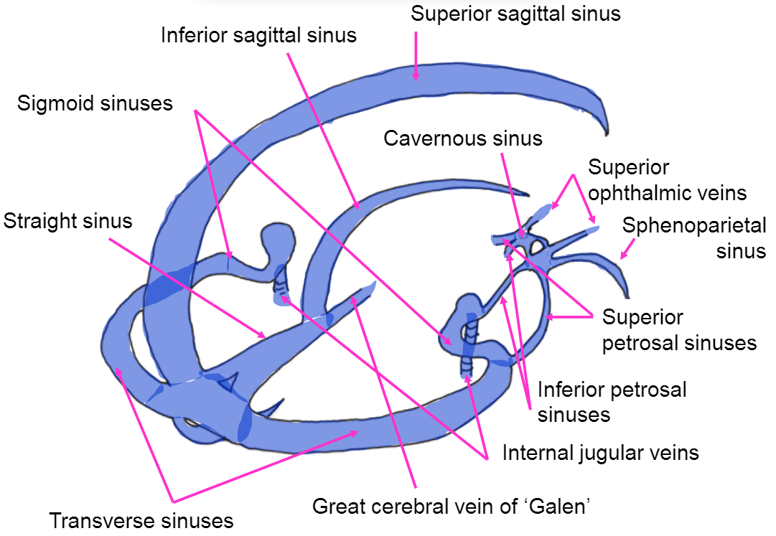
STATION - 1

Slide 6
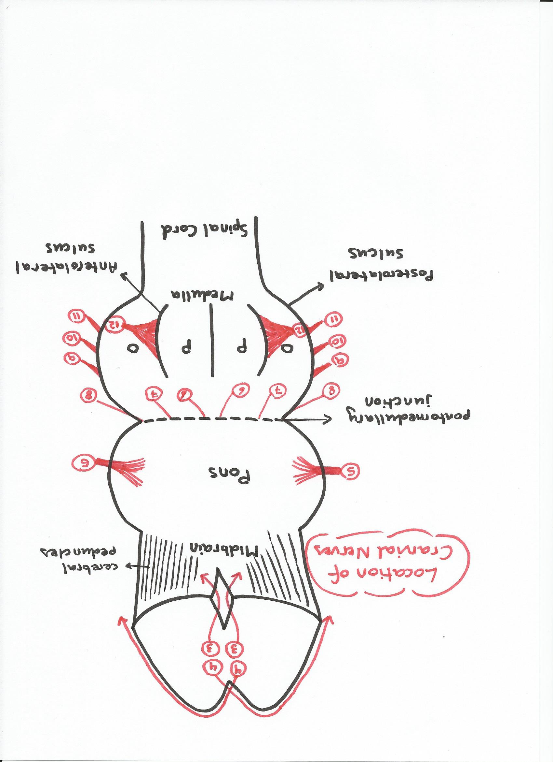
STATION - 2

Slide 7
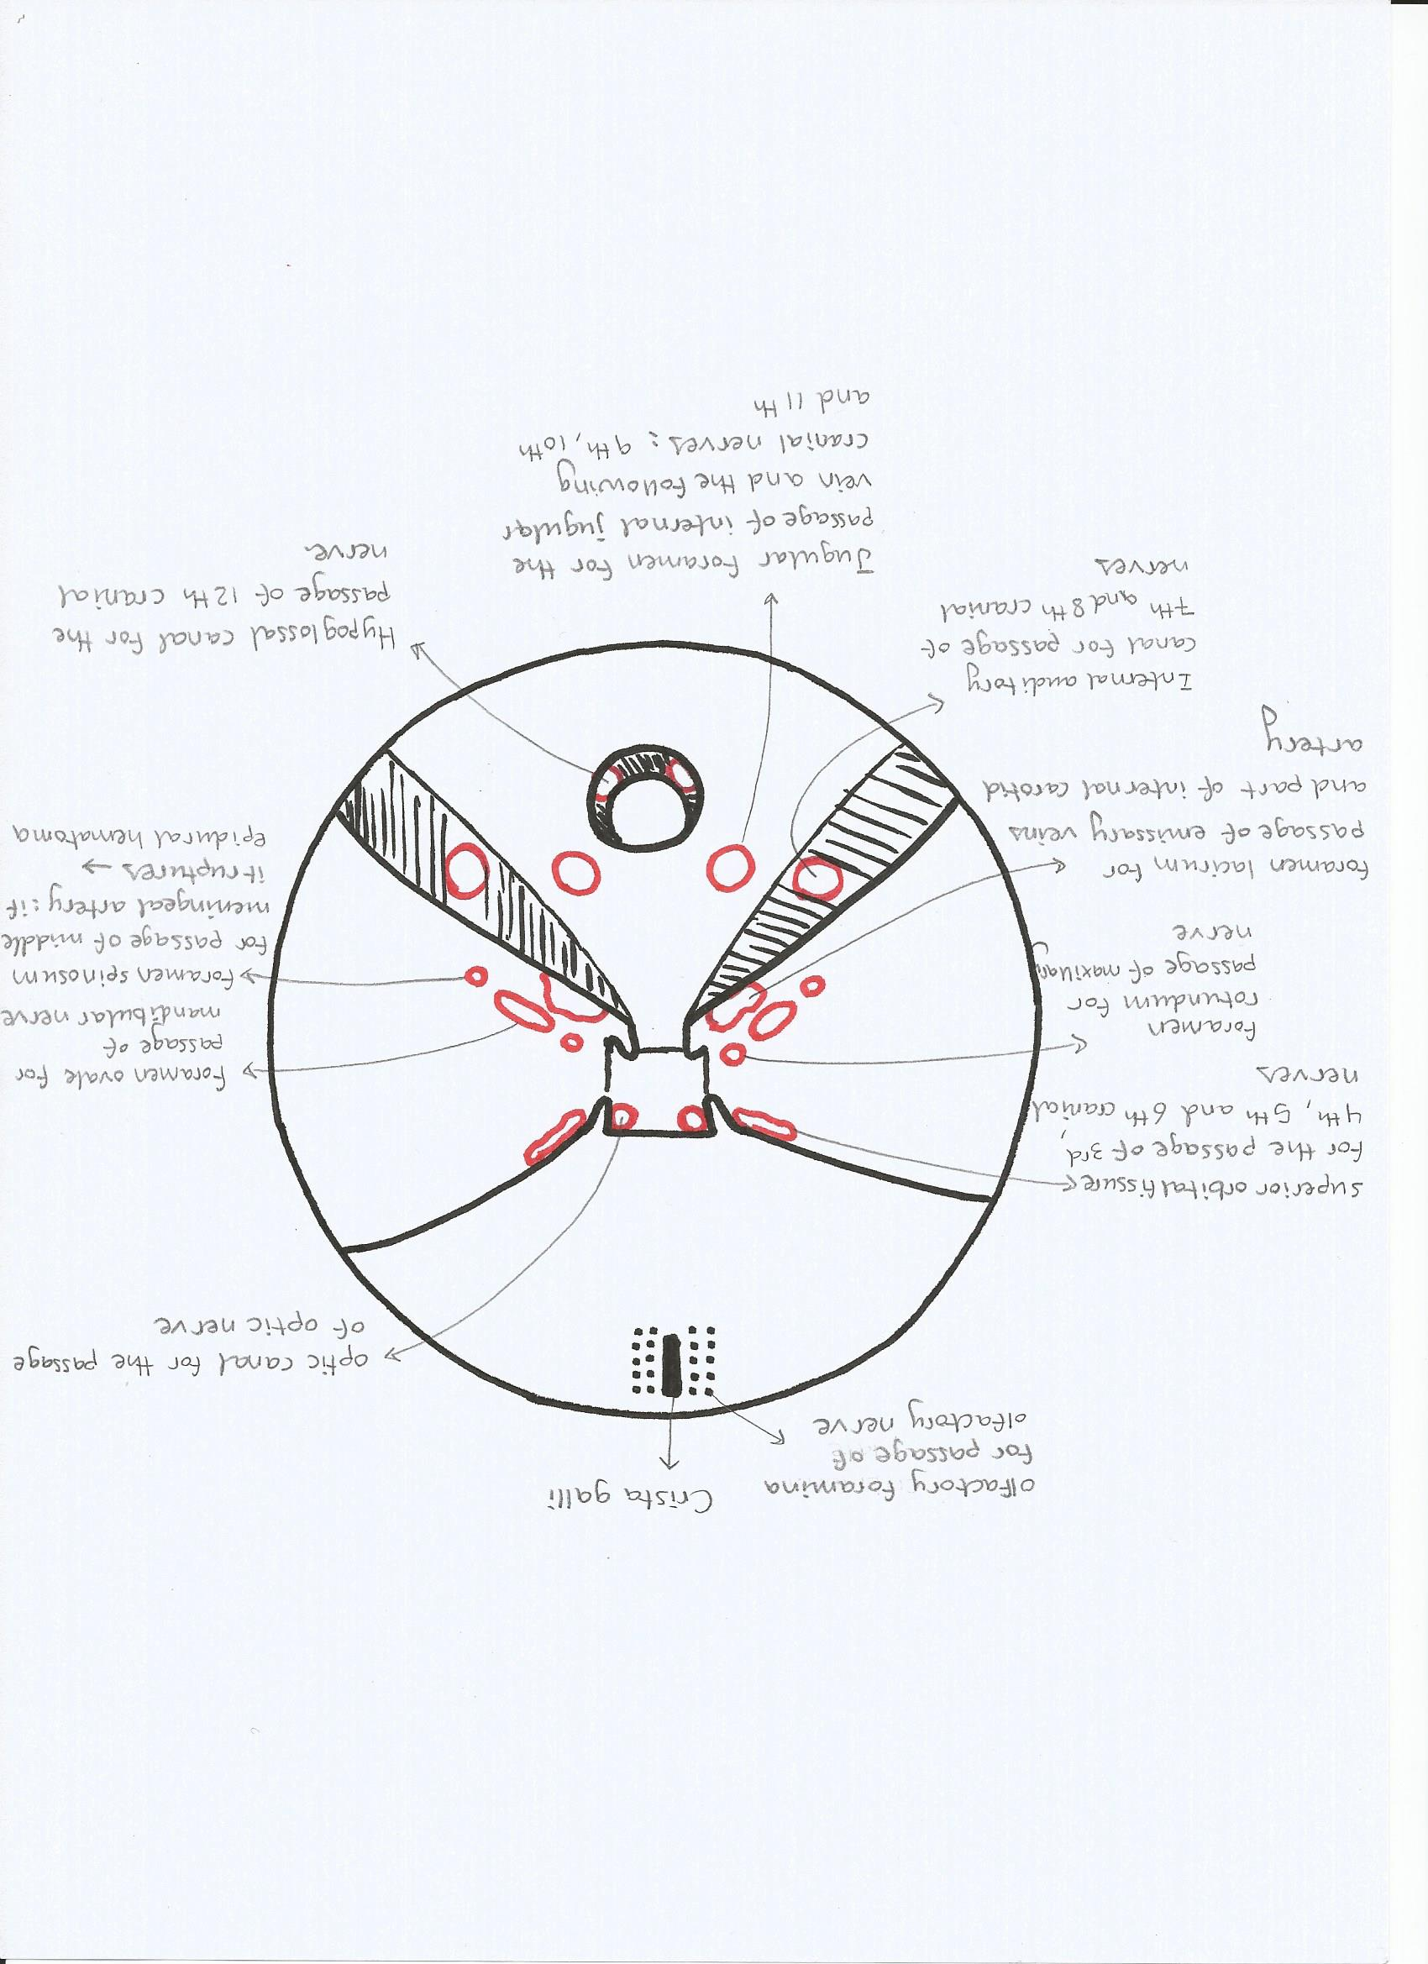
STATION - 2

Slide 8
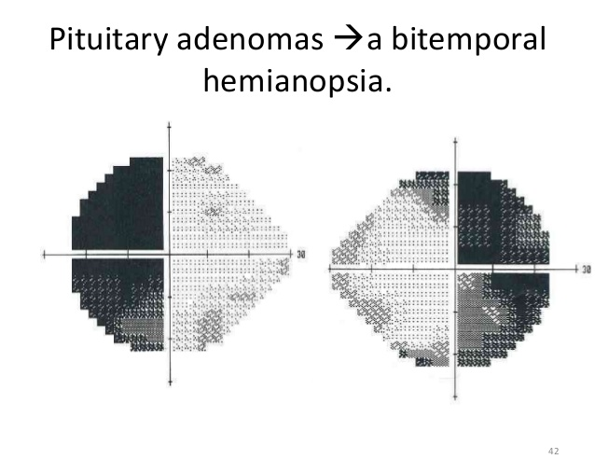
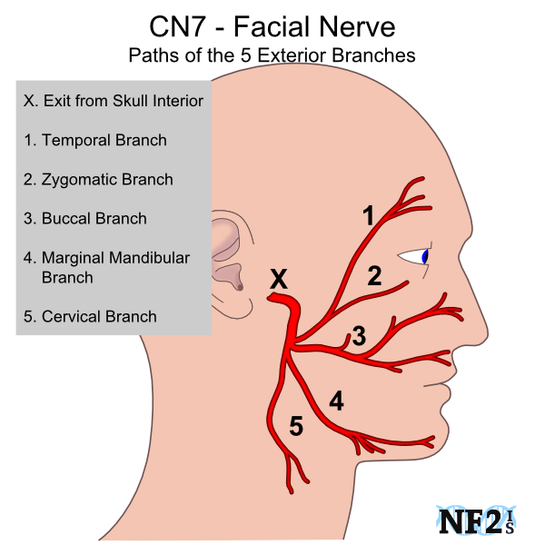
STATION - 2
Notice that the pituitary gland is in close relation to optic canal. If the pituitary gland enlarges (tumor: pituitary adenoma), it might compress the optic chiasma leading to a condition known as bitemporal hemianopsia.
Facial and vestibulocochlear nerves enter the internal auditory canal → then, they exit the cranial cavity through stylomastoid foramen. Afterthat, the facial nerve will divide into its 5 branches:
Temporal.
Zygomatic.
Buccal.
Marginal mandibular.
Cervical.

Slide 9
STATION - 3
Types of hydrocephalus:
Communicating: occurs when there is impaired CSF reabsorption in arachenoid villi or obstruction of CSF flow in subarachenoid space.
Non-communicating: occurs when there is obstruction of CSF flow in ventricles especially at narrow places such as (cerebral aqueduct).
Normal pressure: it is a form of communicating hydrocephalus in which CSF is not rabsorbed. The ventricles will be dilated and there will be thinning of the brain (death of brain cells) → resulting in the triad of :
Dementia.
Apraxic gait.
Urinary incontinence.
Note: this condition is treated by shunt with internal jugular vein or with abdominal peritoneum.
Hydrocephalus ex vacuo: when there is brain damage → the damaged area will be occupied by CSF which will lead to compression and act as if there is a tumor.
Absorption of CSF: this occurs through arachenoid villi which possess a one-way valve:
When CSF pressure is increased (more than pressure of venous blood), these valves will open allowing CSF to enter venous blood in superior sagittal sinus. If CSF pressure is low (lower than pressure of venous blood), venous blood will not be allowed to enter the subarachenoid space.

Slide 10
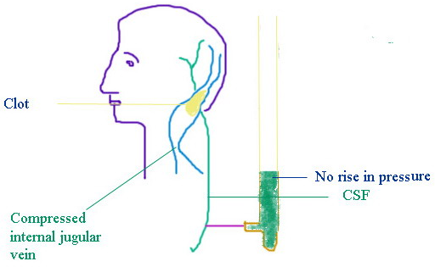
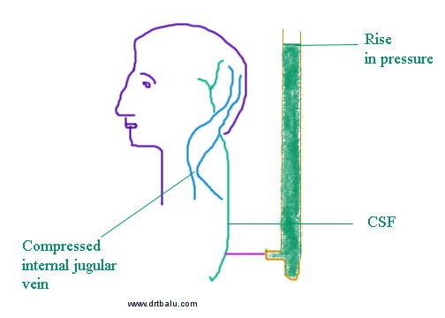
STATION - 3
Queckenstedt test: a test for spinal blockage of the subarachnoid space in which manual pressure is applied to the jugular vein to elevate venous pressure, which indicates the absence of a block when there is a simultaneous increase in cerebrospinal fluid pressure, and which indicates the presence of a block when cerebrospinal fluid pressure remains the same or almost the same (called also Queckenstedt sign)

Slide 11
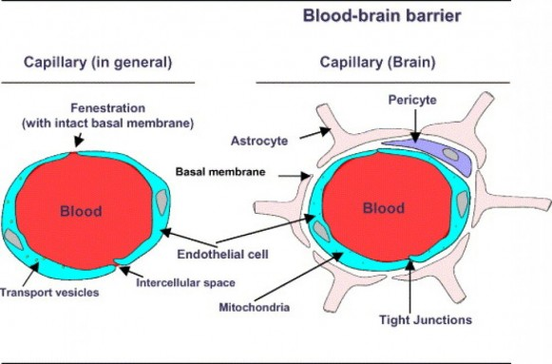
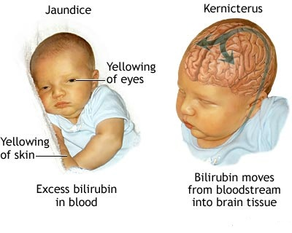
STATION - 3
Blood-brain barrier (BBB): it is composed of:
Capillary endothelial cells with tight junctions.
Basement membrane.
Astrocytes.
There are some areas in the brain which are deficient in blood-brain barrier (BBB):
Area postrema: it is the center which is responsible for nausea and vomiting and is present at the junction where 4th ventricle meets the central canal.
Pineal gland: which is secreting melatonin that regulates circadian rhythm.
Posterior pituitary gland.
Hypothalamus.
Note: in newborns, blood-brain barrier is still not completely developed and this explains why kernicterus can occur in them.

Slide 12
STATION – 3 (Comparison of CSF composition in different conditions)
Characteristics | Normal | Pyogenic meningitis | Tuberculous meningitis | Viral meningitis
Color | Clear | Yellow/ turbid (due to presence of pus) | Turbid ± fibrin web | Clear
Cells | Neutrophils are not present but there are few lymphocytes (>5/ml3) | +++ neutrophils / + lymphocytes | + neutrophils/ +++ lymphocytes | + neutrophils/ +++ lymphocytes
Glucose level | 66% or 2/3 of plasma glucose concentration | Decreased (>50% of plasma glucose concentration) | Decreased (>50% of plasma glucose concentration) | <50% of plasma glucose concentration
proteins | 0.4 gm/L (very low compared to plasma protein level) | Moderate-severe increase (++) | Severe increase (+++) | Mild increase (+)

Slide 13
STATION – 4 (Clinical Case)
Innervation of dura matter:
Dura matter which is present in anterior and middle cranial fossae is innervated by: ophthalmic and maxillary divisions of trigeminal nerve (5th cranial nerve).
Dura matter which is present in posterior cranial fossa is innervated by: vagus nerve + C1,C2,C3
Notice that recurrent laryngeal nerve is not part or branch of the vagus nerve. It is originating from nucleus ambiguus and traveling along with vagus nerve then separating from it in the neck.
Neck stiffness: it is a reflex. The dura will be inflammed and as you stretch it more → this will cause more pain → which in turn will result in a shortcut (monosynaptic) pathway to the ventral horn cells in the spinal cord → resulting in contraction of the muscles (maintained spasm).
One of the most serious adverse effects of injecting a lipid-soluble drug in epidural space is severe hypotension (due to blockage of the sympathetic chain).

Slide 14
GOOD LUCK! (Wish You All The Best)

