Slide 1
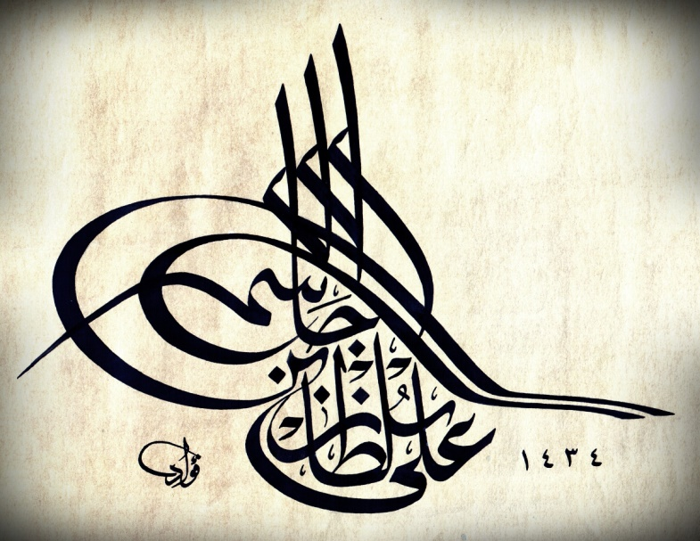
DEMO-IV (Cerebellum and Basal Nuclei)
Ali Jassim Alhashli
Year IV – Unit VIII - CNS

Slide 2
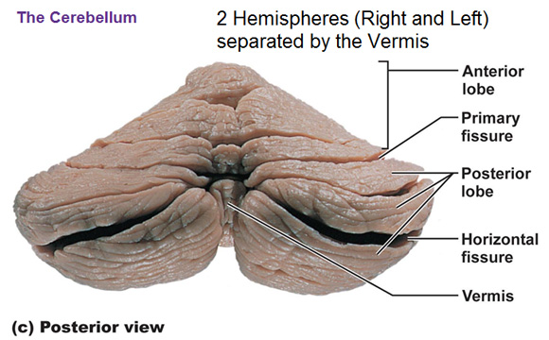
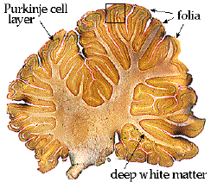
STATION – 1 (Cerebellum)
Gross features of the cerebellum:
The white matter looks like a tree.
The superior surface of the cerebellum is concave.
The inferior surface of the cerebellum is convex.
The cerebellum is separated into two hemispheres which are not clearly demarcated from each other when compared with cerebral hemispheres.
The vermis is located between the two cerebellar hemispheres and it is divided into 2 parts (superior and inferior) depending on in which surface it is.
The small gyri on the surface of the cerebellum are known as (folia). These projections on the cerebellum are equal to each other compared with those of the cerebrum in which some gyri may be projecting more than others.

Slide 3
STATION – 1 (Cerebellum)
Gross features of the cerebellum:
The anterior surface of the cerebellum has a large depression.
The cerebellum is connected to the brainstem (which is located anterior to it) through 3 cerebellar peduncles. These are:
Superior cerebellar peduncle: connecting the cerebellum to the midbrain. Dentato-rubro-thalamic tract and ventral spino-cerebellar tract are passing through this peduncle.
Middle cerebellar peduncle: connecting the cerebellum to the pons. Ponto-cerebellar fibers (coming from the cortex) are passing through this peduncle.
Inferior cerebellar peduncle: connecting the cerebellum to the medulla. All fibers (other than those which were mentioned above) are passing through this peduncle.
Notice that cerebellar tonsils are close to foramen magnum (which is located in the posterior cranial fossa). If there is a space-occupying lesion in infratentorial space (such as a tumor) → this might cause the tonsils to herniate and thus compressing on the medulla leading to complications such as respiratory depression (due to compression on respiratory center) or bulbopalsy.
The floculus is connected to the vermis to form the fluculonodular lobe (which is representing the connection of the cerebellum with vestibular nuclei that is concerned with balance of the body).

Slide 4
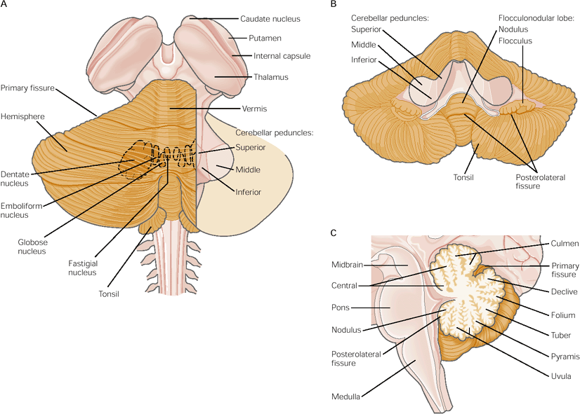
STATION – 1 (Cerebellum)

Slide 5
STATION – 1 (Cerebellum)
Arterial supply of the cerebellum:
Posterior Inferior Cerebellar Artery (PICA): which is a branch from vertebral artery.
Anterior Inferior Cerebellar Artery (AICA): which is a branch from basilar artery (that is passing in the basilar groove of pons).
Superior cerebellar artery: which is also a branch from basilar artery.

Slide 6
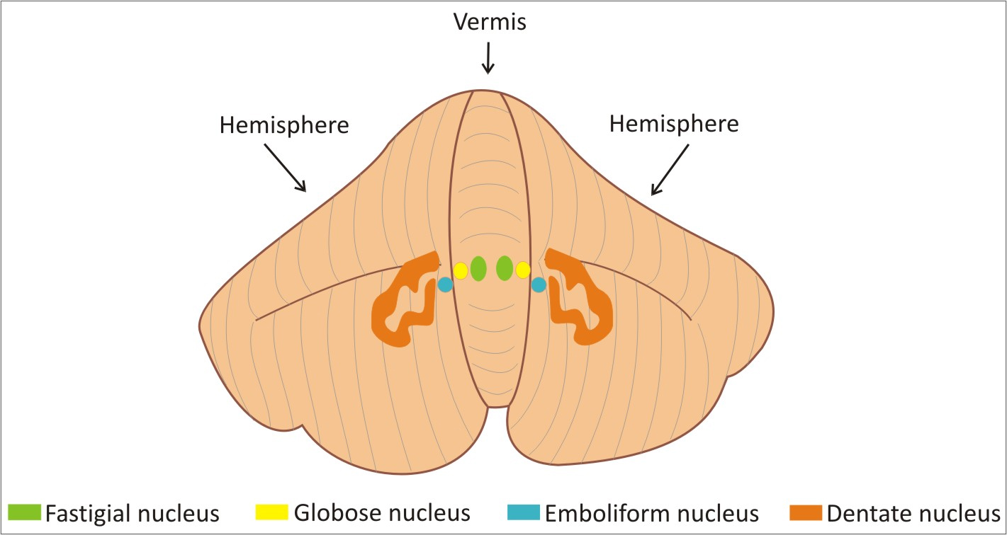
STATION – 1 (Cerebellum)
The internal structure of the cerebellum is mostly histological:
The cerebellum has 3 deep cerebellar nuclei:
Dentate nucleus: is concerned with cerebro-cerebellum.
Fastigial nucleus: is concerned with vestibulo-cerebellum.
Interposed nucleus (composed of globose nucleus + emboliform nucleus): is concerned with spino-cerebellum.

Slide 7
STATION – 1 (Cerebellum)
Afferents of cerebellum:
All fibers entering the cerebellum are classified into the following 2 fibers:
Climbing fibers: which are projecting from inferior olivary nucleus and terminating in the outer layer of cerebellar cortex. Notice that these fibers are excitatory (releasing aspartate).
Climbing fibers will stimulate the deep nuclei directly.
They will also inhibit the deep nuclei indirectly (through stimulation of purkinje cells which are GABAergic).
All other afferent fibers are known as Mossy fibers. Notice that these fibers are excitatory (releasing glutamate). Mossy fibers will terminate in granular cells and then axons from these cells will project toward cerebellar cortex, bifurcating, and each Mossy fiber will make connections with many purkinje cells (in contrast to climbing fibers in which each climbing fiber is making connection with 1 purkinje cell).

Slide 8
STATION – 1 (Cerebellum)

Slide 9
STATION – 1 (Cerebellum)
Efferents of cerebellum:
Vestibulocerebellum:
Fibers reaching vestibular nucleus and then descending forming the vestibulospinal tract which is concerned in stimulation of anti-gravity muscles (extensors) → balance.
Fibers reaching vestibular nucleus and then ascending as the medial longitudinal fasciculus which is representing the internal connection between 3rd, 4th and 6th cranial nerves → movement of eyes with movement of head.
Spinocerebellum:
From interposed nucleus of cerebellum to the red nucleus (in the midbrain) and then descending as the rubrospinal tract.
From interposed nucleus of cerebellum to red nucleus and then to thalamus (forming the cerebello-rubro-thalamic pathway) which is functioning in modification and correction of movement.
Cerebrocerebellum:
From dentate nucleus of cerebellum to red nucleus and then to the thalamus (forming dento-rubro-thalamic pathway).

Slide 10
STATION – 2 (Basal Nuclei)
Basal nuclei: they are a collection of cell bodies (which are surrounded by white matter) inside the central nervous system. These nuclei are located at the base of cerebral hemispheres.
Classification of basal nuclei:
Traditional classification: in which the basal nuclei are formed by:
Lentiform nucleus: putamen + globus pallidus.
Caudate nucleus.
Clostrum.
Clinical classification: in which the basal nuclei are formed by:
Lentriform nucleus: putamen + globus pallidus.
Caudate nucleus.
Subthalamus.
Substantia nigra.

Slide 11
STATION – 2 (Basal Nuclei)
Arrangement of basal nuclei from medial aspect to the lateral aspect:
Caudate nucleus.
Internal capsule.
Lentiform nucleus: with globus pallidus medially and putamen laterally.
External capsule.
Clostrum.
Extreme capsule.

Slide 12
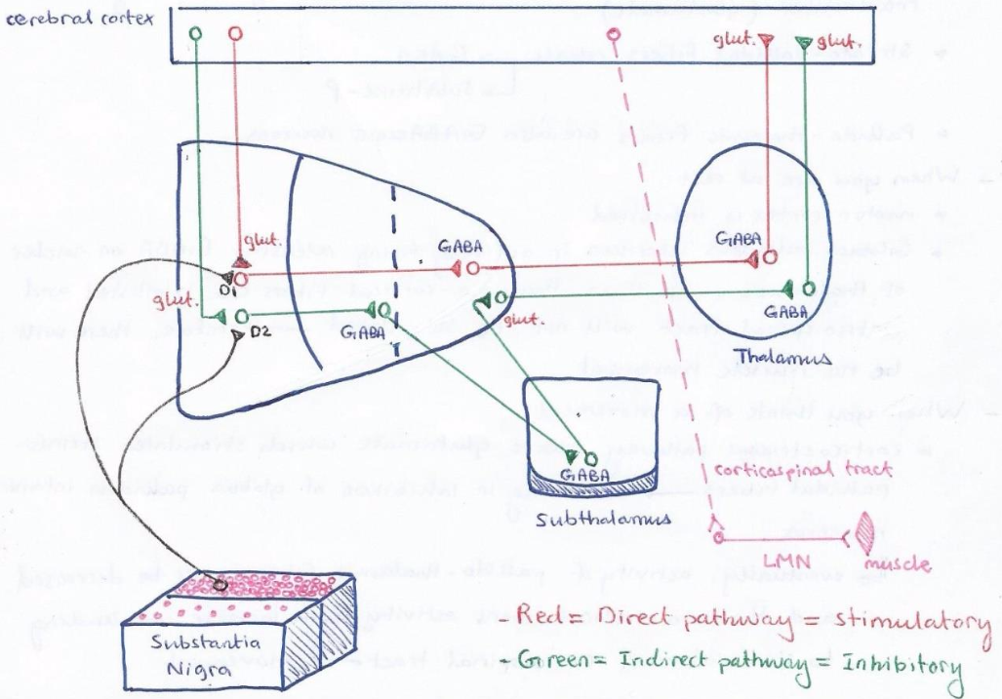
STATION – 2 (Basal Nuclei)

Slide 13
STATION – 2 (Basal Nuclei)
Direct pathway (refer to the diagram in the previous slide):
When you want to initiate movement (this pathway is stimulatory):
Cortico-striatal fibers release glutamate which stimulates striato-pallidal fibers. Therefore, this will result in inhibition of globus pallidus internus. Because of this, the activity of pallido-thalamic fibers will be decreased resulting in increased activity of thalamo-cortical fibers → stimulation of corticospinal tract and movement.
Indirect pathway (refer to the diagram in the previous slide):
When you want to initiate movement (this pathway is inhibitory):
Cortico-striatal fibers will release glutamate and stimulate those fibers going to globus pallidus externus. These in turn will release GABA inhibiting those fibers going to subthalamus. Therefore, subthalamo-pallidal fibers will have increased activity resulting in stimulation of fibers going from globus pallidus internus to thalamic nuclei which will cause them to release GABA → this will inhibit thalamo-cortical fibers (inhibition of movement).

Slide 14
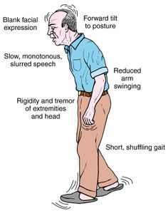
STATION – 2 (Basal Nuclei)
Role of substantia nigra (nigro-striatal fibers):
Dopaminergic fibers will originate from pars compacta and influence both direct and indirect pathways.
When dopamine is released on:
D1-receptors → it results in stimulation of neurons of direct pathway.
D2-receptors → it result in inhibition of neurons of indirect pathway.
Notice that eventually both of these actions will result in enhancement of movement.
Degeneration of nigrostriatal fibers will result in hypokinetic disorders one of which is Parkinson’s disease which is characterized by:
Rigidity (cog-wheel).
Shuffling gait.
Tremors at rest.
Reduced facial expressions.

Slide 15
STATION – 2 (Basal Nuclei)

Slide 16
STATION – 2 (Basal Nuclei)

Slide 17
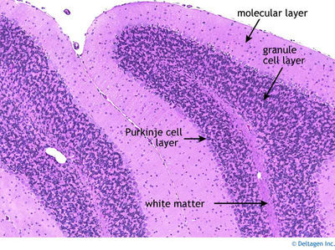
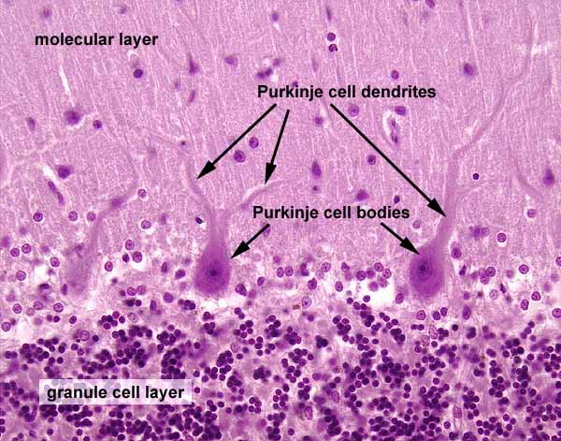
STATION – 3 (Histology of Cerebellum)
Summary of cerebellar cortex:
Deep folds in the cortex called cerebellar folia separated by sulci. Notice that the surface of cerebellum is covered by pia matter.
Outer molecular layer contains small neurons and fibers.
Middle purkinje layer contains large purkinje cells whose dendrites branch in molecular layer.
Granule cell layer contains small granular cells, Golgi type-II cells and empty spaces called glomeruli.

Slide 18
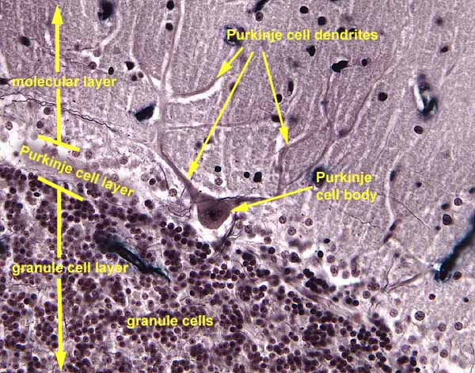
STATION – 3 (Histology of Cerebellum)

Slide 19
STATION – 3 (Histology of Cerebellum)

Slide 20
STATION-4 (Case Discussion) Similar stations will not be included in my DEMO notes because they are useless ☺

Slide 21
GOOD LUCK! Wish You All The Best ☺

