Slide 1
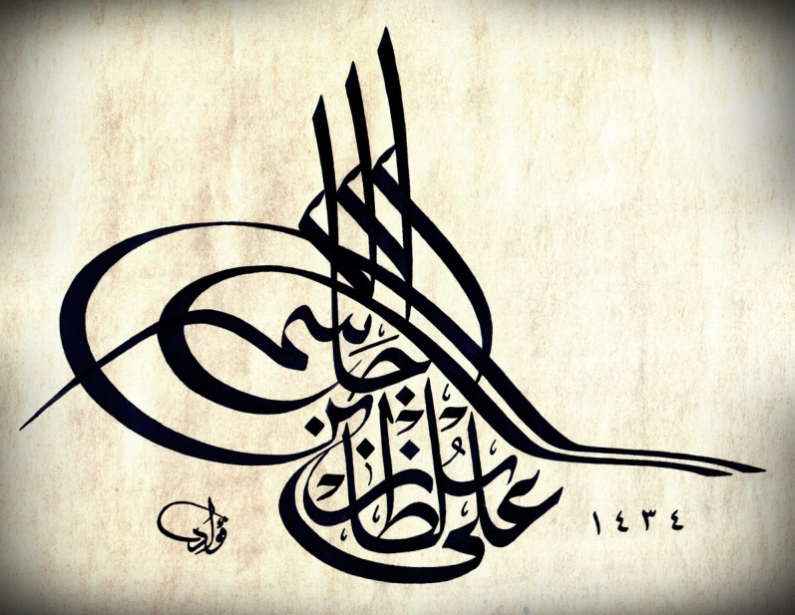
DEMO-II (Brainstem: Medulla, Pons & Midbrain)
Ali Jassim Alhashli
Year IV – Unit VIII - CNS

Slide 2
STATION – 1 (Medulla Oblongata)
The brainstem is composed of:
Midbrain.
Pons.
Medulla.
Anterior surface of medulla:
You will find the anterior median fissure which continues down in the spinal cord.
There are 2 elevations on each side of this fissure:
P: Pyramids (formed by the passage of corticospinal tract).
O: Olives (formed by the presence of the big inferior olivary nuclei).
Medulla has 2 sulci:
Antero-lateral sulcus: from which 12th cranial nerve (hypoglossal nerve) is emerging.
Postero-lateral sulcus: from which 3 cranial nerves originate (9th “glossopharyngeal”, 10th “vagus” and 11th “accessory”)
There is a junction called ponto-medullary junction separating between pons and medulla → 6th (abducens), 7th (facial) and 8th (vestibulocochlear) cranial nerves are originating from this junction.
5th cranial nerve (trigeminal) is originating from antero-lateral surface of pons.
3rd (oculomotor) and 4th (trochlear) cranial nerves are originating in the midbrain at the level of superior and inferior colliculi respectively.
Note: nervous terminalis is “cranial nerve zero” → concerned with sexual function.
1st (olfactory) and 2nd (optic) cranial nerves are originating from the cerebrum not brainstem.

Slide 3
STATION – 1 (Medulla Oblongata)
Motor decussation:
The croticospinal tract originates from neurons in the cortex → descending to pass in the posterior limb of internal capsule → then passing in crus cerebri of midbrain to reach pons → where it will get dispersed by pontine nuclei and will send some fibers to the cerebellum through middle cerebellar peduncle → then rest of fibers will continue and descend through pyramids of medulla and (90%) decussate in the lower end of it → reaching lower motor neurons in the ventral horn of the spinal cord.

Slide 4
STATION – 1 (Medulla Oblongata)
Sensory decussation (Dorsal column – medial lemniscus pathway):
1st order neurons: sensory fibers will enter the spinal cord through the dorsal horn and ascend from the dorsal column (without synapsing) as fasciculus gracilis (from lower limbs) and fasciculus cuneatus (from upper limbs) to terminate in nucleus gracilis and nucleus cuneatus in the medulla.
2nd order neurons: will originate from n.gracilis and n.cuneatus in the medulla → cross as internal arcuate fibers and ascend to terminate in the VPL nucleus of thalamus.
3rd order neurons: from VPL nucleus of thalamus to post-central gyrus of cerebral cortex (sensory cortex).

Slide 5
STATION – 1 (Medulla Oblongata)
Occlusion of anterior spinal artery leads to medial medullary syndrome. In this syndrome:
There will be hemiplagia and sensory loss of dorsal column at the contralateral side of the body (opposite to the site of lesion in the brainstem).
Occlusion of PICA (Posterior Inferior Cerebellar Artery) leads to lateral medullary syndrome. In this syndrome:
There is loss of spinothalamic sensations.
Lesion in the sympathetic chain.
May affect peduncles resulting in ataxia.
Posterior aspect of medulla:
There is an open part forming the caudal 1/3 of the floor of 4th ventricle (the rostral 2/3 of the floor of 4th ventricle is formed by pons).
F.gracilis and F.cuneutus can be seen in the caudal part of medulla.
Considered as the house of important centers:
Respiratory center → if it is blocked, this will result in death.
Cardiac center.
Vasomotor center.

Slide 6
STATION – 1 (Medulla Oblongata)
Midbrain
Pons
Postero-lateral sulcus
Medulla
Inferior cerebellar peduncle
Spinal cord
Antero-lateral sulcus
Anterior median fissure

Slide 7
STATION – 1 (Medulla Oblongata)

Slide 8
STATION – 2 (Pons)
There are 3 connections (3 peduncles) between the brainstem and the cerebellum:
Superior cerebellar peduncle: connecting the cerebellum with midbrain. This peduncle contains efferents.
Middle cerebellar peduncle: connecting the cerebellum with pons. This peduncle contain afferents (especially cortico-ponto-cerebellar fibers).
Inferior cerebellar peduncle: connecting the cerebellum with medulla oblongata. This peduncle contains both afferents and efferents.

Slide 9
STATION – 2 (Pons)

Slide 10
STATION – 2 (Pons)
Sensations coming from the face will be transmitted to the trigeminal ganglion (in the middle cranial fossa) → and then sensory fibers from trigeminal ganglion will transmit these information to 3 nuclei:
Mesencephalic nucleus: unconscious proprioception.
Principle nucleus: fine touch.
Spinal nucleus: pain and temperature.

Slide 11
STATION – 2 (Pons)
Functions of 7th cranial nerve (facial nerve):
Sensory: taste from anterior 2/3 of the tongue.
Motor: muscles of facial expression.
Parasympathetic: salivation and lacrimation.
Facial nerve palsy:
If a patient is presented with a lesion which caused paralysis of half of the face → this is a LMN lesion at the same paralyzed side of the face (in the facial nucleus at the lateral part of pons).
If a patient is presented with a lesion in corticobulbar tract → there will be no paralysis of upper part of the face (because it is compensated by the other intact corticobulbar tract) but the lower part of the face will be paralyzed contralaterally (at the opposite side of the lesion).
Taste sensation:
7th CN: anterior 2/3 of the tongue.
9th CN: posterior 1/3 of the tongue.
10th CN: posterior most aspect of the tongue.
Note: sensation from all of these fibers will go to nucleus solitarius.

Slide 12
STATION – 3 (Midbrain)
Midbrain: it is located between thalamus and pons (2 cm in height).
The posterior surface of midbrain has 4 colliculi:
2 superior colliculi: concerned with vision (lateral geniculate attached to superior colliculi).
2 inferior colliculi: concerned with hearing (medial geniculate attached to inferior colliculi).
Note: just below the level of inferior colliculi you will find the decussation of the 4th cranial nerve (trochlear nerve).
The anterior surface of midbrain has crus cerebri which are carrying fibers coming from the posterior limb of internal capsule and going to brainstem and spinal cord (pyramidal tract: corticonuclear and corticospinal fibers). Between the 2 crus cerebri is the interpeduncular fossa.

Slide 13
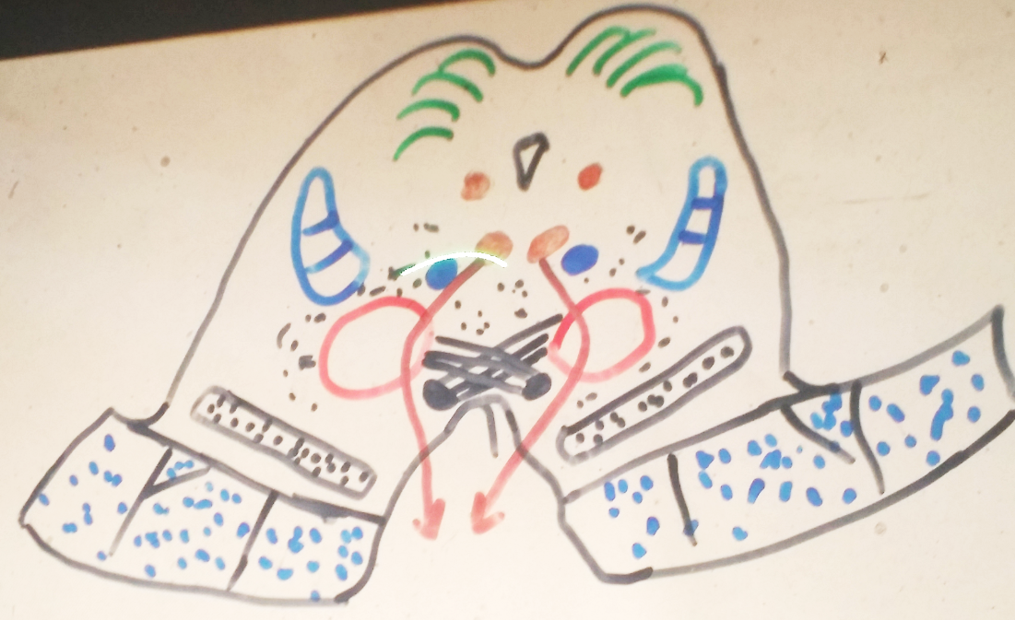
STATION – 3 (Midbrain) (section at the level of superior colliculi)
Cerebral aqueduct
Superior colliculi
Trigeminal nucleus
Trigeminal lemniscus
Medial longitudinal fasciculus
Spinal lemniscus
Red nucleus
Medial lemniscus
Substantia nigra
Temporopontine fibers
Corticobulbar & corticospinal fibers
Frontopontine fibers
Oculomotor nerve

Slide 14
STATION – 3 (Midbrain) (section at the level of inferior colliculi)
Trochlear nerve
Inferior colliculus
Lateral lemniscus
Superior cerebellar peduncle

Slide 15
STATION – 4 (Skull)
The frontal bone of the skull is contributing in:
Vertex.
Orbits.
Face.
Coronal suture: it is between frontal and parietal bones.
Sagittal suture: it is between the 2 halves of parietal bone.
Lambdoid suture: between parietal bones and the occipital bone.
Lambda: it is the point where sagittal and lambdoid sutures meet.
Bergma: it is the point where sagittal and coronal sutures meet.
Nasion: it is the intersection between the frontal bone and the 2 nasal bones.
Pterion: it is the point where frontal, parietal, temporal and greater wing of sphenoid bone meet together.

Slide 16
STATION – 4 (Skull)
Mastoid process: it is part of the temporal bone and medial to it you will find the styloid process. Stylomastoid foramen is located between these two processes (it is the foramen from which facial nerve is going to exit the cranium). External auditory meatus is lateral to these two processes.
Zygomatic and temporal bones articulate with each other (zygomatic process of temporal bone with temporal process of zygomatic bone). Notice that zygomatic bone is forming the cheeks.
Mandibular bone is composed of: body + rami. The condyles of mandibular bone are articulating with mandibular fossa which is present at the base of the skull.
Maxillary bone is formed of 2 bones which are fusing at the intermaxillary suture.
Nasal bone:
Piriform fossa: it is the anterior nasal opening.
Choanae: posterior nasal opening.
Nasal septum is formed by:
Vomer.
Ethmoid.

Slide 17
STATION – 4 (Skull)

Slide 18
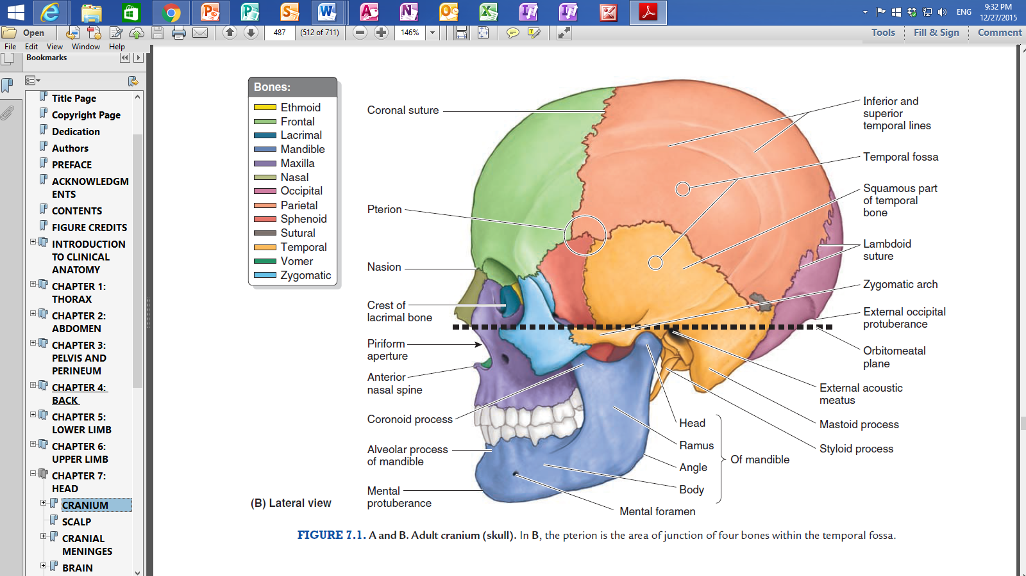
STATION – 4 (Skull)

Slide 19
STATION – 4 (Skull)

Slide 20
STATION – 4 (Skull)
Base of the skull:
Hard palate is formed by 2 bones:
Palater processes from maxillary bone.
Palatine bone.
Sphenoid bone: it is a butterfly-shaped bone which is composed of:
Greater and lesser wings.
Lateral and medial pterygoid processes.
Temporal bone: it has 2 parts:
Squamous (flat) part.
Petrous (rough part) which contains:
Jugular foramen.
Carotid canal.
Occipital bone:
It has occipital condyles which are articulating with the 1st cervical vertebra (atlas) forming the atlanto-occipital joint.
There is an external occipital protuberance with superior nuchal line extending laterally from it.
In addition, there is an inferior nuchal line.

Slide 21
STATION – 4 (Skull)

Slide 22
STATION – 4 (Skull: internal structure)

Slide 23
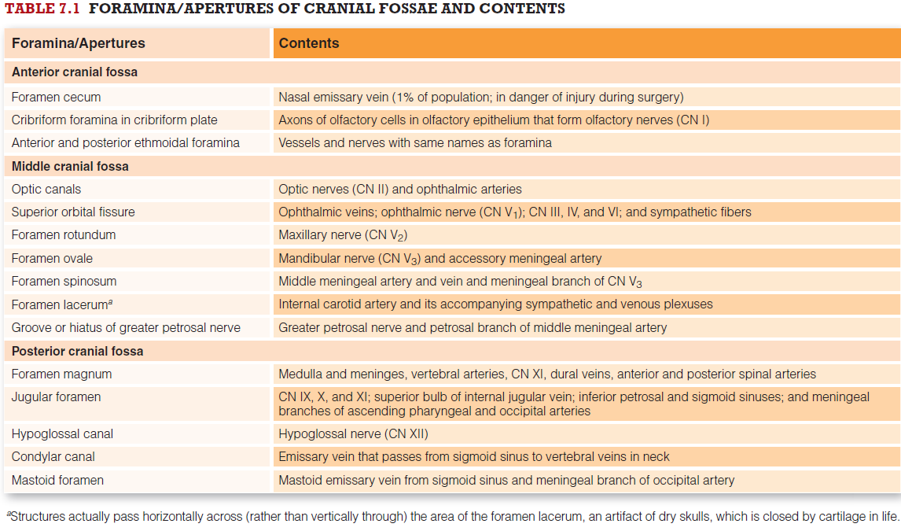
STATION – 4 (Skull: internal structure)

Slide 24
Good Luck! Wish You All The Best ☺

