Slide 1
DEMO – IV Embryology of Reproductive System, Perineum and Placenta
Ali Jassim Alhashli
Year III – Unit IV
(Endocrine & Reproductive Systems)

Slide 2
STATION – 1 (Embryology)
Overview:
Male internal genitalia: includes the testis, epididymis, vas deferens and the ejaculatory duct which will open in the prostatic urethra and then in the penile urethra.
Male external genitalia: penis + scrotum.
Female internal genitalia: vagina, cervix, uterus, fallopian tubes and ovaries.
Female external genitalia: mons pubis, libia majora, libia minora, clitoris and vestibule.

Slide 3
STATION – 1 (Embryology)
Gonads are formed in the genital ridge which is located in the posterior abdominal wall (intermediate mesoderm)
Primordial girm cells formed in the epiblast reside in the yolk sac. During the 5th wk they will migrate from yolk sac and invade the genital ridges in the 6th wk.
Note: the genital ridges are also formed by: the proliferation of the epithelium and the condensation of the underlying mesenchyme.
When primordial germ cells reach the genital ridges, primitive sex cords will be formed and in this stage the gonad is known as the indifferent gonad.

Slide 4
STATION – 1 (Embryology)
Contains the testis- determining gene called the SRY (Sex-determining Region on Y). Under its influence, male development occurs
Leydig cells lie between testis cords and will produce testosterone later. Testis cords remain solid until the time of puberty when they acquire lumen (seminiferous tubules
They remian close to the surface and split into isolated cell clusters which will continue to proliferate and begin to surround each oogonium with a layer of epithelial cells called follicular cells
Separates the testis cords from the surface epithelium

Slide 5
STATION – 1 (Embryology)
TESTES
OVARIES

Slide 6
STATION – 1 (Embryology)

Slide 7
STATION – 1 (Embryology)
Remnants/ Remarks
Paradidymis is the remnant of the degenerated caudal paragenital tubules of mesonephric duct
Appendix epididymis is the remnant of most cranial part of the mesonephric duct
Appendix testis is the remnant of cranial end of paramesonephric duct

Slide 8
STATION – 1 (Embryology)
Mesonephric duct
Paramesonephric duct
Testis
Ovary
A cranial vertical portion that opens into the abdominal cavity
They develop into the uterine tube
A horizontal part that crosses the mesonephric duct
A caudal vertical part that fuses with its partner from the opposite side to form the uterine canal
Mullerian tubercle
Urogenital sinus

Slide 9
STATION – 1 (Embryology)

Slide 10
Uterine and Vaginal Defects
STATION – 1 (Embryology)

Slide 11
STATION – 1 (Embryology)
Will differentiate later to clitoris in females and penis in males
Indifferent Stage
Will develop to labia majora in females and scrotal swelling in males
•Under the influence of androgens, there will be elongation of the genital tubercle, which is now called the phallus.
•The urethral groove extends along the caudal aspect of the elongated phallus but does not reach the most distal part, the glans.
•The two urethral folds close over the urethral plate, forming the penile urethra. This canal does not extend to the tip of the phallus. This most distal portion of the urethra is formed when ectodermal cells from the tip of the glans penetrate inward and form a short epithelial cord. This cord later obtains a lumen, thus forming the external urethral meatus.

Slide 12
STATION – 1 (Embryology)

Slide 13
STATION – 2

Slide 14
STATION - 2
Note that the lymphatic drainage of external genitalia is by superficial inguinal lymph nodes.
Nerve supply:
Lower part of the vagina: superficial nerve from pudendal.
Cervix: pelvic splanchnic (S2,S4)
Body of the uterus: sympathetic nerve fiber T10-L1
Suspensory ligament of ovary: containing ovarian arteries which arise from abdominal aorta and ovarian veins, right drains in inferior vena cava, left drains in left renal vein.

Slide 15
Drainage of testicular venous plexus:
•Right testicular vein in the inferior vena cava.
•Left testicular vein in left renal vein.
Testicular artery arises
from the abdominal aorta.
STATION – 2
Coverings of spermatic cord:
•Internal spermatic fascia.
•Cremasteric fascia.
•External spermatic fascia.
Wall of scrotum consists
of:
•Skin.
•Dartos muscle.
•Colles fascia.

Slide 16
STATION - 2

Slide 17
STATION - 2
Pubic symphysis
Femur
bone
Urinary
bladder
Rectum
Gluteus maximus
Obturator internus

Slide 18
STATION – 3 (Histology of Uterus and Vagina)

Slide 19
Uterus: secretory (luteal) phase
Larger: as a result of increased accumulation of the secretory products.
STATION – 3 (Histology of Uterus and Vagina)

Slide 20
Uterus: menstrual phase:
•The endometrium in the functionalis layer degenerates and is sloughed off.
•Some of the intact uterine glands are filled with blood.
•The basalis layer and the bases of the uterine glands remain intact.
STATION – 3 (Histology of Uterus and Vagina)

Slide 21
STATION – 3 (Histology of Uterus and Vagina)
The surface epithelium is stratified squamous non-keratinized. Most of the superficial cells in vaginal epithelium appear empty owing to increased accumulation of glycogen in their cytoplasm. The lamina propria contains dense, irregular connective tissue. The lamina propria lacks glands but contains blood vessels and lyphocytes.

Slide 22
STATION – 4 (Female Perineum)
Boundaries:
Anterior: pubic symphysis
Anterolateral: ischiopubic rami
Lateral: ischial tuberosities
Posterolateral: sacrotuberous ligaments
Posterior: coccyx
Inferior to the pelvic outlet.
Diamond-shaped area below the pelvic diaphragm extending from mons pubic anteriorly, the medial surfaces (insides) of the thighs laterally, and the intergluteal cleft posteriorly.
Divided into two triangles:
Anal: contains anal canal and its orficie, the anus.
Urogenital (UG) triangle: containing the vulva.

Slide 23
STATION – 4 (Female Perineum)
Boundaries:
Between the perineal membrane (superiorly) and Colles’ fascia (inferiorly).
Contents:
Clitoris.
Bulb of the vestibule.
Greater vestibular glands.
Deep perineal branches of internal pudendal vessels and pudendal nerves.
Part of the urethra
Superficial perineal muscles:
Superficial transverse perineal muscles.
Bulbospongiosus muscles.
Ischiocavernosus muscles.

Slide 24
STATION – 4 (Female Perineum)
Boundaries:
- Between the superior and inferior fascia of the urogenital diaphragm.... (superior to the perineal membrane).
Contents:
- Muscles of the urogenital diaphragm:
# External urethral sphincter.
# Compressor urethrae.
# Urethrovaginal sphincter.
# Deep transverse perineal muscle.
Dorsal branches of internal pudendal vessels and
pudendal nerves.
Part of the urethra.

Slide 25
STATION – 4 (Female Perineum)
•Location of ischioanal fossa:
Wedge-shaped space between: Anal canal, obturator internus, pelvic diaphragm, skin.
It is filled with fat and loose connective tissue.
Note: the fat bodies support the anal canal but are readily displaced to permit expansion of the anal canal during the passage of feces.
Boundaries:
Laterally: The ischium, and inferior part of the obturator internus with its fascia.
Medially: Rectum, and the anal canal, with their associated lavetor ani and anal sphincters.
Posteriorly: Sacrotuberous ligament and the overlying gluteus maximus muscle.
Anteriorly: Base of the urogenital diaphragm.
Inferiorly: Skin and deep fascia of the perineum.
Apex: Between obturator fascia and levetor ani.

Slide 26
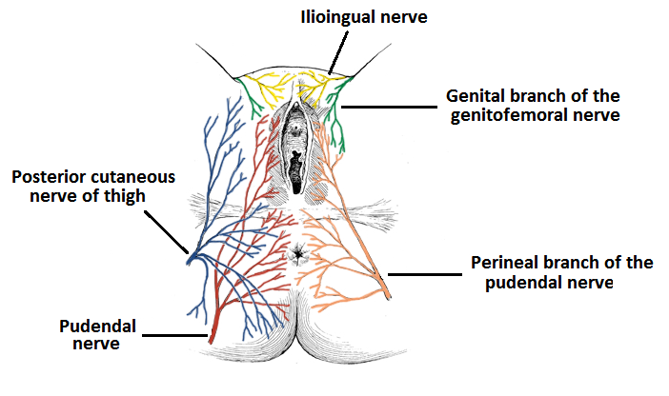
STATION – 4 (Female Perineum)
•Pudendal and ilio-inguinal nerve blocks:
•To relieve the pain experienced during childbirth, pudendal nerve block anesthesia may be performed by injecting a local anesthetic agent into the tissues surrounding the pudendal nerve.
•Although a pudendal nerve block anesthetizes most of the perineum, it does not abolish sensation from the anterior part of the perineum that is innervated by the ilio-inguinal nerve. To abolish the pain from the anterior part of the perineum, an ilio-inguinal nerve block is performed.

Slide 27
STATION – 4 (Female Perineum)
•Ischio-anal abscess:
•The ischio-anal fossae are occasionally the sites of infection, which may result in the formation of ishio-anal abscesses. These collections of pus are painful.
•Diagnostic signs are fullness and tenderness between the anus and the ischial tuberosity. A perineal abscess may rupture spontaneously, opening into the anal canal, rectum or perineal skin.

Slide 28
STATION – 5 (Placenta)

Slide 29
STATION – 5 (Placenta)

Slide 30
STATION – 5 (Placenta)

Slide 31
STATION – 5 (Placenta)
- Umbilical cord:

Slide 32
GOOD LUCK! Wish You All The Best ☺

