Slide 1
DEMO – III Bony Pelvis and Female Genitalia
Ali Jassim Alhashli
Year III – Unit IV
(Endocrine & Reproductive Systems)

Slide 2
STATION – 1 (Bony Pelvis)
The bony pelvis is formed by three bones:
Right & left hip bones:
Ilium: superior, flattened, fan-shaped part.
Ischium: has a body and a ramus.
Pubis: an angulated bone with superior & inferior pubic rami.
Sacrum: formed by the fusion of five, originally separate, sacral vertebrae.
Position of the pelvis: anterior superior iliac spine is in a vertical line with the pubic symphysis

Slide 3
STATION – 1 (Bony Pelvis)

Slide 4
STATION – 1 (Bony Pelvis)

Slide 5
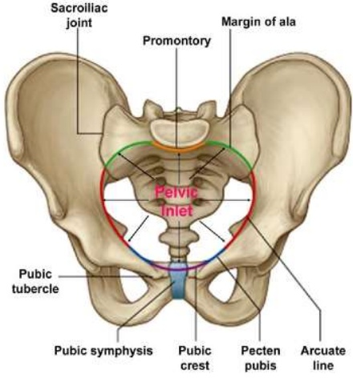
STATION – 1 (Bony Pelvis)
Pelvic inlet boundaries:
Superior margin of the pubic symphysis
Posterior border of pubic crest
Pectin pubis
Arcuate line of the ilium
Anterior border of the ala of the sacrum
Sacral promontary

Slide 6
STATION – 1 (Bony Pelvis)
Sacrotuberous ligament
Sacrospinous
ligament
Pelvic outlet boundaries: inferior margin of pubic symphysis anteriorly, ischiopubic rami anterolaterally, sacrotuberous ligament posterolaterally and tip of the coccyx posteriorly

Slide 7
STATION – 1 (Bony Pelvis)

Slide 8
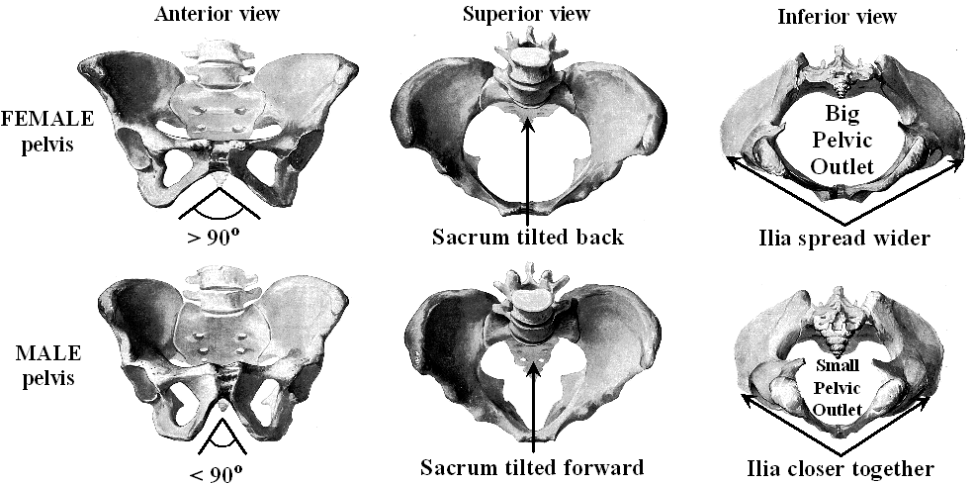
STATION – 1 (Bony Pelvis)
 | Male | Female
General structure | Thick & heavy | Thin & light
False pelvis | Deep | Shallow
True pelvis | Deep & narrow | Shallow & wide
Pelvic inlet | Heart-shaped | Oval & round
Pelvic outlet | Narrow | Wide
Pubic arch | > 70 | < 80
Obturator foramen | Round | Oval
Acetabulum | Large | Small

Slide 9
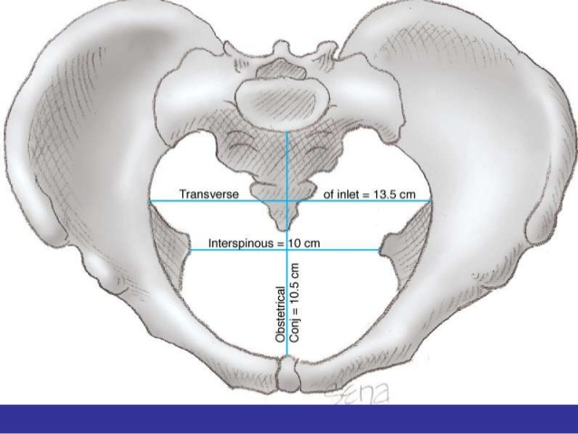
STATION – 1 (Bony Pelvis)
Notes:
The transverse diameter is bigger in the pelvic inlet.
The anterior-posterior diameter is bigger in the pelvic outlet.
The interspinous space is the narrowest (10cm).

Slide 10
STATION – 1 (Bony Pelvis)
It is the diagonal conjugate which a doctor can measure when doing the examination.

Slide 11
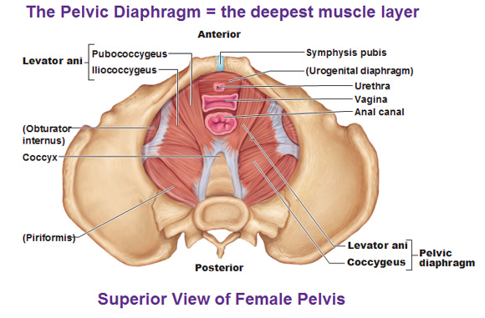
STATION – 1 (Bony Pelvis)
Note: The vagina has 4 sphincters:
Pubovaginalis.
External urethral sphincter.
Urethrovaginal sphincter.
Bulbospongiosus sphincter.

Slide 12
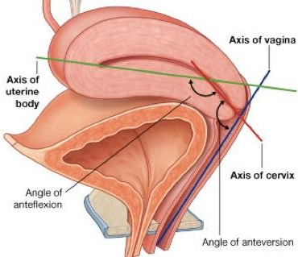
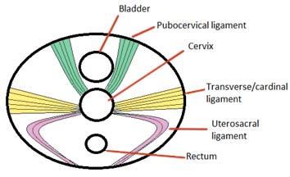
STATION – 1 (Bony Pelvis)
The normal position of the uterus is anteverted-anteflexed.
The uterus is kept in its position by the aid of:
Pelvic diaphragm.
Transverse cervical (cardinal) ligament extending from the lateral aspects of the cervix and
extending toward the lateral pelvic walls.
Uterosacral ligament.
Uteropubic ligament.
The round ligament of the uterus running through the inguinal canal and attaching to labia majora.

Slide 13
STATION – 2 (Radiology)

Slide 14
STATION – 2 (Radiology)
Clinical correlation: if there is an inflammation in the peritoneum, fluids might accumulate in the recto-uterine pouch, culdocentesis is performed. An endoscopic instrument (culdoscope) can be inserted through incision made in the posterior part of the vaginal fornix into the peritoneal cavity to drain a pelvic abscess (collection of pus) in the recto-uterine pouch (culdocentesis).
There are 15-20 fimbriae in the infundibulum of the fallopian tube, with one of them being longer than the others and attaching to the ovary.
The uterine tube has 2 openings: one in the abdominal cavity and the other in the body of the uterus. The uterine tube consists of: the infundibulum, the ampulla (site of fertilization) and isthmus.

Slide 15
STATION – 2 (Radiology)
Hysterosalpingography: is an operative procedure whereby a radiographic study of the interior of the uterotubal anatomy is made using a contrast media.
Salpingitis → pelvic inflammatory disease → peritonitis → iritation of diaphragm → iritation of phrenic nerves (from C3,C4,C5) → tip of right shoulder will be iritated

Slide 16
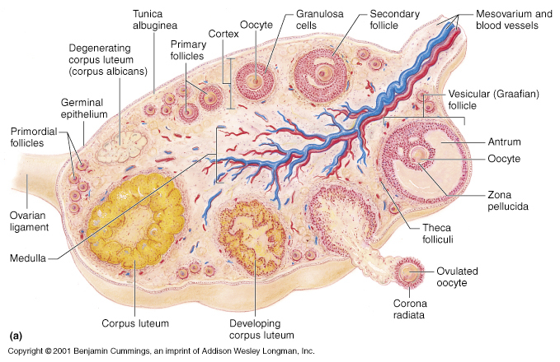
STATION – 3 (Histology of Ovaries)

Slide 17
STATION – 3 (Histology of Ovaries)
There are variant stages of follicular development:
Primary oocyte surrounded by squamous/flat follicular cells (known as primordial follicle).
Simple cuboidal/simpe colomnur follicular cells (known as primary follicle).
The primary follicle grows even more and the follicular cells become stratified cuboidal/stratified colomnur.
Then the primary follicle become a secondary follicle with follicular spaces.
Finally, these follicular spaces will merge to become one larger space that will push the oocyte to one side of the follicle (mature follicle).
Primordial follicle
Primary follicle
Secondary follicle
Mature follicle

Slide 18
STATION – 3 (Histology of Ovaries)

Slide 19
STATION – 3 (Histology of Ovaries)
A mature follicle

Slide 20
STATION – 3 (Histology of Ovaries)
After ovulation and the release of the occyte, the remnants of the follicle will be converted to corpus luteum.
If fertilization occurs, the corpus luteum begins to progesterone to maintain pregnancy
(corpus luteum of pregnancy) until the 3rd month (the placenta will take its place).
If fertilization does not occur, the corpus luteum will degenerate after 10 days of ovulation and will be converted to a white body called (corpus albicans).

Slide 21
STATION – 3 (Histology of Ovaries)
Epithelium: simple colomnur partially ciliated epithelium.
Muscularis: smooth muscles.
Serosa: connective tissue covered by simple squamous epithelium
Note: the cilia are microtubules in (9+2) arrangement.

Slide 22
STATION – 4 (Clinical Correlations)
Female infertility:
Can be cause by altered hypothalamus/pituitary function (reduction in the release of GnRH--<FSH & LH).
Structural abnormalities of the uterus.
Obstruction of the fallopian tubes.
No access of viable sperm:
A change in vaginal pH.
Secretion of thick cervical mucus.
Development of antibodies.
Endometriosis:
It is a disease in which cells similar to that which line the uterus (endometrium) grow outside the uterine cavity. This can cause secondary dysamenorrhea and might be associated with infertility in females. The disease can also present as:
Chocolate cyst of the ovary (see the pic).
Adhesions:
The pelvic and abdominal organs, such as the ovaries and uterus, are wrapped in a clear membrane known as the peritoneum (membrane that wraps the pelvic and abdominal organs). Whenever there is any injury, trauma or infection, or when surgery is performed in this area, adhesions can form. Removing these bands of scar tissue aggravates the healing cycle, and can therefore cause the formation of new adhesions (see the pic).

Slide 23
STATION – 4 (Clinical Correlations)
Pelvic Inflammatory Disease (PID):
A term for inflammation of the uterus, fallopian tubes and/or ovaries as it progresses to scar formation with adhesions to nearby tissues and organs.
Short-term concerns: peritonitis.
Long-term concerns: infertility and ectopic pregnancy.
Etiology:
Gonorrhea.
Chlamidyosis.
IUD (if it causes perforation).
Ovarian cyst:
Any collection of fluid, surrounded by a very thin wall, within an ovary. Any ovarian follicle that is larger than about two centimeters is termed an ovarian cyst. Such cysts range in size from as small as a pea to larger than an orange.
Most ovarian cysts are functional in nature and harmless (benign).
Ovarian cysts affect women of all ages. They occur most often, however, during a woman's childbearing years.
Some ovarian cysts cause problems, such as bleeding and pain. Surgery may be required to remove cysts larger than 5 centimeters in diameter.

Slide 24
STATION – 4 (Clinical Correlations)
Cervical cancer:
Cancer arising from the cervix. It is due to the abnormal growth of cells that have the ability to invade or spread to other parts of the body. Early on there are typically no symptoms. Later symptoms may include: abnormal vaginal bleeding, pelvic pain or pain during sexual intercourse.
Human papillomavirus (HPV) infection appears to be involved in the development of more than 90% of cases; most people who have had HPV infections, however, do not develop cervical cancer. Other risk factors include: smoking, a weak immune system, birth control pills, starting sex at a young age and having many sexual partners, but these are less important.
Diagnosis is typically by cervical screening (pap smear) followed by a biopsy. Medical imaging is then done to determine whether or not the cancer has spread.

Slide 25
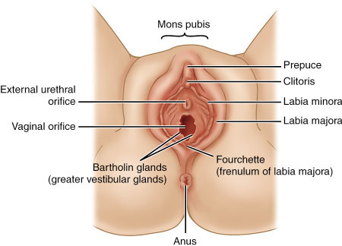
External female genital organs are found in the perineum below the pelvic diaphragm. They include:
Mons pubis: rounded fatty eminence anterior to pubic symphysis & superior pubic rami.
- Labia majora: containing fat + smooth muscles and it is protecting the orfices.
Labia minora: fat-free hairless skin + erectile tissues and it is pink in color.
Clitoris: erectile organ consisting of a root and a body.
Vestibule: containing both urethral and vaginal openings.
Bulbs of vestibule: elongated erectile tissues along the sides of the vaginal orfice under the cover of bulbospongiosus muscles.
Vestibular glands: greater & lesser (secreting mucus into the vestibule especially during sexual arousal).
STATION – 5 (Female Genitalia)

Slide 26
STATION – 5 (Female Genitalia)
Internal female genital organs:
Vagina:
Consisting of mucosa (non-keratinized stratified squamous lubricated by cervical and vestibular glands), muscularis (smooth muscles) and adventitia (of connective tissue).
It is divided to:
A lower third: which is sensitive to pain (supplied by pudendal nerve).
A middle third.
An upper third: where you found anterior, posterior and lateral fornices formed by the projection of the cervix into the vagina.
Note: both the middle and upper parts are insensitive to pain.
Relations of the vagina: urinary bladder and urethra (anteriorly) – rectum and anal canal (posteriorly).
Uterus:
A thick-walled, pear-shaped, hollow muscular organ.
It is consisting of endometrium (simple colomnur secretory), myometrium and perimetrium.
It is divided into two main parts:
Body of the uterus: consisting of the fundus (superior to the orfices of the uterine tubes), isthmus (constricted region of the body) and uterine horns (where uterine tubes enter.
Cervix of the uterus: cylindrecal, narrow, inferior part of the uterus with a supravaginal and vaginal parts. It also has and internal os and an external os.

Slide 27
STATION – 5 (Female Genitalia)

Slide 28
STATION – 5 (Female Genitalia)
Uterine tubes:
Each uterine tube is devided into 4 parts:
Infundibulum: funnel-shaped. The finger – like projections are called fimbriae.
Ampulla: widest and longest part where fertilization occurs.
Isthmus: thick-walled part.
Uterine part.
Ovaries:
Almond-shaped.
Attached to the posterior part of the broad ligament by mesoverium.
The ovaries also attach to the uterus by the ligament of ovary.
The suspensory ligament of ovaries conveys the ovarian vessels, lymphatics and nerves and attaches the ovaries to the pelvic wall.

Slide 29
STATION – 5 (Female Genitalia)

Slide 30
STATION – 5 (Female Genitalia)
Vesico-uterine
pouch
These two pouches are the relationships of the uterus (anterior & posterior)

Slide 31
STATION – 5 (Female Genitalia)

Slide 32
GOOD LUCK! Wish You All The Best ☺

