Slide 1
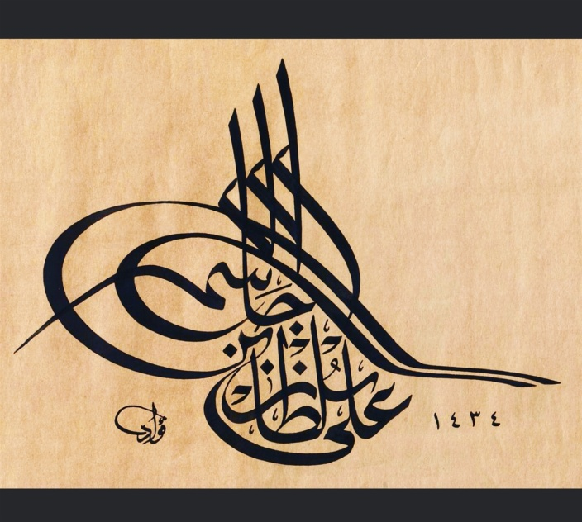
DEMO – I Thyroid Gland and Triangles of The Neck
Ali Jassim Alhashli
Year III – Unit IV
(Endocrine & Reproductive Systems)

Slide 2
STATION - 1
Location of thyroid gland:
Anteriorly in the neck.
From level of C5-T1 vertebrae.
Shape of thyroid gland:
Two lobes: right and left connected at the center by isthmus (anterior to second and third tracheal rings).
The gland is surrounded by a fibrous capsule. External to the capsule is a pretracheal fascia.
Note: parathyroid glands are embedded in the posterior wall (aspect) of thyroid gland. During surgery (thyroidectomy) we must be careful not to remove the posterior part of the gland.
Note: the thyroid gland moves (up & down) when
you swallow.

Slide 3
STATION - 1
Structural relations to thyroid gland:
Medially:
Upper part: the middle constrictor muscle of the pharynx
Lower part: Trachea, esophagus and between them is recurrent laryngeal nerve (resulting in hoarseness and paralysis of all laryngeal muscles except cricothyroid muscle if damaged).
Anteriorly: infrahyoid muscles (omohyoid, sternohyoid, sternothyroid). These muscles are innervated by the (ansa cervicalis).
Posteriorly: carotid sheath (consisting of common carotid artery, internal jugular vein and vagus
nerve)

Slide 4
STATION - 1
Vasculature of thyroid gland:
Arterial supply:
Superior thyroid artery which is a branch from the external carotid artery. (note: superior laryngeal nerve passes with superior thyroid artery).
Inferior thyroid artery which is a branch from thyrocervical trunk which in turn is a branch from the subclavian artery. (note: recurrent laryngeal nerve passes with inferior thyroid artery).
Venous drainage:
Superior thyroid vein: drains into the internal jugular vein.
Middle thyroid vein: drains into the internal jugular vein.
Inferior thyroid vein: drains into the brachiocephalic vein.

Slide 5
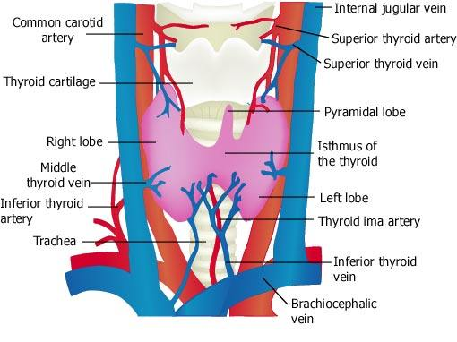
STATION - 1

Slide 6
STATION - 1
Dissection of the anterior neck (thyroid gland).
Internal jugular vein
Common carotid artery
Thyroid cartilage
Left lobe of the thyroid gland
Thyroglossal duct
Hyoid bone

Slide 7
STATION - 2
Posterior triangle of the neck:
Boundaries: Posterior border of SCM muscle, Anterior border of trapezius muscle, Middle third of clavicle inferiorly.
Brachial plexus is located in the occipital triangle. It supplies the upper limb and when It is injured, signs and symptoms can range from complete paralysis to anesthesia (Policeman’s tip hand).
Spinal accessory nerve is also located in the occipital triangle and it innervates the SCM & trapezius muscles.
Note: external jugular vein is found in the occipital triangle.

Slide 8
STATION - 2
Anterior triangle of the neck:
- Boundaries:
Anterior border of SCM muscle.
Midline of the neck.
Inferior border of the mandible (lower jaw).
Apex: jugular notch in the manubrium of sternum.
Subdivision of anterior triangle | Boundaries | Contents
Submental triangle | the apex is toward the jaw symphysis and the base of the triangle is formed by the hyoid. From both sides you find the anterior belly of digastric muscle. The floor is formed of two mylohyoid muscles which meet in a fibrous raphe. | Submental lymph nodes.
Digastric triangle | Inferior border of the mandible - Anterior belly of digastric muscle - Posterior belly of digastric muscle. | Submandibular (salivary) gland with its duct
Carotid triangle | Superior belly of the omohyoid muscle - Anterior border of SCM muscle - Posterior belly of the digastric muscle. | Common carotid artery (injury results in coma) – internal jugular vein – vagus nerve
Muscular triangle | Midline of the neck - Superior belly of the omohyoid - Anterior border of SCM. | -

Slide 9
STATION - 2
Branches of the external carotid artery:
SISTER LUCY’S POWDERED FACE OFTEN ATTRACTS MEDICAL STUDENTS
S | Superior thyroid
L | Lingual
P | Posterior auricular
F | Facial
O | Occipital
A | Ascending pharyngeal
M | Maxillary
S | Superficial temporal

Slide 10
STATION - 3
Histology of thyroid gland:
The thyroid gland is consisting of follicles filled with colloid.
The precursor of thyroid hormone T3 & T4 “thyroglobulin” is stored in the colloid.
Colloid is surrounded by follicular cells which can be flattened, cuboidal or tall columnar depending on their activity. They are cuboidal or tall columnar when active and flattened in the resting state.
The follicles are surrounded by fenestrated blood
capillaries to carry secretions to target tissues.
Parafollicular cells are found on the periphery of the follicles. They stain lighter than follicular cells and secrete the hormone calcitonin which lowers blood calcium levels in the body.

Slide 11
STATION - 3
Histology of parathyroid gland:
Parathyroid gland contains two cell types: the chief (principle) cells and the oxyphil cells.
Chief cells: they are the most numerous and secrete
the parathyroid hormone.
Oxyphil cells: less numerous, larger, found as single cells or in small clumps and they increase in number with increasing age.
Parathyroid gland regulates calcium levels by:
Increasing the activity of osteoclasts in bones.
Increasing kidneys reabsorption of calcium.
Increased calcium absorption from the gastrointestinal tract into the bloodstream.

Slide 12
Station – 3 (Additional)
Embryology of the thyroid gland:
Begins to develop in day 24 from median endodermal thickening in the floor of the premordial pharynx.
Thyroid premordium is formed and the developing thyroid gland begins to descend through the thyroglossal duct.
Then, the lumen of thyroid diverticulum obliterates and divides into right and left lobes connected by isthmus.
By week 7, thyroglossal duct degenerates.
By week 11, colloid begins to appear in thyroid follicles.
Thyroglossal duct cysts and sinuses:
A remnant of the thyroglossal duct may persist and form a cyst in the tongue or in the anterior part of the neck, usually just inferior to the hyoid bone.
The swelling produced by a thyroglossal duct cyst usually develops as a painless, progressively enlarging, movable median mass.
In case of infection of the cyst, perforation of the skin occurs in the median plane of the neck forming a thyroglossal duct sinus.

Slide 13
STATION – 3 (additional)

Slide 14
STATION - 4
Pancreas
Exocrine: consisting of serous acini and zymogenic cells (dark staining, blue periphery, red center)
Endocrine: Islets of Langerhans. Surrounded by capillaries & delicate connective tissue.
Cells of the islet
Alpha cells (20%): in the periphery. Secrete glucagon.
Beta cells (80%): in the center. Secrete insulin.
Delta cells: secreting somatostatin .
PP cells: secreting pancreatic polypeptide

Slide 15
STATION - 4

Slide 16
STATION - 4

Slide 17
STATION - 4

Slide 18
GOOD LUCK!
Wish You All The Best ☺

